Slide 1

What global surveillance data tells us about the extinction of Foot-and-Mouth Disease Virus Serotype C?
¿Qué nos dicen los datos de vigilancia mundial sobre la extinción del serotipo C del virus de la fiebre aftosa?
Shelley Mehlenbacher, DVM
USDA APHIS
Notes:
Good morning, thank you very much, it is nice to back at COSALFA, it is such wonderful meeting.
My name is Shelley Mehlenbacher, I am a veterinarian at the United States Department of Agriculture working for the international section of APHIS at the US Embassy in Brasilia, Brazil
Today I will give a brief introduction of APHIS, and then share some findings from a study on global surveillance data and what it tells us about the extinction of FMD, Serotype C.

Slide 2
Thanks to Drs. Manuel Sanchez-Vazquez, David Paton, Daniel Gizaw, David Lefebvre, Hussaini Ularamu, Joseph Hyera, Nagendrakumar Singanallur Balasubramanian, The FAO/WOAH FMD Serotype C Task Force, and The FAO/WOAH FMD Reference Laboratory Network (www.foot-and-mouth.org) for their diligent reviews, epidemiological input, and collaboration.
Sarah R. Mielke¹, Marta Remmenga¹, Donald P. King² , Aldo Dekker³ and Melissa McLaws⁴
¹ United States Department of Agriculture, Animal and Plant Health Inspection Service, Fort Collins, CO, USA
² WRLFMD, The Pirbright Institute, UK
³ WBVR-Lelystad, the Netherlands
⁴ Food and Agriculture Organization of the United Nations, Rome, Italy
Notes:
This study is the result of a collaboration between:
USDA APHIS
the FAO
The Pirbright Institute in the UK, and
the Wageningen Bioveterinary Research in the Netherlands [FYI, this collaborator joined the collaboration at a later stage and was not part of the initial request nor a provider of surveillance data, as the other two collaborators were.]
We would like to thank the SMEs listed for their diligent reviews, epidemiological input, and collaboration.
The manuscript from the study is in its final review with collaborators and will be submitted for publication in the coming weeks.

Slide 3
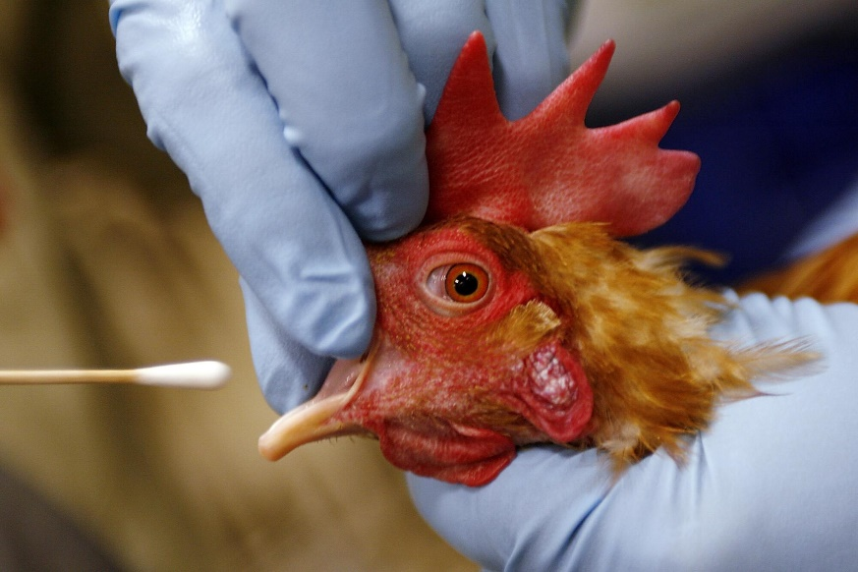
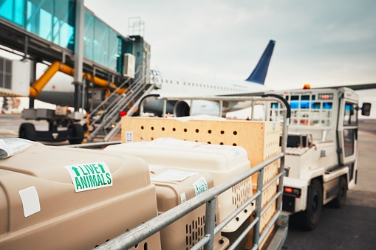
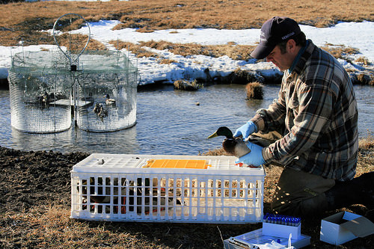


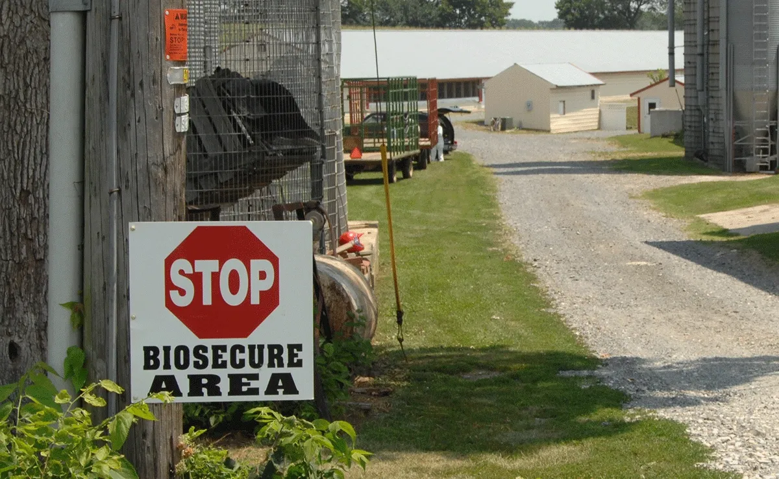
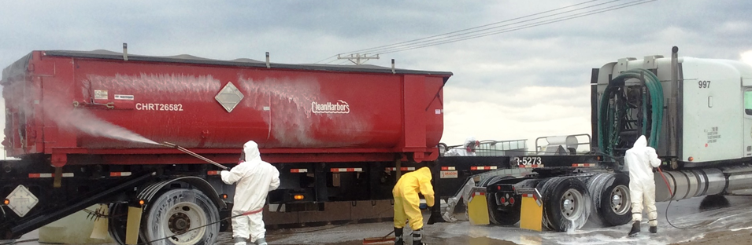
Notes:
APHIS works globally to protect U.S. agriculture with Foreign Service Officers and technical experts located around the world.
APHIS helps other countries safeguard their animal and plant health infrastructures.
While the U.S. is not a member of COSALFA, we are honored to be invited as observers and contribute to our shared mission to eradicate FMD.
Previous years presentations at this meeting have been focused on the economic and technical support we’ve historically provided to help eradicate FMD from South America.
Since 1947 we’ve been involved in a variety of efforts, including training on:
· Emergency Response and the Incident Command System
· Transboundary animal diseases at the Foreign Animal Disease Diagnostic Laboratory in Plum Island, New York
· Epidemiological methods at our office in Ft. Collins, Colorado, and
· Laboratory techniques at the University of Delaware
In addition to in-country trainings around the world

Slide 4
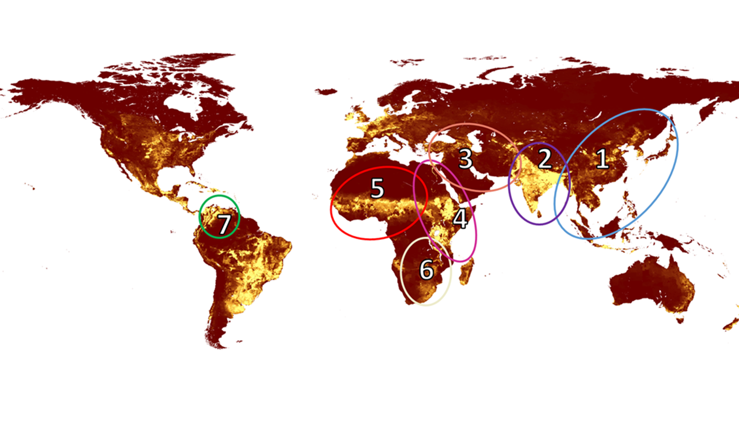
Regional Virus Pools 1 through 7
Grupos regionales de virus del 1 a 7
Yellow represents higher cattle density
El amarillo representa una mayor densidad de ganado
Notes:
A study of global FMD surveillance was initiated by the FAO FMD Task Force and the Pirbright Institute.
USDA collaborated to evaluate the data, looking specifically at the potential extinction serotype C.
The data was grouped to the various regional virus pools, which represent global regions defined by the specific strains of FMDV circulating there, which are determined through sequencing.
Each region circled on the map represents a different Regional Virus Pool. The yellow represents cattle density. The brighter the yellow, the higher the density. The data was further stratified by country, allowing us to evaluate the surveillance data for each country within a regional virus pool (RVP).
Serotype C has been found in all of the current RVPs except for RVP5 and was previously present in Europe, The last reported outbreaks of C were in 2004 in Brazil and Kenya.
The different RVPs include:
RVP1 - Southeast Asia and East Asia
RVP2 - South Asia
RVP3 – West Eurasia and Near East
RVP4 - Eastern Africa
RVP5 – West and Central Africa
RVP6 - Southern Africa, and
RVP7 - South America

Slide 5

Objectives & Measures
Determine confidence in the surveillance system
Identify gaps in the surveillance effort, and
Calculate the detection probability and capability of the surveillance system
Objetivos y medidas
Determinar la confianza en el sistema de vigilancia
Identificar las deficiencias en el esfuerzo de vigilancia, y
Calcular la probabilidad de detección y la capacidad del sistema de vigilancia
Notes:
The primary objectives of the study were to:
Determine the confidence in the surveillance system, and
Identify gaps in the surveillance efforts.
This was investigated using the detection probability, which is the probability that serotype C would be detected, if present, given a prevalence threshold, and
the detection capability, which is the lowest prevalence value that can be detected at a given detection probability (in our analysis this is set to 95%).
Extra details for clarity and to field questions:
Detection probability and detection capability are the inverse of each other and are a way to evaluate whether the surveillance system achieves detection probabilities of 95% at various prevalence values and how low the prevalence of serotype C can be and still be detected.

Slide 6
What does this information tell us?
¿Qué nos dice esta información?
Serotype C, if it is present, can be detected at low prevalence values in individual countries
Countries with low detection capabilities could represent the entire RVP
El serotipo C, si está presente, se puede detectar con valores de prevalencia bajos en países individuales
Los países con baja capacidad de detección podrían representar a todo el GVR
Países con baja capacidad de detección
(umbral de prevalencia ≤1 %) con una probabilidad del 95%
Países con una probabilidad de detección del 95 % en umbrales de prevalencia específicos
Countries with Low Detection Capabilities (≤1% Prevalence Threshold) with 95% Probability |  | Countries with a Detection Probability of 95% at Specified Prevalence Thresholds
≤ 1% | Prevalence Value | 2% | 5%
Brazil Colombia Ecuador Bolivia Perú Venezuela Panamá | 0.03 0.07 0.21 0.27 0.38 0.67 1.00 | Bolivia Brazil Colombia Ecuador Panamá Paraguay Perú Venezuela | Argentina Bolivia Brazil Chile Colombia Ecuador Panamá Paraguay Peru Uruguay Venezuela
Notes:
What did the information show us? Specific to South America, the analysis shows that surveillance data provides a 95% probability that serotype C, if present, can be detected at or below 1% prevalence in 7 of the 13 countries analyzed.
These countries can detect serotype C if prevalent at the value highlighted in gray
The analysis also showed that the surveillance effort provides a 95% probability that in 8 of the 13 countries serotype C, if present, could be detected at a 2% prevalence, and in 11 of the 13 countries at a 5% prevalence.
Therefore, using SME input to inform the mathematical analysis becomes a critical aspect
Extra Details:
Can discuss the detection capabilities at or below 1%
Example: In RVP7, 7 of 13 countries have detection capabilities at or below 1%
Brazil and Colombia have the lowest detection capabilities in that region, 0.03 and 0.07%.

Slide 7
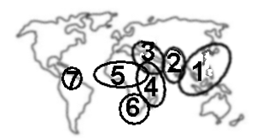
Subject matter expert input provided critical information about the surveillance effort
Factors of high importance in RVP 7
  National FMD control programs
  Serological surveys
El aporte de las PYME proporciona información crítica sobre el esfuerzo de vigilancia
Factores de gran importancia en el GVR 7
  Programas nacionales de control de la fiebre aftosa
  Encuestas serológicas
Notes:
SME input was critical in providing information about the on the ground situations in all of the RVPs, and if the sampling that is performed is representative of all susceptible populations. For example, with RVP4, one of the regions with the last known appearance of C, SME input suggested it is unlikely for isolated populations to exist in RVP4 due to the free movement of livestock throughout the region, which allows for contact between susceptible populations and therefore C should have been detected at some point in the past 20 year.
For RVP7, here in SA, PANOFTOSA provided more information about C activity in the region, showing the decline of C in the RVP, highlighting the active control measures and the national FMD control programs, supporting the findings from this analysis

Slide 8
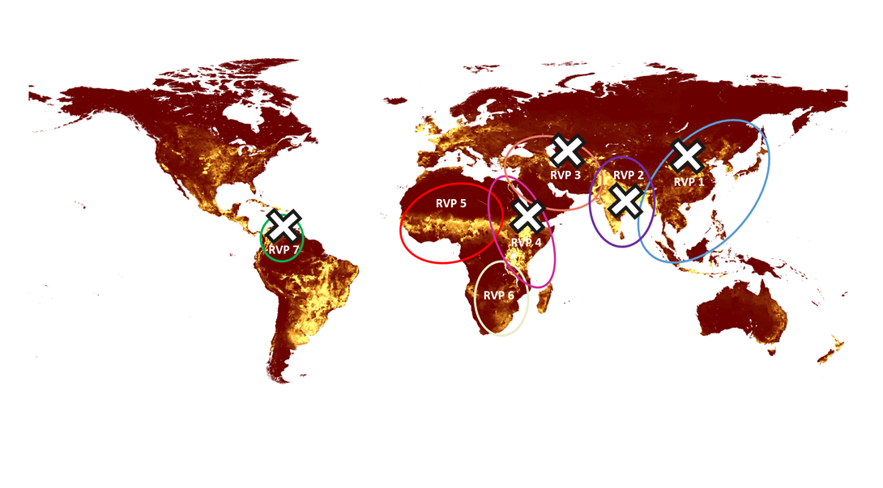
Conclusions
Conclusión
It is unlikely that serotype C is circulating in RVP 7
Es poco probable que el serotipo C esté circulando en los 7
Notes:
Based on the quantitative analysis and SME knowledge of the epidemiological situation in the region, it is unlikely that FMD serotype C is circulating in RVP 7 or in the regions with and X.
Analysis focused on establishing a foundation of evidence of serotype C status. Authors did not interpret this dataset in relation to O or A serotypes; therefore, we do not have conclusions about the presence of those serotypes included in this study.

Slide 9
Gracias, ¿Preguntas?
Obrigado, Dúvidas?
shelley.mehlenbacher@usda.gov
AHPIS Brasilia, Brasil
Institution logo

