Slide 1
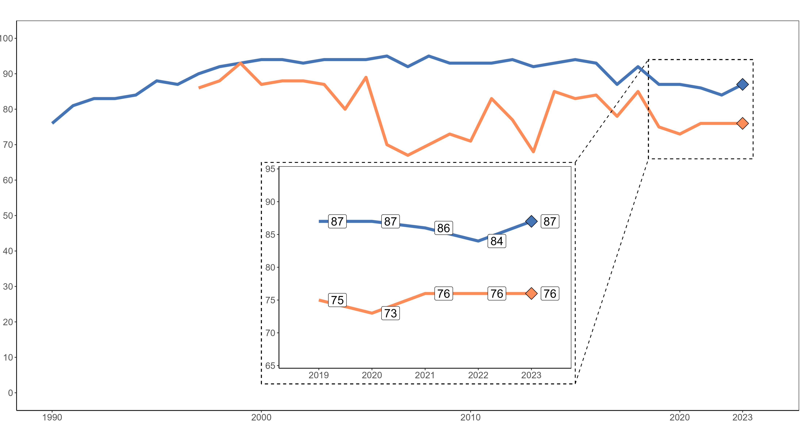

Vaccination coverage for MMR1 and MMR2 vaccines
Region of the Americas, 1990-2023*
This graph shows the historical coverage for MMR1 and MMR2 in the Region of the Americas, with special focus on the years 2019 to 2023 which are shown enlarged in the box. We observed the following:
MMR1 coverage increased in 2023 compared to 2022 but it is still below the 95% expected goal.
There was no increase in coverage for MMR2, but it is still well below 95%.
Coverage (%)
MMR1
MMR2
Year
Source: Country reports through the electronic PAHO-WHO/UNICEF Joint Reporting Form (eJRF).
* Data updated as of 8 July 2024. | MMR-measles-mumps-rubella.

