Slide 1
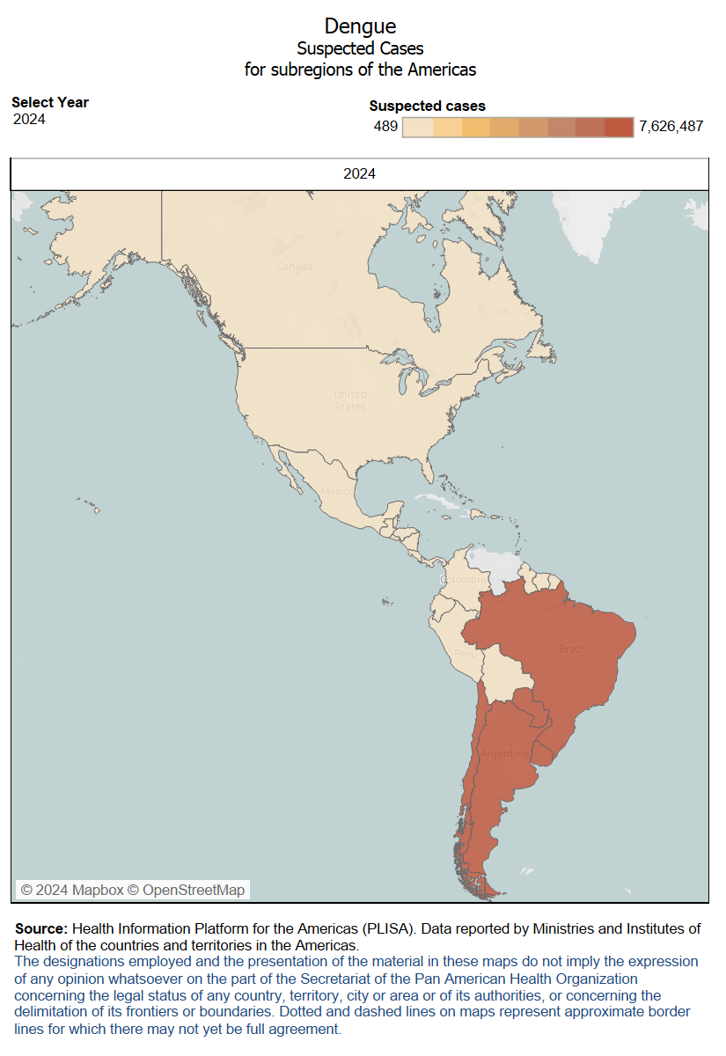
Active laboratory search of measles and rubella cases within dengue epidemics
Given the surge of dengue outbreaks in the Americas, PAHO recommends the implementation of active laboratory search (ALS) on serum obtained for dengue surveillance, to be tested for measles and rubella (MR).
The sera selected must meet ALL the following criteria:
case presented fever and rash;
case is from a silent area, without reporting MR cases to surveillance system;
serum was negative for dengue; and
serum was obtained 30 days before IgM testing for measles and rubella.
Cases with positive IgM or indeterminate results identified in the active search should be adequately investigated for final classification. Cases with IgM negative results should not be entered into the routine surveillance system. For more information click here.

