Slide 1



Catalyzing ethical research in emergencies​
Ethics guidance, lessons learned from the COVID-19 pandemic, and pending agenda

Slide 2

Catalyzing ethical research in emergencies. ​
Ethics guidance, lessons learned from the COVID-19 pandemic, and pending agenda
Regional production based on a regional reflection to improve our ethics preparedness for future health emergencies.
Funded by the Wellcome Trust.

Slide 3

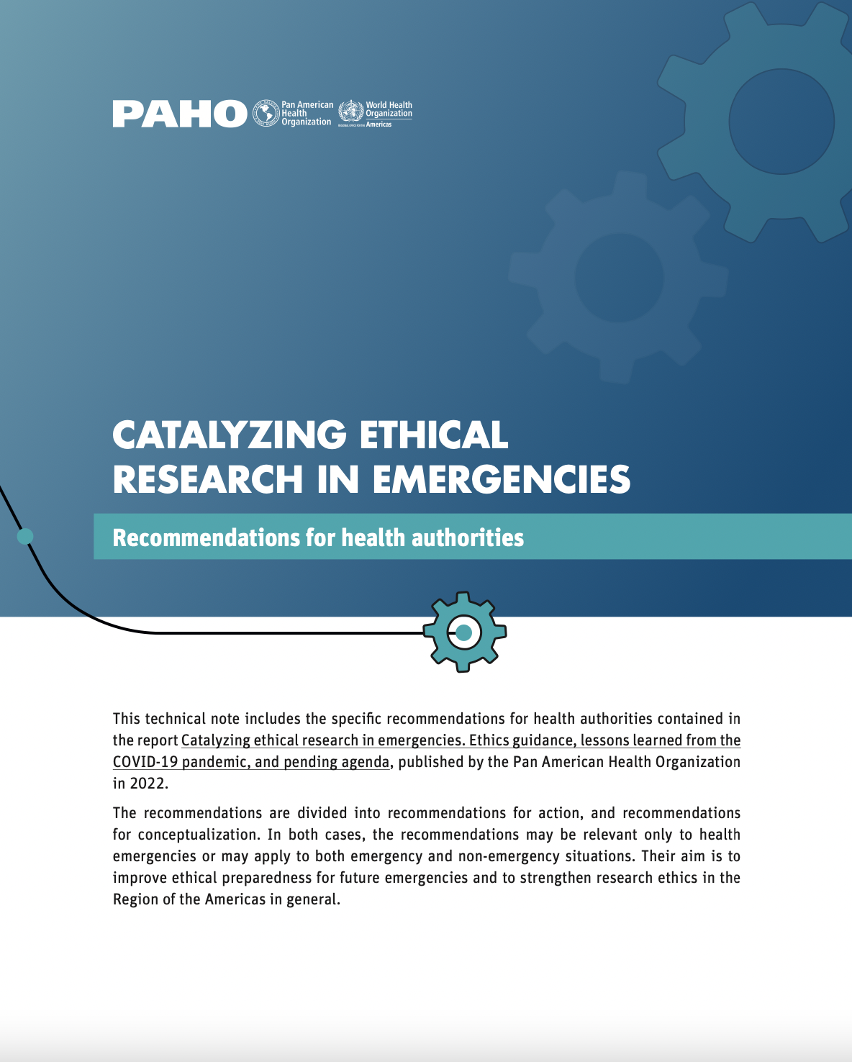
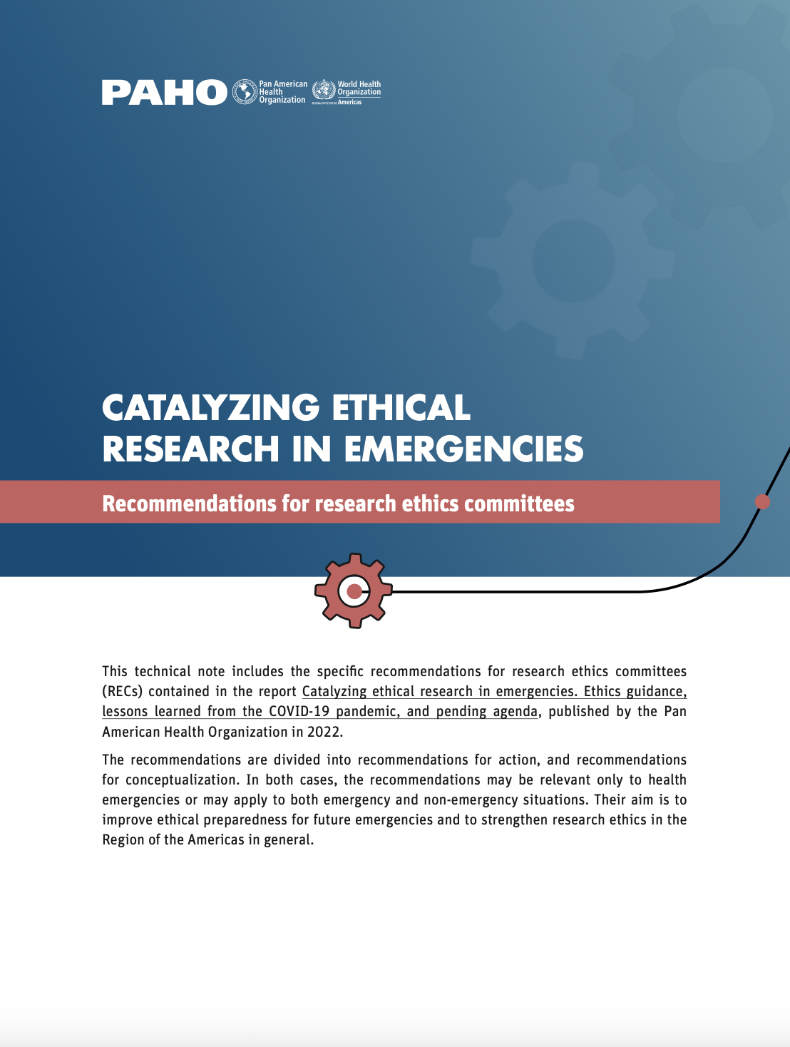
Catalyzing ethical research in emergencies. ​
Ethics guidance, lessons learned from the COVID-19 pandemic, and pending agenda
Summary
Recommendations for health authorities
Recommendations for research ethics committees

Slide 4
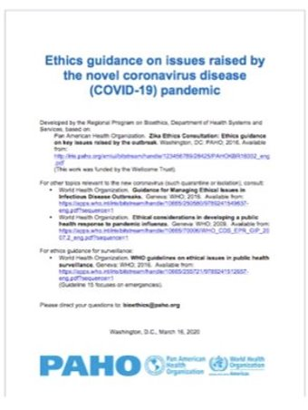

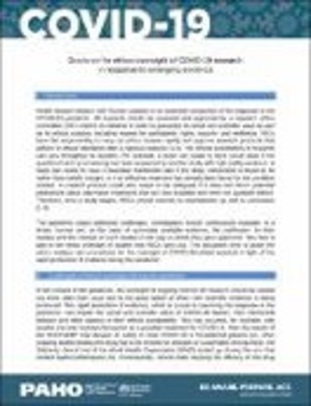

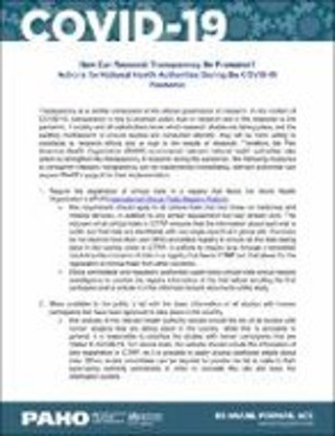
Integrates, revises and supplements previous ethics guidance documents
Greater clarity and precision.
“Crossing information” so that the content of one section informs the other sections. ​
Includes examples and lessons from the region.​
Fills gaps in topics where confusions persist.
Includes recommendations from a regional dialogue.

Slide 5
1. Lessons learned from the Zika outbreak and challenges during the COVID-19 pandemic
The COVID-19 pandemic found us in a different place than the Zika outbreak.
Learning from the Zika outbreak led to consensus on key issues that were no longer subject to discussion during the COVID-19 pandemic:
  Research is an essential component of the response to emergencies.
  Research conducted in emergencies must adhere to ethical standards.
  Ethics review processes must be modified to ensure rapid and rigorous review of research.
Zika also promoted a subsequent regional reflection that led to the commitment of PAHO’s Member States to improve ethics preparedness for future emergencies.

Slide 6
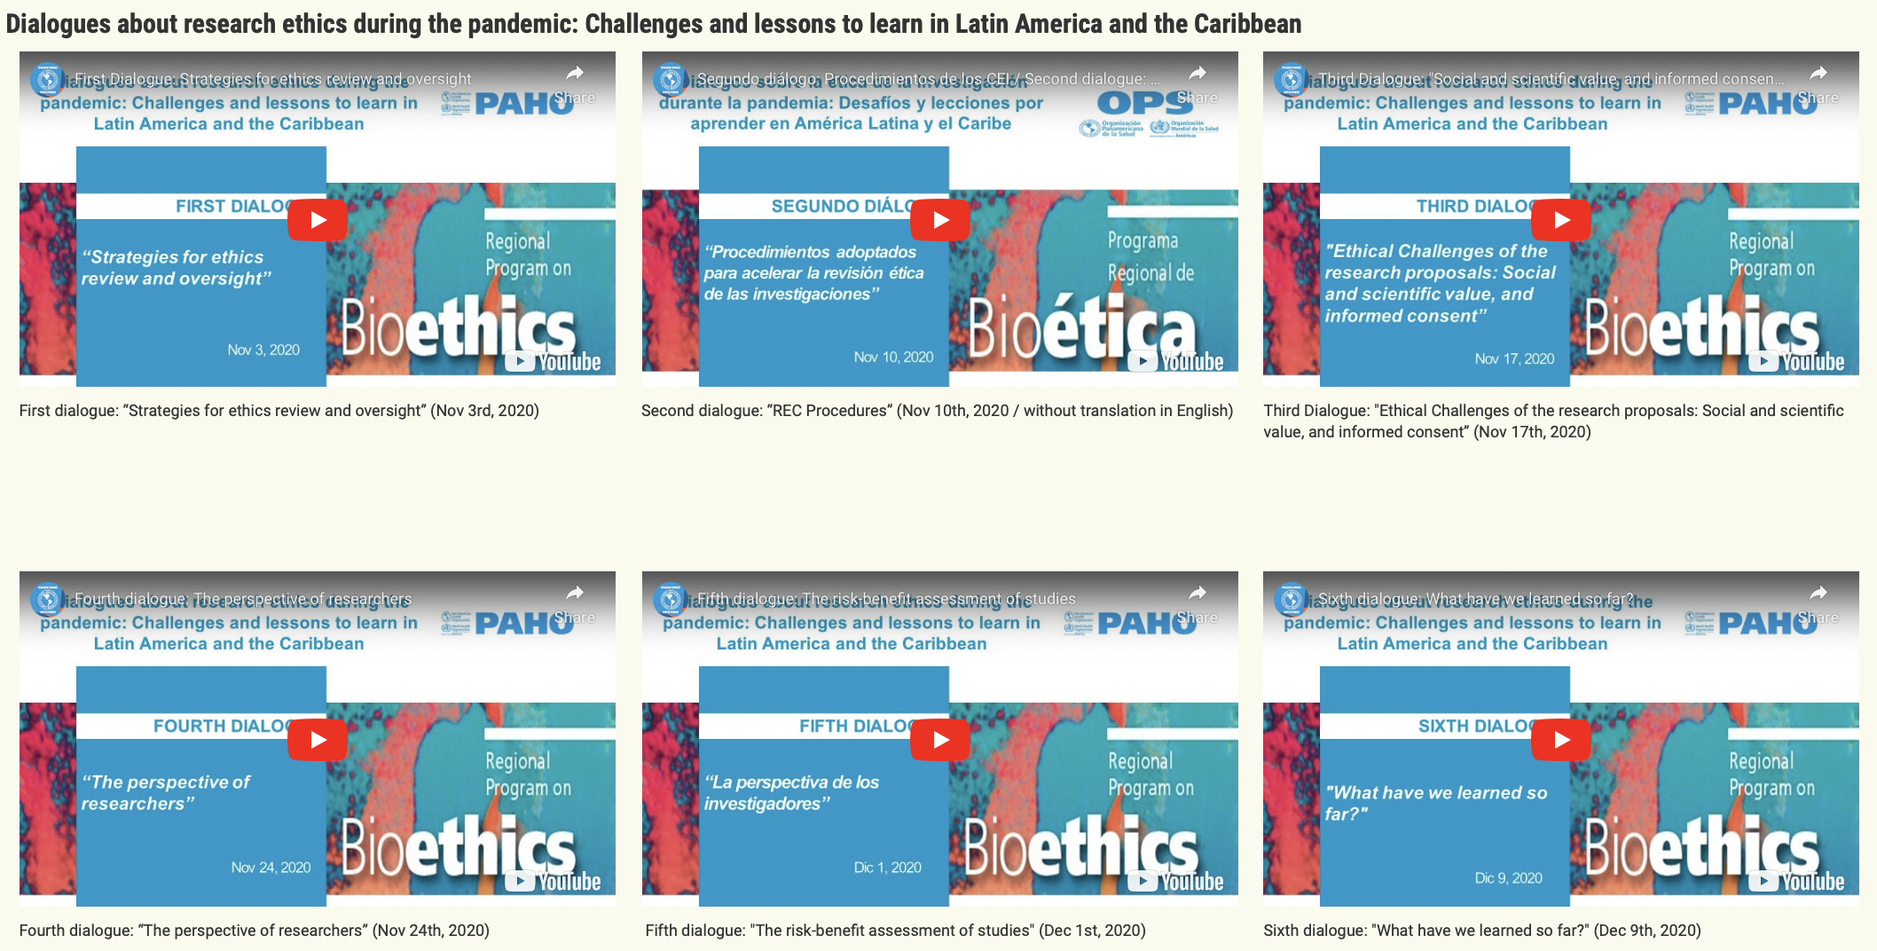
1. Lessons learned from the Zika outbreak and challenges during the COVID-19 pandemic
Regional response to COVID-19:​
    Implementation of PAHO’s guidance: ethics review processes + informed consent processes
    Initiating research as soon
    as the pandemic started.
Challenges persist. But we have been evaluating them collectively throughout the pandemic: regional dialogues.

Slide 7
2. How can trust in research conducted in emergencies be strengthened? Transparency and public engagement
Ethical research entails tasks at the societal level:
    Engagement
    Trust
Transparency is a key component of the ethical governance of research.
Argentina, Brazil, Colombia and Peru adopted initiatives to strengthen transparent communication about ongoing research during the pandemic: health authorities required the registration of COVID-19 studies on their websites.

Slide 8
2. How can trust in research conducted in emergencies be strengthened? Transparency and public engagement
Actions are proposed for authorities, researchers, research ethics committees (RECs) and research funding institutions.
Make available to the public a list of the studies undertaken in the country.
Include as part of research protocols a public engagement plan.
Share research results rapidly in order to guide decision-making.
Inform the public about the purpose of RECs and their role during health emergencies.
Examples of actions to strengthen trust in research

Slide 9
3. How to ensure that the ethics review and monitoring of research conducted by research ethics committees are agile yet rigorous in emergencies
RECs should conduct accelerated ethics reviews without compromising their rigor. It is therefore necessary to adapt and seek alternatives to ordinary processes of ethics oversight.
Ethics oversight of research
Ethics review of research projects with human participants. | Monitoring of approved research throughout the course of the study.

Slide 10
3. How to ensure that the ethics review and monitoring of research conducted by research ethics committees are agile yet rigorous in emergencies
Two-step approach:
Define the organizational strategy for research oversight that best suits the context to avoid repetitive ethics review processes.
Possible strategies
1. Ad hoc committee | 2. National-level committee | 3. Extraterritorial committee | 4. Provincial or sub-national committee | 5. Institutional committees

Slide 11
3. How to ensure that the ethics review and monitoring of research conducted by research ethics committees are agile yet rigorous in emergencies
Establish rapid and flexible standard operating procedures (SOPs) that ensure a rapid and rigorous review of research and an agile and adequate monitoring of ongoing studies.
Relevant topics to be considered in the SOPs
Submission of electronic documentation
Flexibility in the requirements for the submission
Mechanisms for communication and coordination
Virtual meetings
Tight deadlines
Reduced quorum
Staggered decision-making
Digital registry and documentation archive
Template of SOPs in annex 1

Slide 12
4. How can the ethical acceptability of research be ensured in response to emerging evidence?
In emergency situations evidence is produced quickly and this can impact the ethical acceptability of ongoing research.
Researchers and RECs are responsible for ensuring that research continues to be ethically acceptable in light of the most up-to-date available evidence.
The case of hydroxychloroquine
At the beginning of the pandemic, several studies tested hydroxychloroquine as a possible treatment for COVID-19. The RECOVERY clinical trial showed the futility of this drug as a treatment for patients hospitalized with COVID-19. Therefore, other ongoing studies had to be suspended or revised. E.g., the Solidarity clinical trial of WHO proceeded to close the arm that studied hydroxychloroquine.

Slide 13
4. How can the ethical acceptability of research be ensured in response to emerging evidence?
Guidance for monitoring:​
  Operational: Procedures for RECs and researchers.
    Continue, modify, suspend or cancel the study.
  Substantial: Guiding questions for the ethical analysis.
    Social value, scientific value, fair participant selection, ….
    Additional questions for the monitoring of ongoing placebo-controlled trials after an emergency use authorization of health interventions has been granted.

Slide 14
5. How can the ethical use of unproven interventions outside of research be ensured in health emergencies?
There are some exceptional situations during health emergencies in which it could be ethically acceptable to use unproven interventions outside of research. For this scenario, there is a specific ethical framework: Monitored emergency use of unregistered and experimental interventions (MEURI).
Most prominent ethical challenge during the pandemic in the Region: Use of unproven interventions outside of research without adherence to this ethical framework.

Slide 15
5. How can the ethical use of unproven interventions outside of research be ensured in health emergencies?
The MEURI framework was devised by WHO during the 2014 Ebola outbreak.
At the beginning of the COVID-19 pandemic, PAHO issued a revised version of the MEURI framework that organizes the ethical considerations into four core criteria for the ethical acceptability of the emergency use of unproven interventions outside of research and provides recommendations for its implementation.
In 2022, WHO published general guidelines on the topic that adopt PAHO’s four ethics criteria and recommendations .

Slide 16
5. How can the ethical use of unproven interventions outside of research be ensured in health emergencies?
Ethics criteria
Is the use of this intervention outside of research ethically justifiable? | 1. Justification
If the use outside of research is justified, how should one proceed to ensure that this use is ethical? | 2. Ethical and regulatory oversight
 | 3. Informed consent process
 | 4. Contribution to the generation of evidence
General and operational recommendations to facilitate the adherence to these four ethics criteria.

Slide 17
6. How to ensure that data and samples are shared ethically for future research
Confusion: Sharing research results vs. sharing inputs for future research.​
This has not been a challenge during COVID-19 because all countries had samples. But this is a topic for future emergencies.
  Collection
    Broad informed consent processes, criteria for obtaining a waiver of informed consent, conditions for informed opt-out procedure: CIOMS guidelines.
  Storage​, transfer, and use
      Fair sharing.

Slide 18
7. Final recommendations
These recommendations are our pending regional agenda.
 | Specific to health emergencies | For ordinary situations, including health emergencies
Recommendations for action
Recommendations for conceptualization

Slide 19
7. Final recommendations
 | Specific to health emergencies | For ordinary situations
Recommendations for action | Health authorities, scientific community, and international organizations. | Health authorities, RECs, institutions that conduct research, scientific community, and international organizations.
Recommendations for conceptualization | All parties involved, including academia.

Slide 20
 | For emergencies
For action | For health authorities: Establish strategies for the oversight of research in health emergencies (not only for COVID-19). Entrust the relevant research authorities with responsibility for coordinating research efforts. Designate a person who serves as a contact point for research. Establish processes to ensure that countries benefit from research results. For the scientific community, international organizations and health authorities: Develop generic research protocols, “pre-approved”.

Slide 21
 | For ordinary situations
For action | For institutions that conduct research: Compensate (financially or through another mechanism) REC members for their time to recognize their work and speed up processes. For RECs and health authorities: Incorporate virtual tools. Allow for informed consent processes to be carried out in different ways. Establish procedures to determine which activities require REC review. For RECs: Require that researchers report prior reviews conducted by other RECs and include a copy of their decisions. Create mechanisms (e.g., social media) to inform the public about studies they are supervising, if necessary.

Slide 22
 | For ordinary situations
For action | For health authorities Create mechanisms to inform RECs about studies that were submitted for review and not approved, if necessary. Require all clinical trials to be registered in registries that feed ICTRP before they begin. Create a website with the approved studies with human participants. Inform the public about the research conducted to facilitate public engagement and promote trust in research. For health authorities and international organizations: Advocate for expanding the scope of ICTRP so that it includes all research with human participants and not only clinical trials.

Slide 23
 | For ordinary situations
For action | For national authorities, international organizations, RECs and the scientific community: Strengthen capacities in research ethics: Distinction between research with human participants and public health activities, MEURI framework, ethical use of samples and data in future research, adaptive designs, human challenges studies, online studies, scientific integrity, and REC’s obligations regarding what must be kept confidential and what must be made public.

Slide 24
 | For emergencies
For conceptualization | Mechanisms for the coordination of research efforts initiated in emergencies to know which initiatives are underway, and therefore prevent the duplication of research and coordinate the conduct of network trials or multicenter studies. Strategy for regional collaborations: to address logistical challenges of conducting regional multicenter clinical trials. Mechanisms for the ethics oversight of research at the (sub)regional level (e.g., extraterritorial ethics oversight during emergencies).

Slide 25
 | For ordinary situations
For conceptualization | Strategies that facilitate the oversight of research of multiple RECs in a coordinated manner which may involve the review of diferent RECs in a simultaneous deliberation or mechanisms that allow a REC to adopt the review carried out by another, without the need to repeat the review proccess (reliance agreements).

Slide 26
Regional Program on Bioethics:
https://www.paho.org/en/bioethics

