Slide 1

Early Experience with Monkeypox
Darrell H. S. Tan MD FRCPC PhD
June 21, 2020

Slide 2


I live and work on the traditional territories of the Mississaugas of the Credit, Anishnabeg, Chippewa, Haudenosaunee and Wendat peoples.

Slide 3
Outline
Clinical challenges
Health system challenges
Community concerns

Slide 4
Traditional teaching on natural history
Stage | Incubation period | Fever stage | Rash stage | Recovery
Timeline | 5-21 days | 1-4 days | 2-4 weeks | Days to weeks
Clinical findings |  | Enanthem, Lymphadenopathy near end | Macule → Papule → Vesicule → Pustule | Crusted and healing
Infectivity | Nil | Low | High | Nil
Notes:
Initial febrile prodrome accompanied by generalized headache nad fatigue
Maxillary, cervcal or inguinal nodes prior to and concomitant with rash development -> big and tender which made it dfferent from small pox
Fever stops on day or up to 3 days after rash onset
Tends to be on face then centrifugally on body

Slide 5
Case: Man in his 40s
Sex w new M partner (give & receive oral, rim, insertive anal)
Sex again w same partner
“Bumps” on penis, pubic area
Headache, malaise, fever, chills, myalgias, cervical LN,
“Bump” on lip
Sees Family Physician
DAY 0 8 12 14 16 19 20
Seen by ID

Slide 6
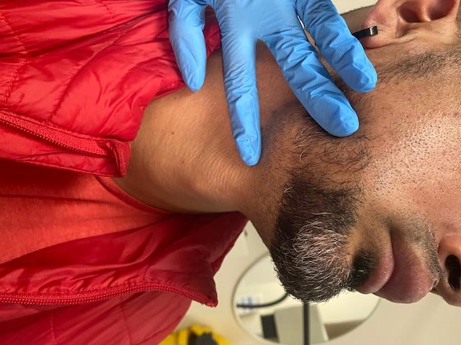
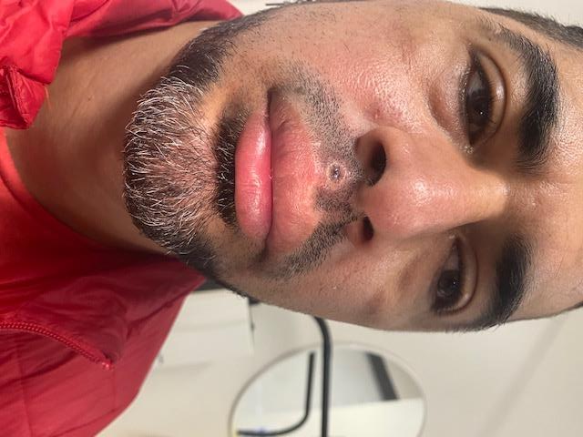
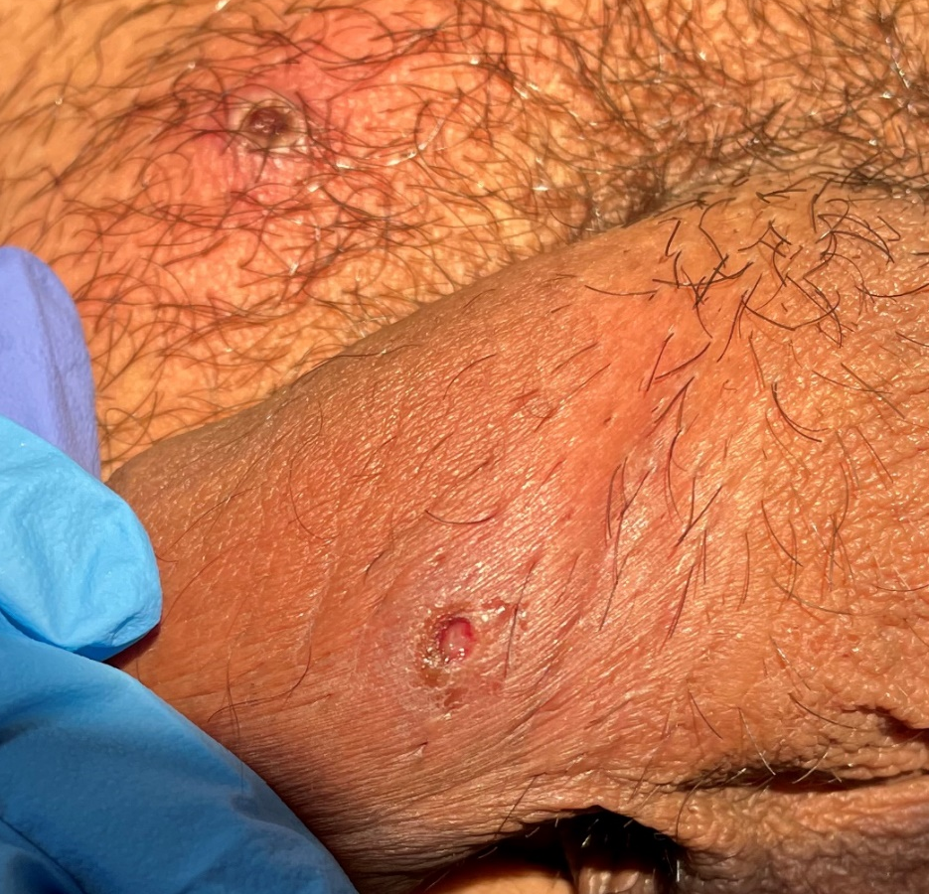
Family Physician assessment day 19
Differential diagnosis: HSV-1 or 2, syphilis
Diagnostic specimens collected but held back in microbiology lab
Photos courtesy of Dr S Jaeranny

Slide 7
ID physician assessment day 20
Challenges identifying negative pressure isolation room for assessment
Clinical evolution atypical: new lesions at multiple stages of evolution
Diagnostic delay due to biosafety considerations in lab: challenges in ruling out other STIs, role of empiric therapy (eg. benzathine penicillin)
Patient voiced concerns about paying rent given need for isolation

Slide 8
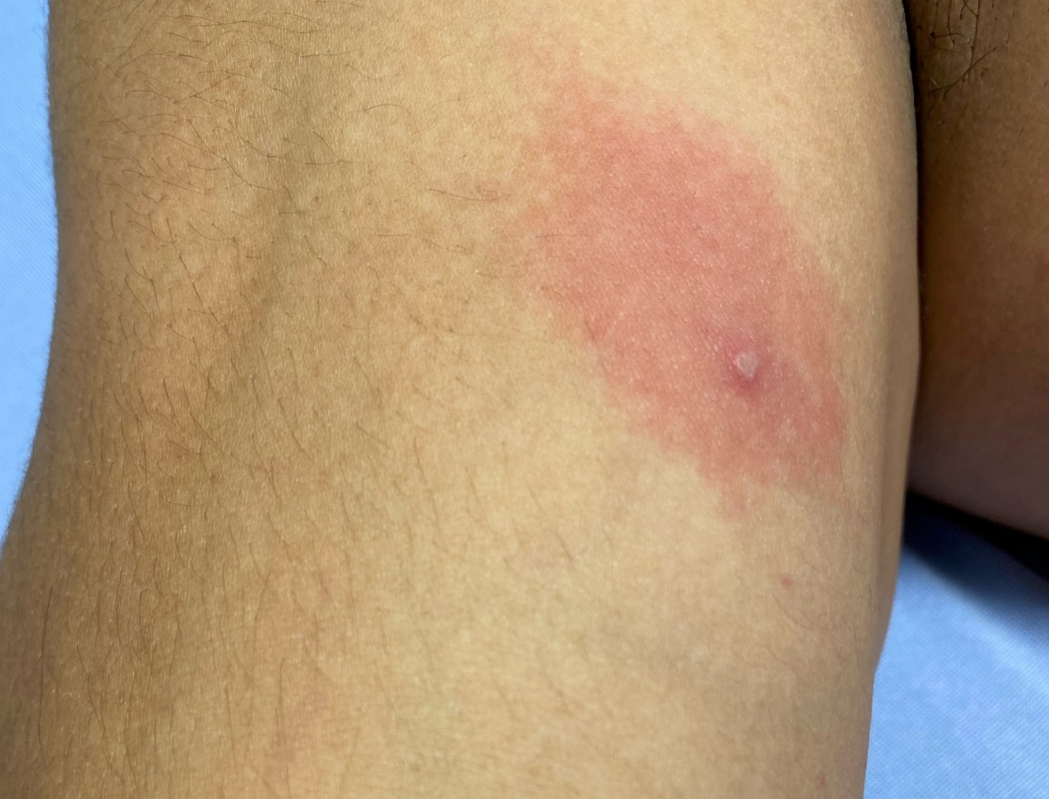
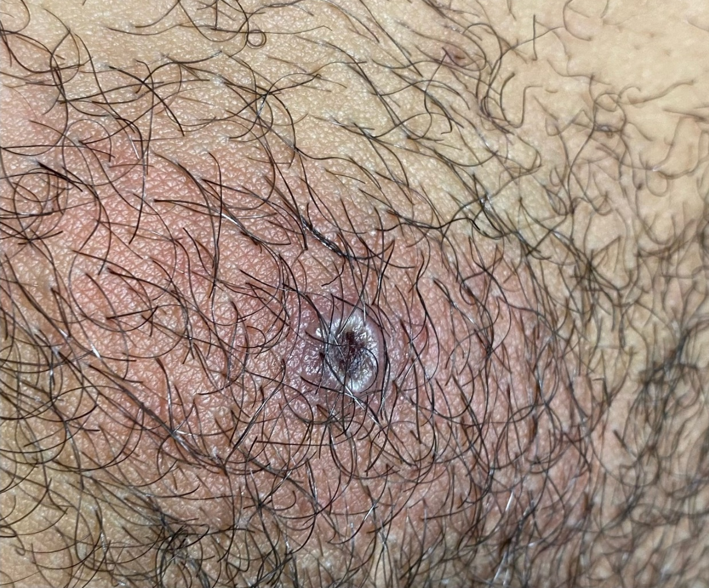
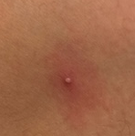
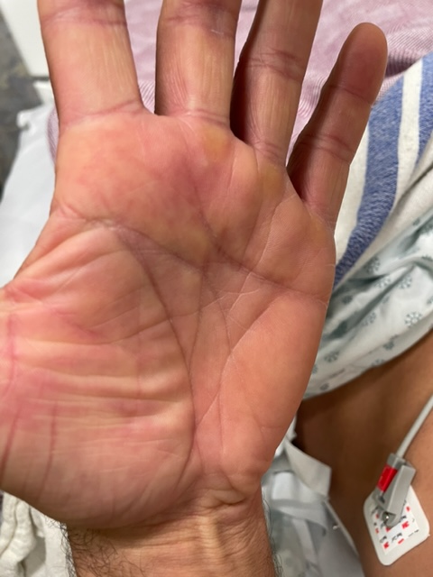
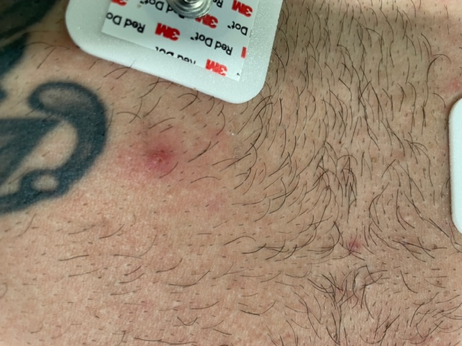
Evolution of rash

Slide 10
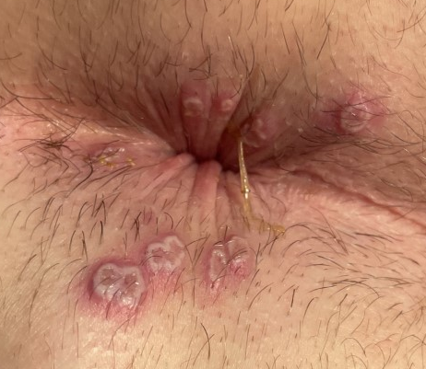
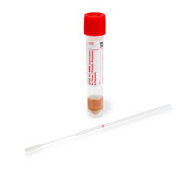
Clinical challenges
Specimen dilution: send in minimal
(1mL) viral transport medium
Diagnostic delays
Serology not available
Analgesia eg. proctitis

Slide 11
Health system capacity
Education / awareness
Infection Prevention & Control limitations
Specimen transport limitations
Sexual health/PrEP clinics
Airborne transmission ?
Airborne / droplet / contact precautions
Negative pressure rooms
Category A → B pathogen
Transportation of dangerous goods training
Limited
capacity
In
Healthcare
system
Emergency departments
Infectious diseases
Primary care providers

Slide 12
Health system challenges
Referral pathways
  Rapid dissemination of information about which sites have clinical capacity to assess and test
Stewardship of scarce interventions
  Antivirals (tecovirimat)
  Vaccine (3rd generation smallpox vaccine)

Slide 13
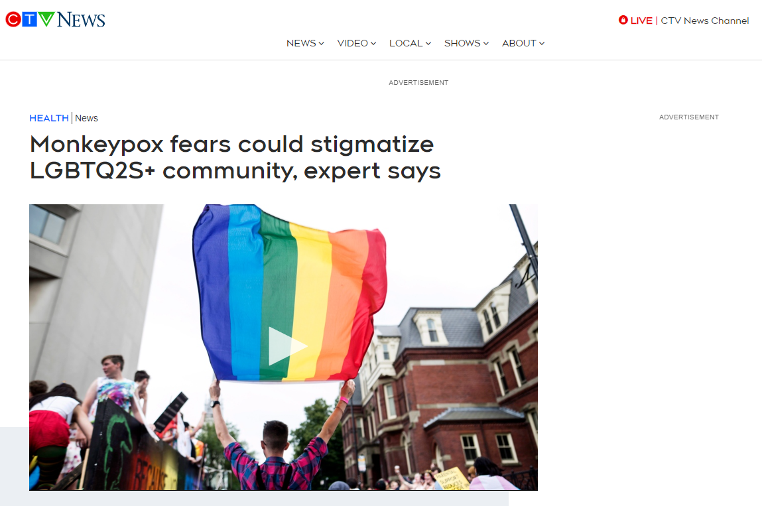
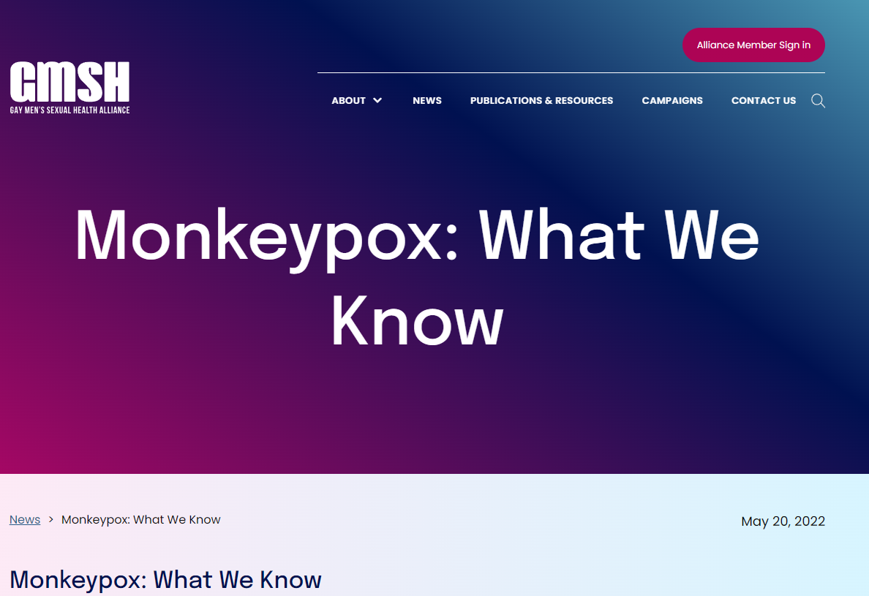

Slide 14
Community mobilization meetings since wk 1
Concerns
Responses
Meaningful engagement
Stigmatizing imagery
Risk of stigma in media
Barrier-free access
Financial support during isolation
Municipal, provincial, federal policy-makers as guests
Image atlas in development
Community spokespeople
Walk-in access at vaccine clinics
Advocacy

Slide 15
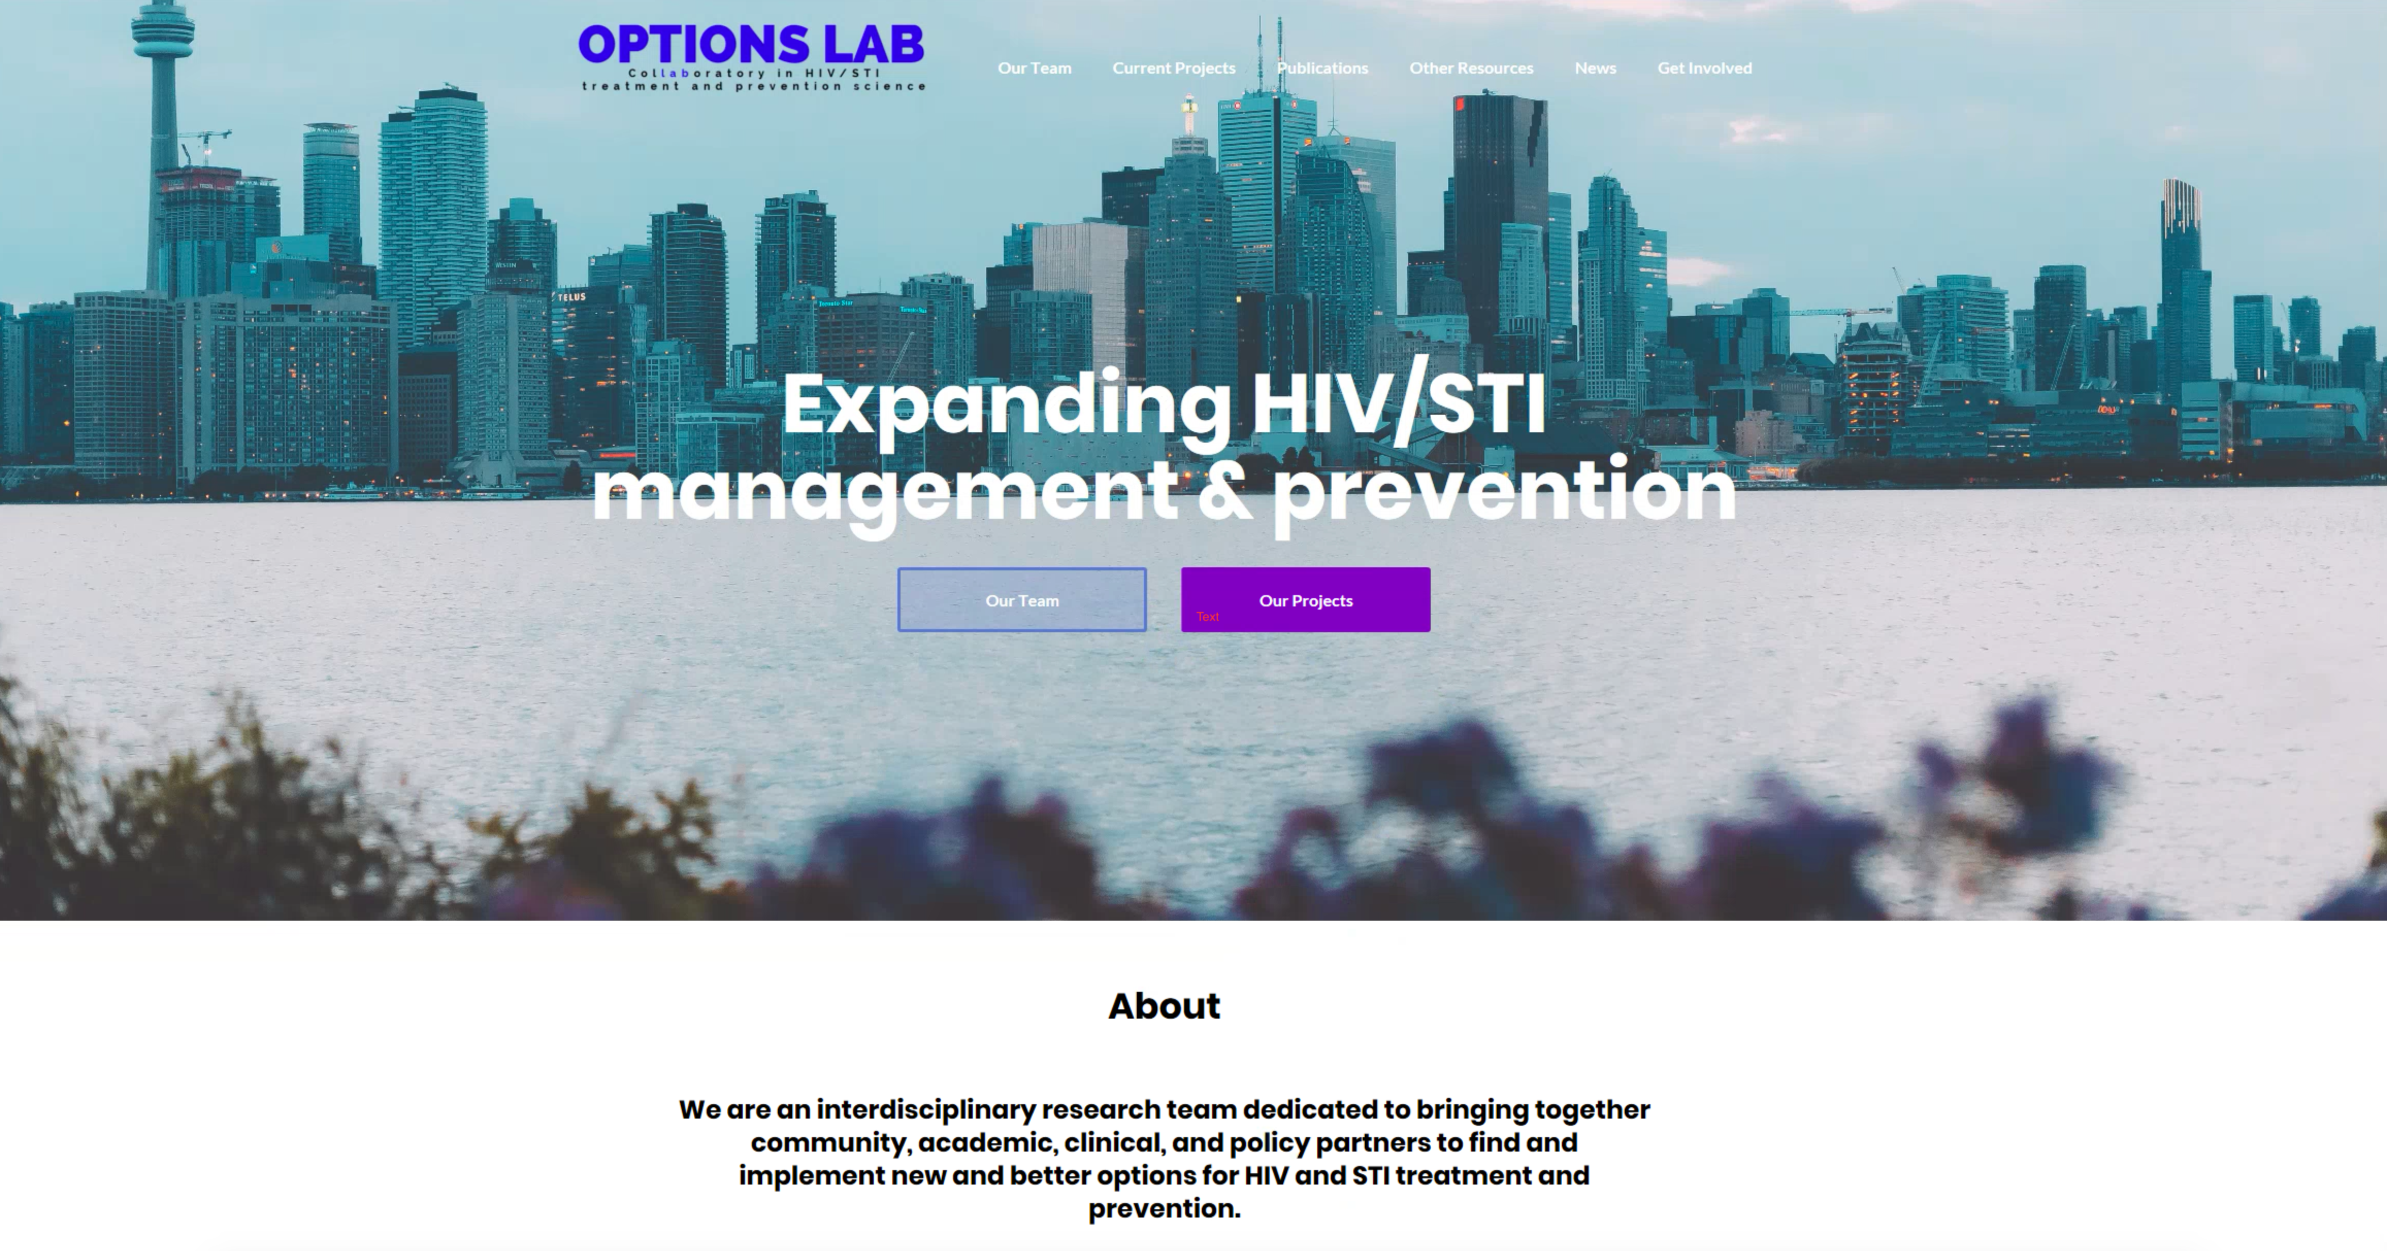


www.optionslab.ca darrell.tan@gmail.com

