Slide 1

HEARTS Initiative in Trinidad and Tobago
Presenter Dr. Rohit Doon
Advisor Health Promotion
And Chair of the National HEARTS Oversight Committee
June 28 & 29, 2021

Slide 2
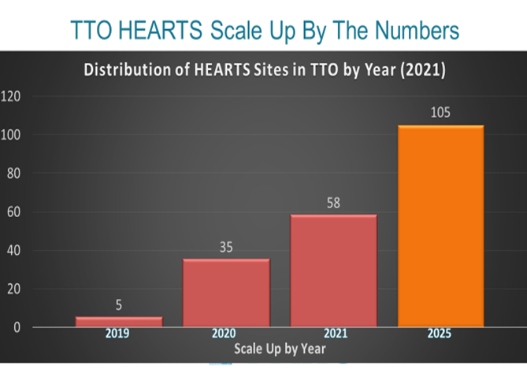
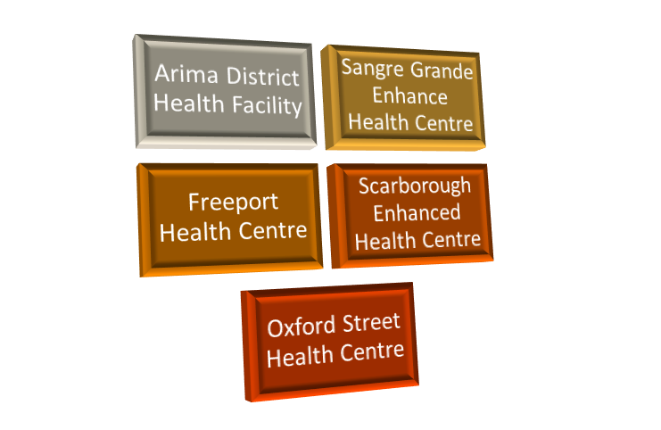

HEARTS Scale Up to 2025….Where we are?
Initial launch in 2019 with 5 Primary sites
Catchment population 150,000
As of January 2020 HEARTS Scaled up to 30 New sites
Cumulative No. Sites – 35
Catchment Population 565, 000
TTO HEARTS Scaled up goal
to 100% PHC on track for achievement by end of 2022

Slide 3
TTO HEARTS Scale Up By The Numbers
2019 2020 2021 2025

Slide 4





TTO HEARTS Scale Up By The Numbers
- 64% Scale Up Achieved by 2021
RHA | Estimated HTN Pop (30% pop ≥ 18 yrs) | No. PHC Facilities | No. HEARTS Scale Up sites 2021 |  | Targeted No. HEARTS Sites 2025
North Central RHA (NCRHA) | 78,750 | 16 | 16 | 100% | 16 | 100%
Eastern RHA (ERHA) | 27,000 | 17 | 17 | 100% | 17 | 100%
South West RHA (SWRHA)) | 135,000 | 35 | 4 | 9% | 35 | 100%
Tobago RHA (TRHA) | 13,500 | 18 | 18 | 100% | 18 | 100%
North West RHA (NWRHA) | 79,863 | 18 | 3 | 17% | 18 | 100%
NATIONAL SUMMARY | 366,750 | 104 | 58 | 56% | 104 | 100%

Slide 5
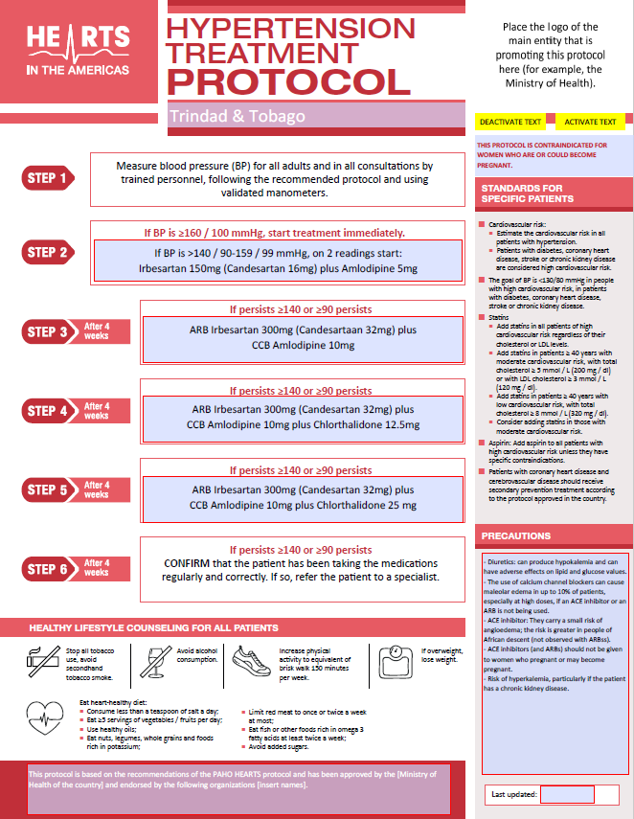
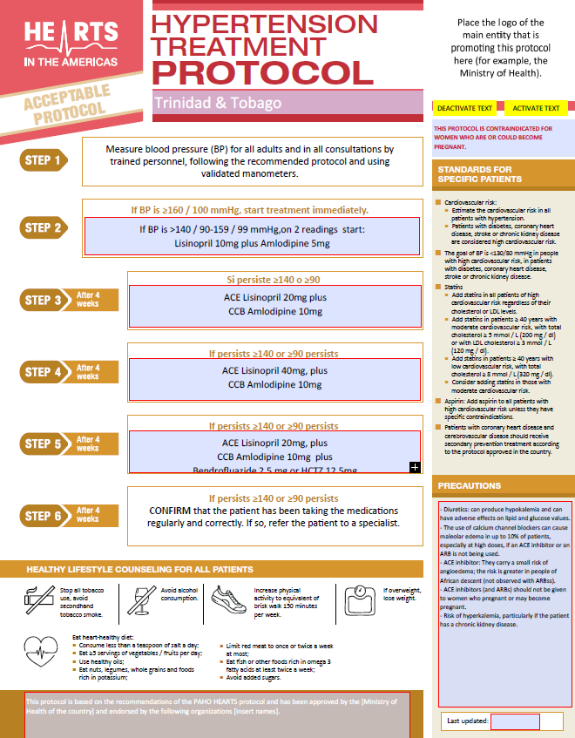
How is the HEARTS scale up included in health system strengthening?
ACCESS TO MEDICINES
Development and approval of TTO HTN Treatment Algorithm.
Adoption of HEARTS HTN Treatment Protocol.
Updating MOH Drug Formulary
WHO Essential Medicines List; Currently In Use – For Introduction

Slide 6
How is the HEARTS scale up being included as part of the health system strengthening in the country?
Building Human Resource Capacity:- Approximately 300 health staff trained in HEARTS by local Master Trainers and through PAHO Virtual Campus
Introducing Telemedicine for managing NCD clients during COVID 19. Pre-packaging and curbside pick up of medication and pharmacies implemented
Strengthening of Registries - Review of HTN Registries completed. Project to standardize and upgrade Registries initiated in 2021
TTO HTN Treatment Algorithm formally approved. Implementation commenced in HEARTS sites. Amendments made to MOH Drug Formulary
Training and certification of the 1st Cohort of Trainers in Self Management by Stanford University in collaboration with PAHO, completed in 2021
Strengthening linkages between primary and secondary health professionals in the development of HTN Algorithm and introduction of the Diabetes Protocol

Slide 7
  What challenges are expected and solutions proposed
Challenges Expected | Solutions Proposed
Access to Medicines on the New WHO Protocol Medication stock Outs | PAHO Strategic Fund – to facilitate availability and effective use of essential Medicines etc Change MOH Purchasing Intensions and Drug Formulary
Improving BP Control and access to Electronic BP Machines for clients | Accessing funds to support installation population BP devices in strategic spaces Providing free BP monitors to HTN Patients in PHC
Impact of COVID 19 - Focal Points also leading COVID response. Reduced in-person management. Use of Telemedicine | Develop Telemedicine Policy and create a balance between in-person care and telemedicine in PHC Provide additional Support for Focal Points Return to in-person meetings Strengthening of reporting and accountability

Slide 8
  What challenges are expected and solutions proposed
Challenges Expected | Solutions Proposed
Improving Diabetes Control as a comorbid condition to HTN | Scale Up of Diabetes Module – Adopt and Scale up Diabetes Treatment Protocol
Delivery of Standardized based evidence based care in both the Public and Private Health sector | Roll out of specific Implementation teams particularly for engagement and sensitization and training in the Private Medical Community
Strengthen Registries | Partner with PAHO and other stakeholders to strengthen registries and develop heart attack and stroke registers
Strengthening M & E | Establishment of Registries throughout the country ( 104 Health Centres) Establishment of heart attack and stroke registries
Reduced patient contact and compromise to quality of care | Recovery of full PHC services post Pandemic National Scale of vaccination to achieve herd immunity

Slide 9
What support is needed from the Regional Office to mitigate the challenges?
Support needed from the Regional Office to mitigate the challenges
Strengthen and Create registries including heart attack and stroke registries
Assistance with Training and capacity building particularly for Private Sector
Strengthen collaboration with private health sector to scale up nationally
PAHO Strategic Fund – to facilitate availability and effective use of essential Medicines etc
Strengthen CVD management and improve patient selfcare
Assistance with National Hearts Symposium (2022)

Slide 10
Learned lessons
Build strong governance structure at all levels
Emphasize capacity building
Strengthen Patient Self Management
Use of Evidenced based Protocols
Ensure mechanism for consistent supply of essential medications
Ensure Public, Private, Civil Society Collaboration in the process

Slide 11




