Slide 1
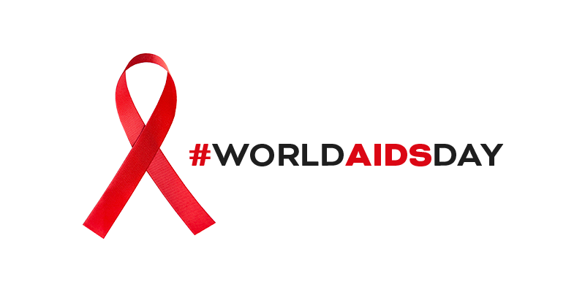
Status of HIV epidemic and response
Latin America and the Caribbean 2019

Slide 2
HIV incidence per 1000 population, 2030 forecast, and targets for Ending AIDS, in Latin America and the Caribbean, 1995-2030
Target:
75% reduction by 2020
90% reduction by 2030
(compared to 2010 values)
0.31
Baseline 2010
0.20
0.19
0.16
Target 2020
End AIDS 2030
Source: UNAIDS. Spectrum HIV estimates 2019 and projected values
Notes:
The United Nations General Assembly adopts the 2016 Political Declaration to end AIDS.
Member States commit to end the AIDS epidemic as a public health threat by 2030, a key target for the 2030 Agenda on Sustainable Development, adopted by the UN General Assembly in 2015.
There were 120,000 new HIV infection estimated in 2018 in Latin America and the Caribbean. Reaching the 2030 target means less than 13,000 new HIV infections per year in 2030. (for 2020 it means less than 32,000 new HIV infections per year)
Ending AIDS requires intensified action in:
Testing and treatment. This incudes “Treat all”, optimizing treatment regimens and viral load monitoring for all patients through integrated people-center health services.
Full package of evidence-based interventions using a combination prevention approach. Including PrEP as an additional option for HIV prevention.
Eliminating stigma and discrimination, including in the health services.

Slide 3
HIV/AIDS mortality, 2030 forecast, and targets for Ending AIDS in Latin America and the Caribbean, 2000-2030
Baseline 2010
Target:
80% reduction by 2020
(compared to 2010 values)
41,000
27,000
Target 2020
Source: UNAIDS. Spectrum HIV estimates 2019 and projected values
Notes:
There were 41,000 AIDS-related deaths estimated in 2018 in Latin America and the Caribbean. Reaching the 2020 target means less than 10,200 AIDS related deaths per year.

Slide 4
New HIV infections, deaths and persons living with HIV receiving ART in Latin America and the Caribbean, 1995-2018
Source: UNAIDS. Spectrum HIV estimates 2019, GARPR and GAM country reports 2000-2019

Slide 5
New HIV infections and AIDS deaths in Latin America and the Caribbean, 2004-2018
Source: UNAIDS. Spectrum HIV estimates 2019 and UNAIDS/WHO. Global AIDS monitoring country responses, 2019

Slide 6
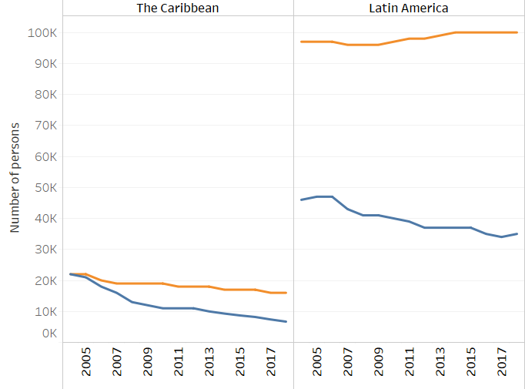

New HIV infections and AIDS deaths in Latin America and the Caribbean, 2004-2018
Source: UNAIDS. Spectrum HIV estimates 2019 and UNAIDS/WHO. Global AIDS monitoring country responses, 2019
Source: UNAIDS. Spectrum HIV estimates 2019

Slide 7
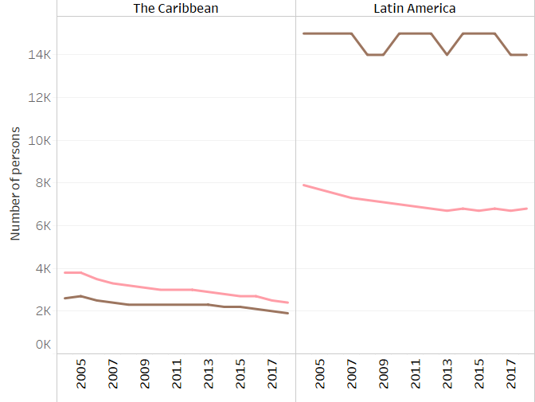

New HIV infections in Latin America and the Caribbean among 15 to 24 years old by sex, 2004-2018
New infections among young people represent 20% (1/5) of all new infections in Latin America and 27% in the Caribbean
Source: UNAIDS. Spectrum HIV estimates 2019 and UNAIDS/WHO. Global AIDS monitoring country responses, 2019
Source: UNAIDS. Spectrum HIV estimates 2019

Slide 8
Distribution of new HIV infections (aged 15–49 years), by population group, Latin America and the Caribbean, 2018
Sex workers
3%
People who inject drugs
3%
People who inject drugs
2%
Sex workers
6%
Gay men and other men who have sex with men
22%
Gay men and other men who have sex with men
40%
Remaining
population
35%
Latin America
The Caribbean
Transgender women
5%
Remaining
population
53%
Clients of sex workers and sex partners of other key populations
12%
Transgender women
4%
Clients of sex workers and sex partners of other key populations
15%
Source: UNAIDS. Modes of transmission study, 2019

Slide 9
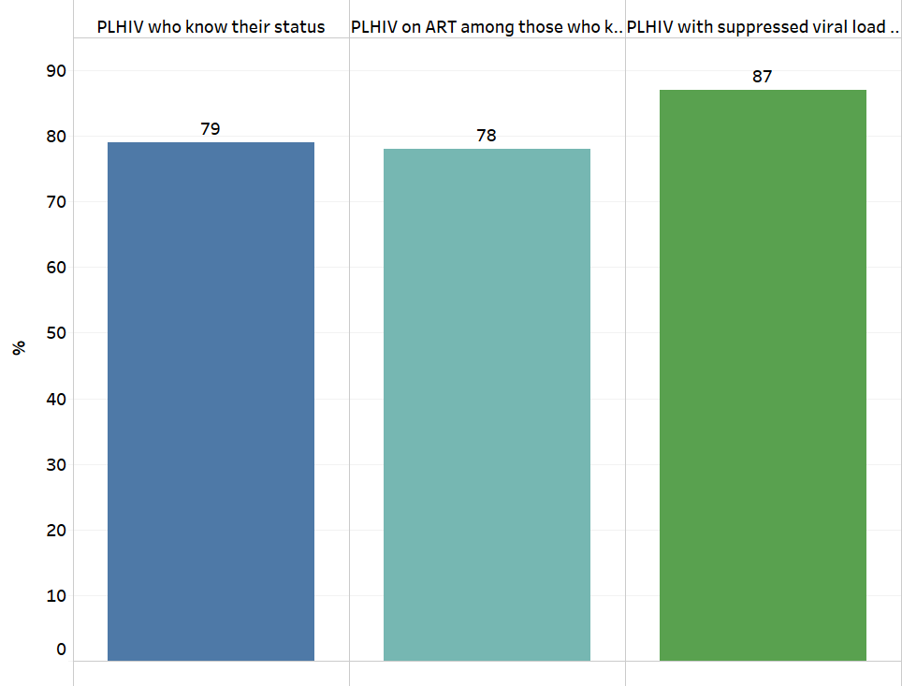
Latin America and the Caribbean towards 90 90 90 Targets, 2018
Source: UNAIDS. Spectrum HIV estimates 2019 and UNAIDS/WHO. Global AIDS monitoring country responses, 2019

Slide 10
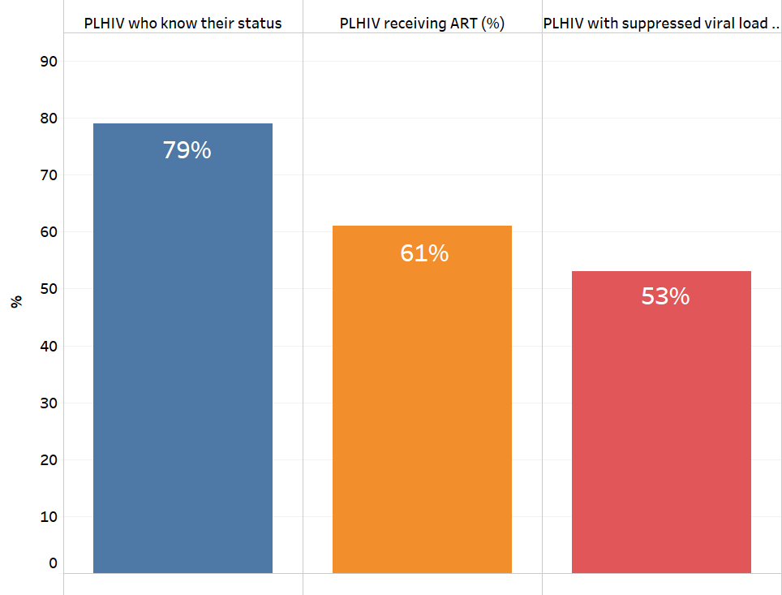
HIV cascade of care, Latin America and the Caribbean, 2018
Target: 90%
Target: 81%
Target: 72%
Source: UNAIDS. Spectrum HIV estimates 2019 and UNAIDS/WHO. Global AIDS monitoring country responses, 2019

Slide 11
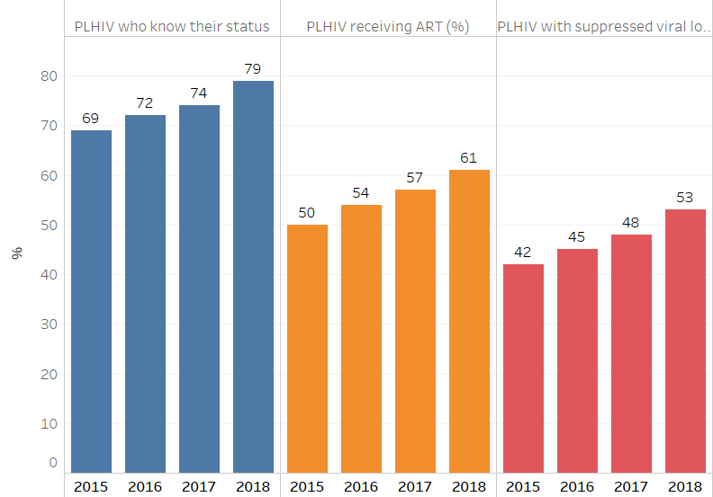
HIV cascade of care, Latin America and the Caribbean, 2015-2018
Source: UNAIDS. Spectrum HIV estimates 2019 and UNAIDS/WHO. Global AIDS monitoring country responses, 2019

Slide 12
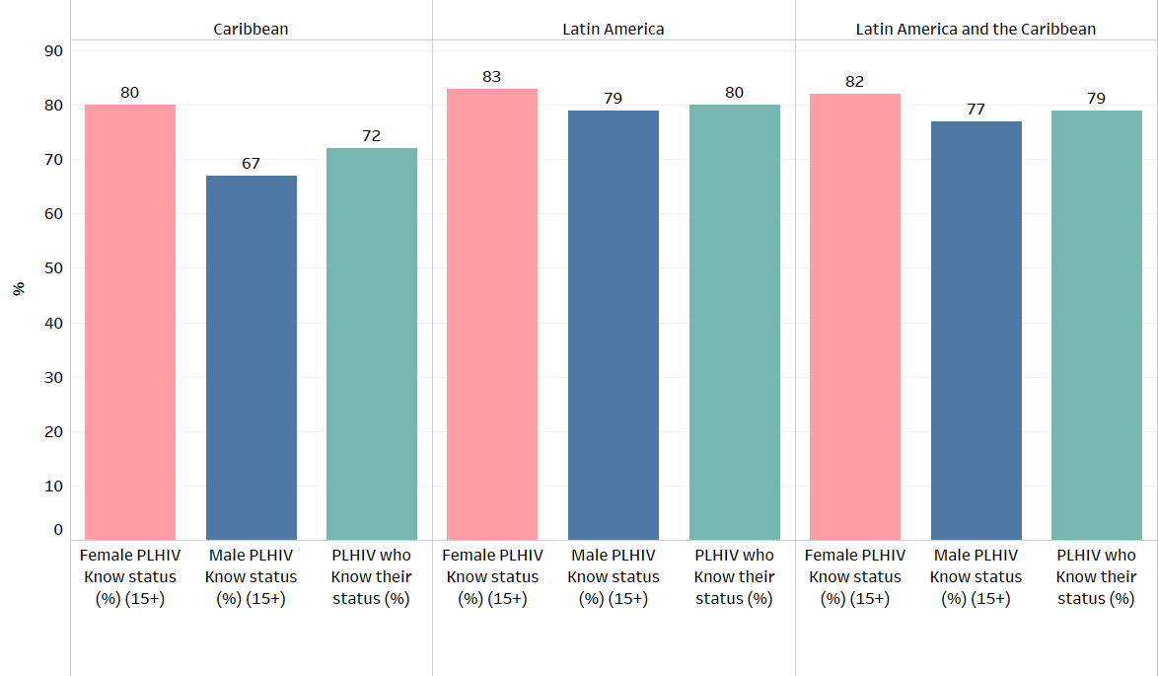
People with HIV that know their status, by sex in Latin America and the Caribbean (%), 2018
Source: UNAIDS. Spectrum HIV estimates 2019 and UNAIDS/WHO. Global AIDS monitoring country responses, 2019

Slide 13
Persons living with HIV and persons receiving ART in Latin America and the Caribbean, 2000-2018
10% increase in persons on ART from 2018 to 2019
ART coverage is now at 61% (2019) up from 57% (2018)
Source: UNAIDS. Spectrum HIV estimates 2019 and UNAIDS/WHO. Global AIDS monitoring country responses, 2019

Slide 14
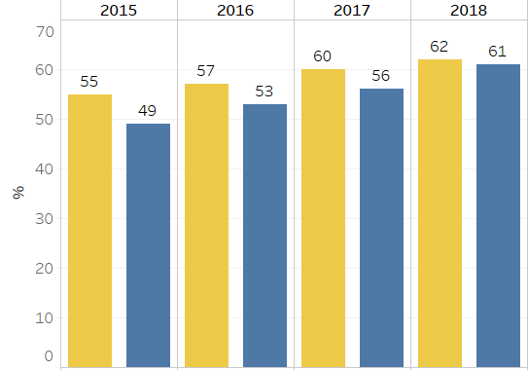

Percent of men and women (15+) on ART, Latin America and the Caribbean, 2015-2018
Source: UNAIDS. Spectrum HIV estimates 2019 and UNAIDS/WHO. Global AIDS monitoring country responses, 2019

Slide 15
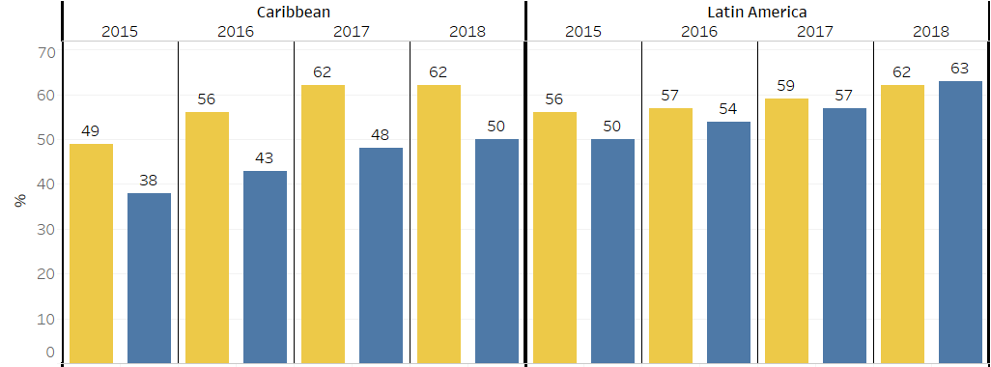

Percent of men and women (15+) on ART, by subregion, 2015-2018
Source: UNAIDS. Spectrum HIV estimates 2019 and UNAIDS/WHO. Global AIDS monitoring country responses, 2019

Slide 16
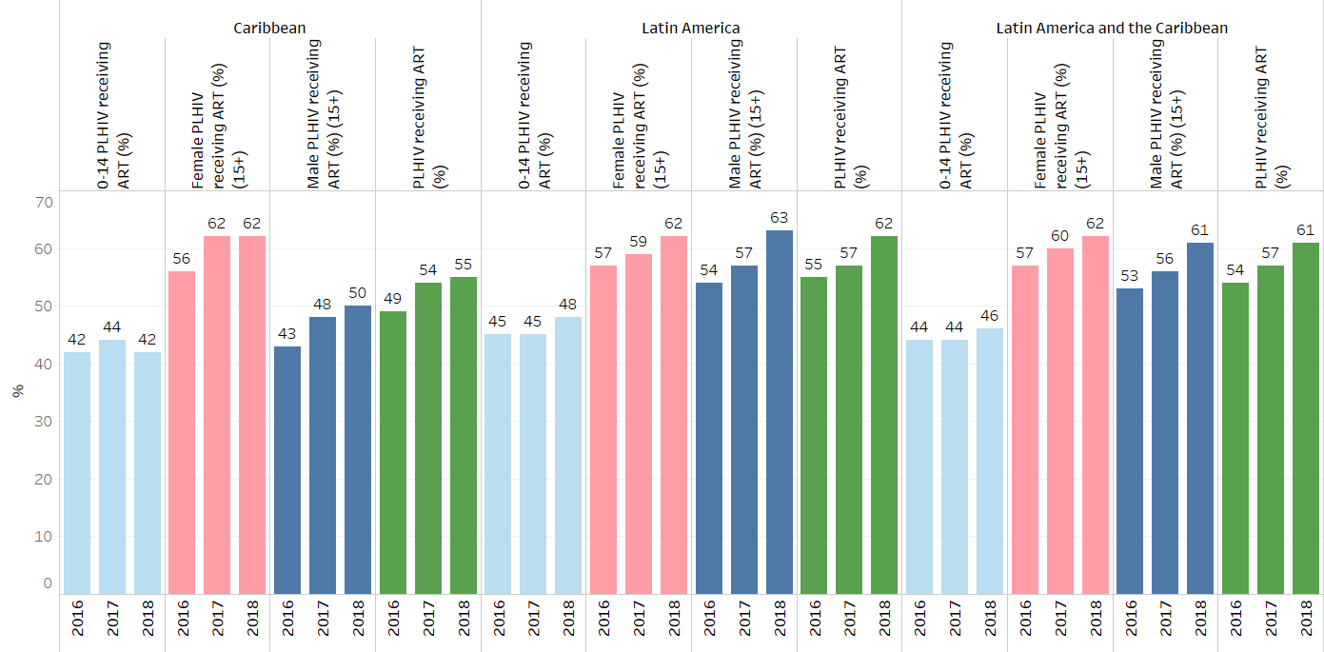
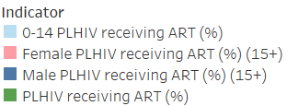
Persons receiving antiretroviral treatment (%), in Latin America and the Caribbean, by age and sex, 2016-2018
Source: UNAIDS. Spectrum HIV estimates 2019 and UNAIDS/WHO. Global AIDS monitoring country responses, 2019

Slide 17
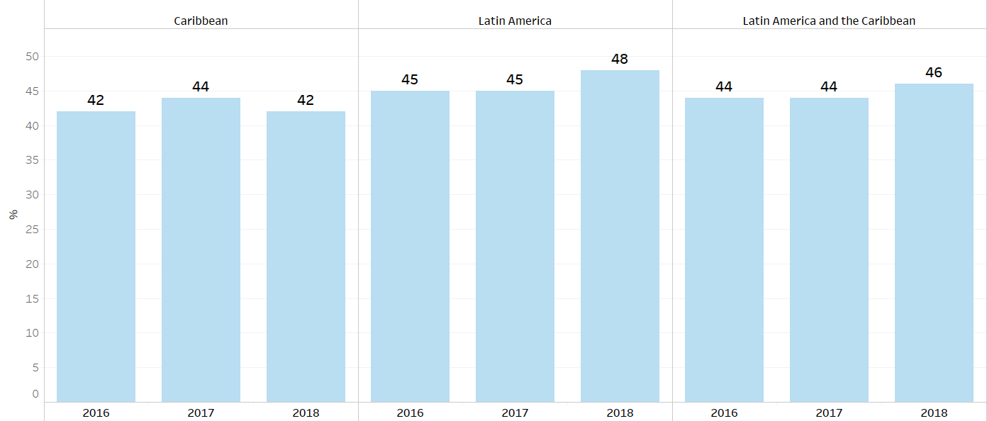
Children (0-14 years old) receiving antiretroviral treatment (%), by subregion in Latin America and the Caribbean, 2016-2018
Source: UNAIDS. Spectrum HIV estimates 2019 and UNAIDS/WHO. Global AIDS monitoring country responses, 2019

Slide 18
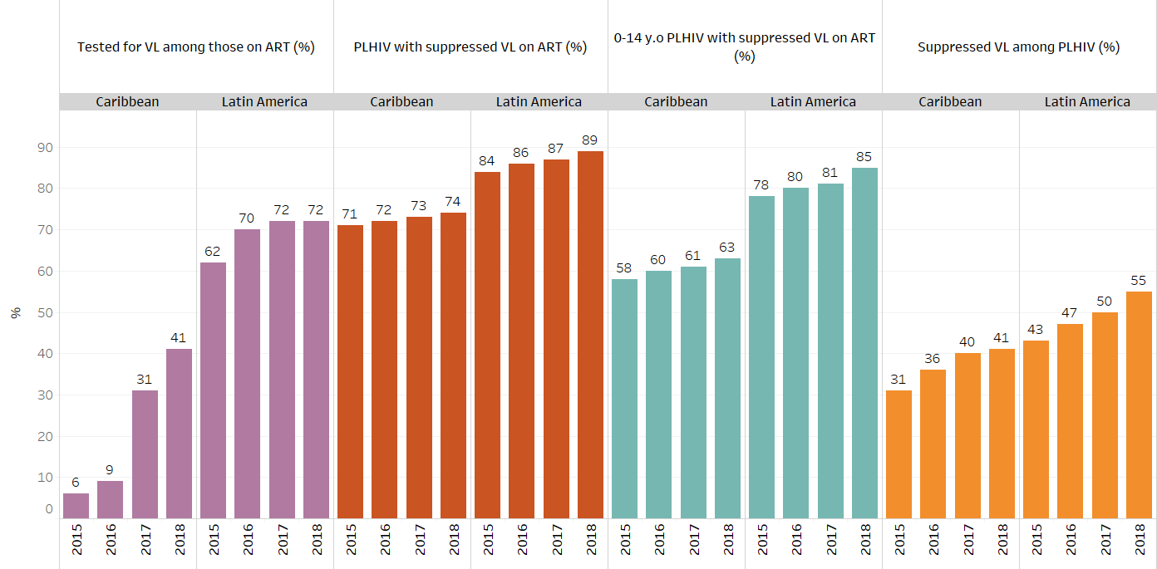
Viral load testing and suppression, in Latin America and the Caribbean, 2016-2018
Source: UNAIDS. Spectrum HIV estimates 2019 and UNAIDS/WHO. Global AIDS monitoring country responses, 2019

Slide 19
Antiretroviral coverage among pregnant women with HIV and final MTCT transmission rate, by subregion, 2010-2018
Caribbean
Latin America
Source: UNAIDS. Spectrum HIV estimates 2019 and UNAIDS/WHO. Global AIDS monitoring country responses, 2019

Slide 20
HIV testing coverage among pregnant women by subregion, 2010-2018

Slide 21
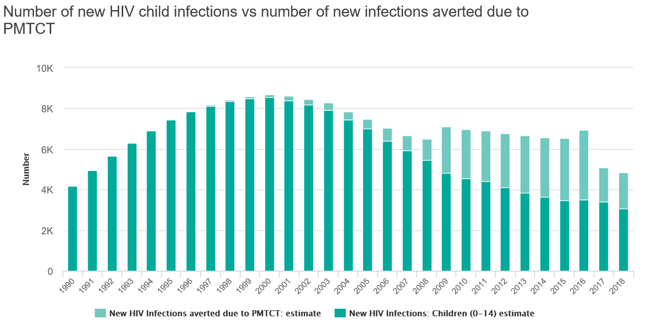
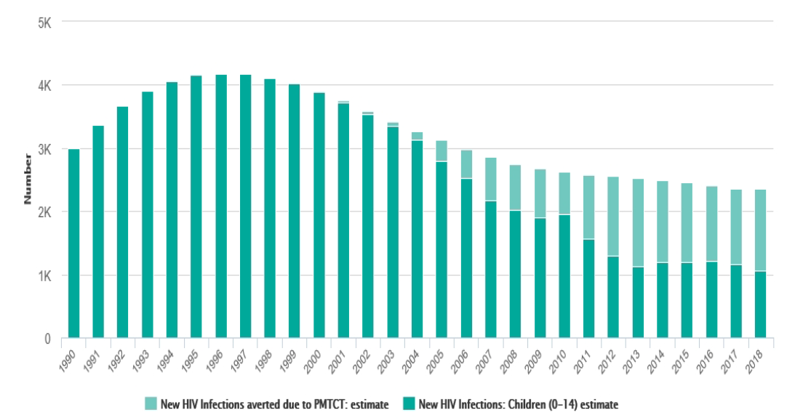
Number of new child HIV infections and new infections averted due to PMTCT by subregion, 1990-2018
In 2018:
1800 infections averted
In 2018:
1,300 infections averted
Latin America
3100 new infections among 0-14-year-olds
Caribbean
1100 new infections among 0-14-year-olds
Source: UNAIDS. Spectrum HIV estimates 2019 AIDS

Slide 22
Thank you!

