Slide 1
Office for Barbados and the Eastern Caribbean Countries
COVID-19 Briefing to the
Diplomatic Corps
17 February 2021

Slide 2
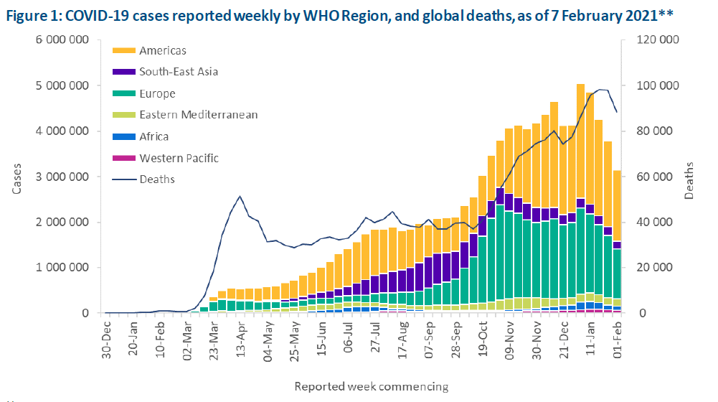
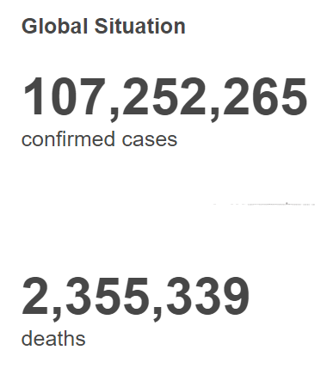
Global Situation
(as of 4 January 10H CET)
Global Overview
https://covid19.who.int/
Notes:
At the global level, we now have around a 107 million cases including 2.4 million deaths as of this morning.
The number of new cases fell again for the fourth week in a row with about 3 million cases reported between 1 – 7 February – a 17% decline compared to the previous week. All 6 WHO regions reported a decline in new cases with 5 of them reporting more than 10% decline – only EMRO reported a 2% decline.
The number of new deaths reported also fell for a second week in a row, with 88 000 new deaths reported last week, a 10% decline as compared to the previous week.

Slide 3
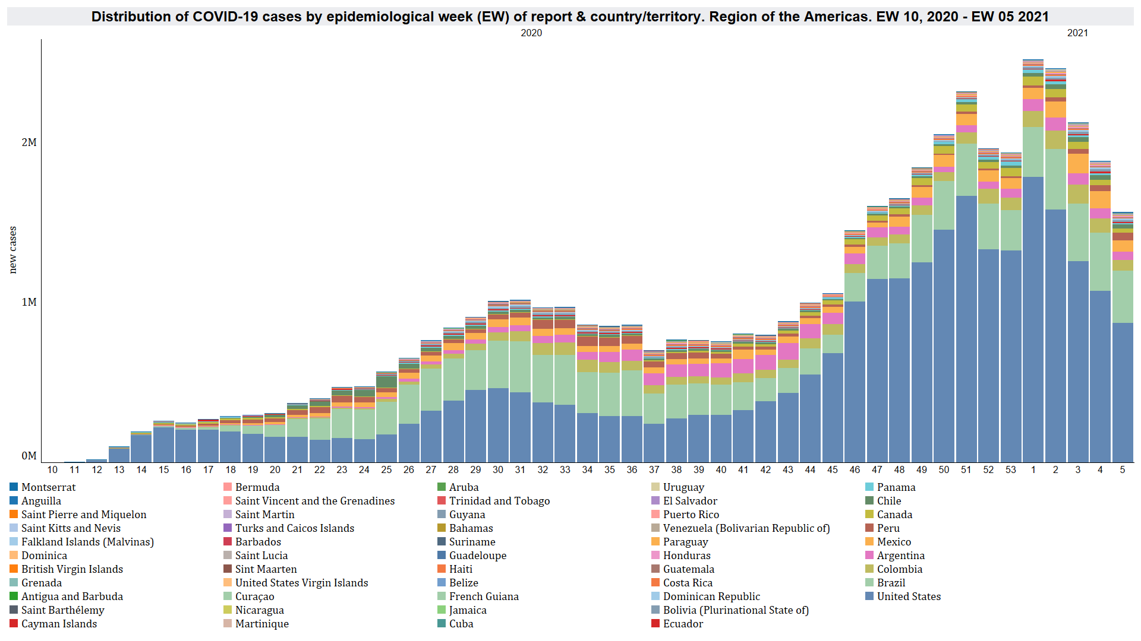
Region of the Americas: COVID-19
Cases
Notes:
The Region of the Americas also observed a decreasing trend for the fourth consecutive week since EW 1 of 2021 driven mainly by the reduction in cases reported by USA.

Slide 4
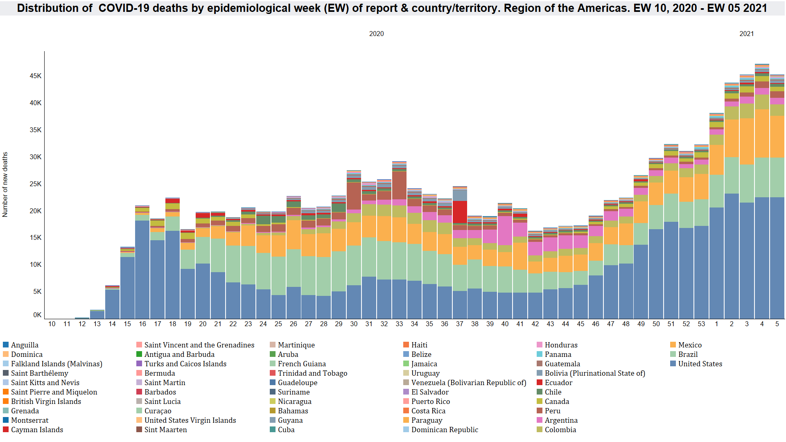
Region of the Americas: COVID-19
Deaths
Notes:
For the first time since EW42 of 2020 ( and not counting the slight dip in EW 52 - holiday period) – there was a decrease in the weekly number of new deaths – 4% relative decrease compared to the previous week. Unlike the cases, the decrease in absolute number of deaths were mainly driven by decreases observed in Mexico, and Colombia.

Slide 5
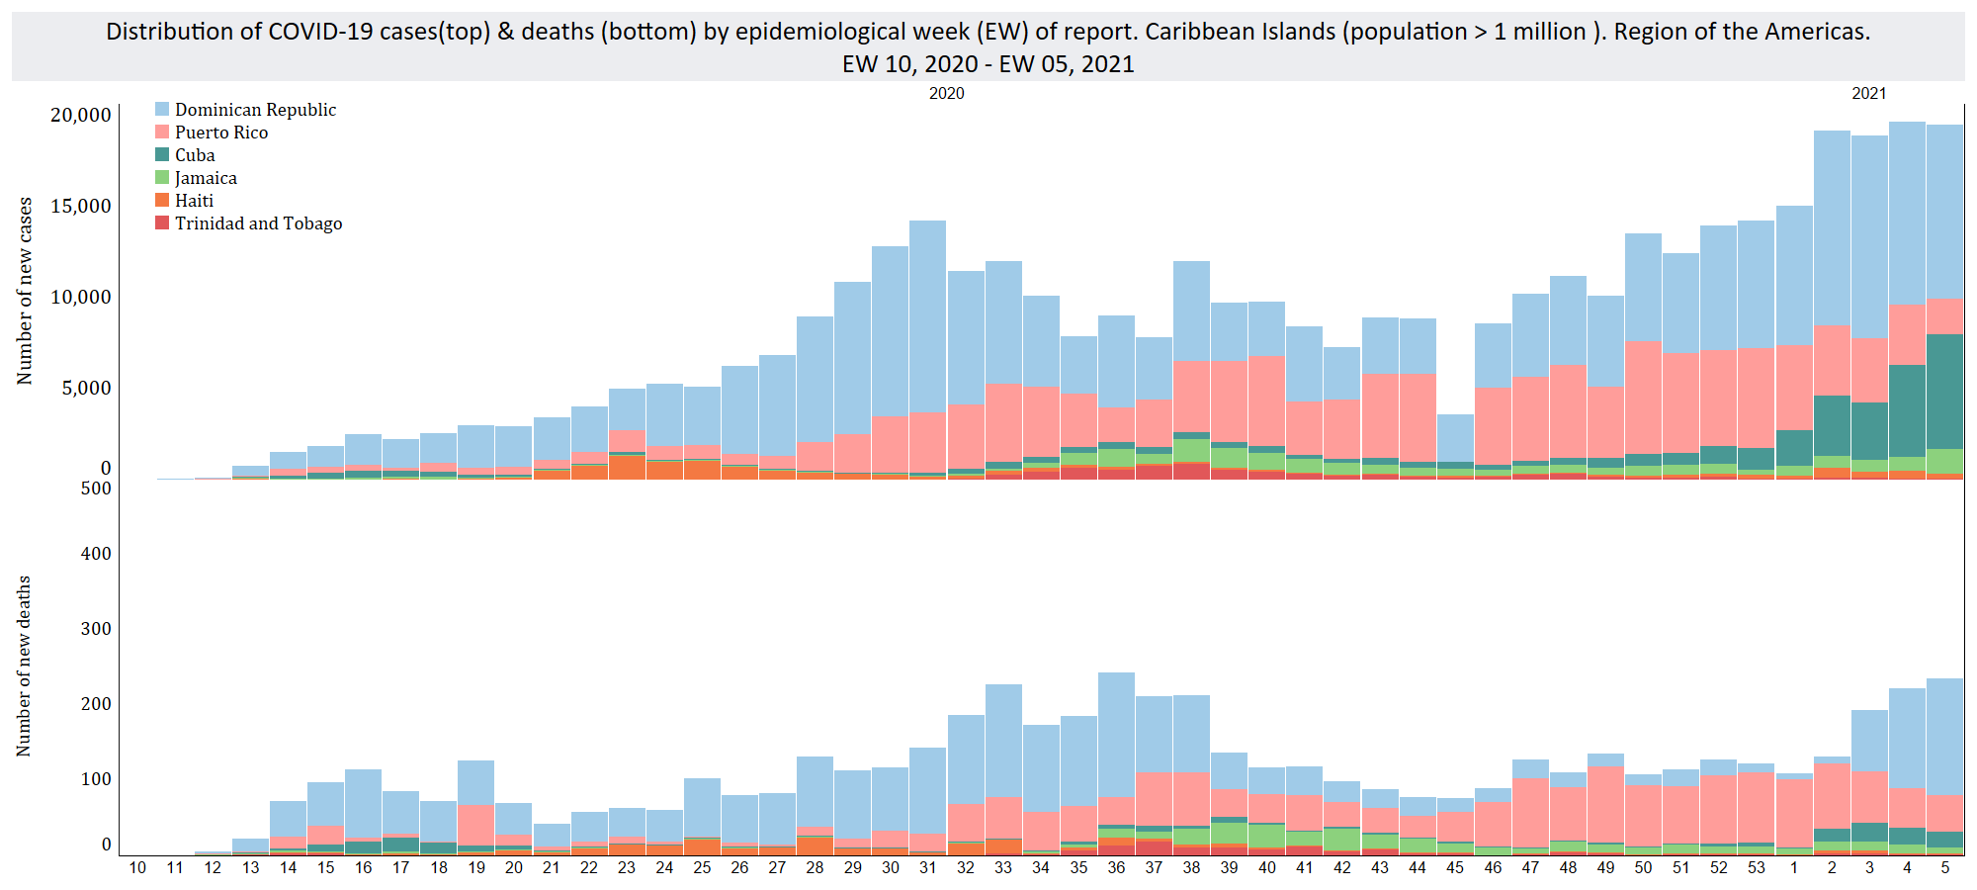
Epidemiological Week of report
Notes:
In this subregion the weekly cases remain elevated, and the number of new deaths are increasing. This increase is driven mainly by the Dominican Republic which has been observing an acceleration in deaths since EW 3 of 2021. On the other hand, after weeks of reporting elevated weekly deaths , Puerto observed a decline starting EW of 2021.

Slide 6
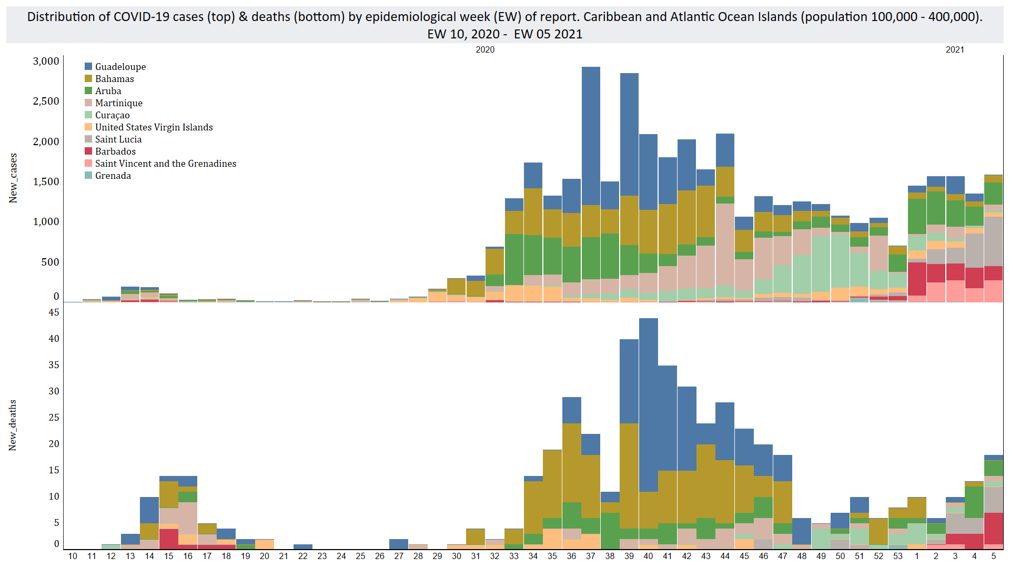
Epidemiological Week of report
Notes:
In the Caribbean and Atlantic Ocean Islands of less than 400,000 population, Aruba, Barbados , St Lucia and St Vincent and the grenadines continue to lead the case increase. Aruba, Barbados and Saint Lucia have also reported an increasing trend in weekly deaths in the past 3 weeks. According to information received from the IHR NFPs, Aruba has been reporting an increase in cases detected with the variant first identified in the UK – VOC 202012/01.

Slide 7
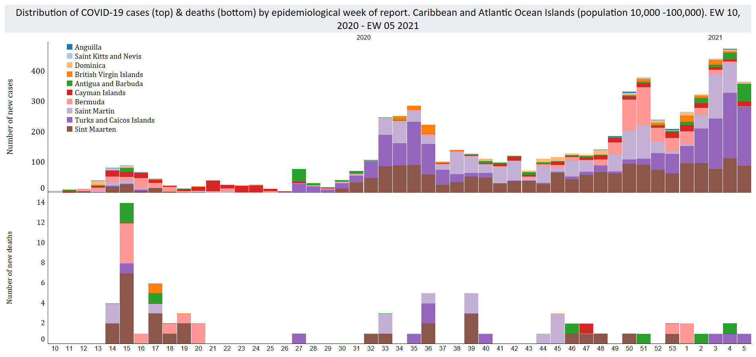
Epidemiological Week of report
Notes:
In this subregion – Turks and Caicos' increasing number of cases continues with Antigua and Barbuda also joining the trend for the past three weeks.

Slide 8
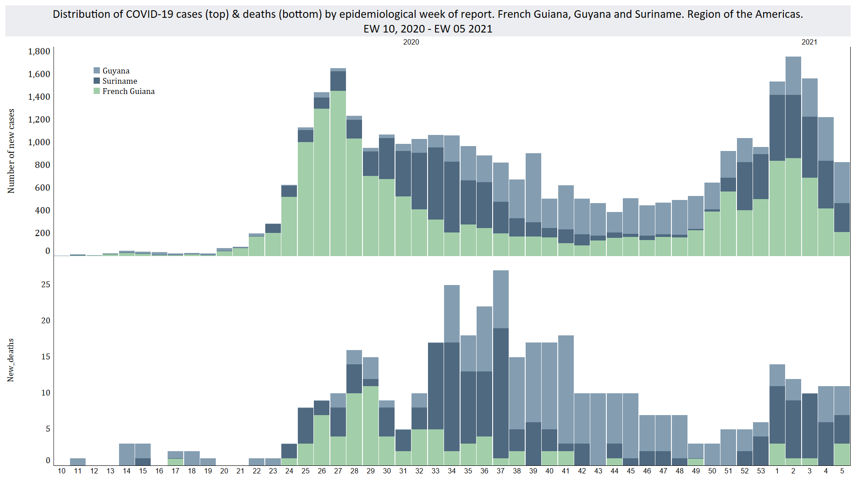
Epidemiological Week of report
Notes:
In the Guyanese shield, the weekly number of cases appear to be on the decline, mainly driven by French Guiana. Cases in Guyana and Suriname continue at the elevated levels seen since the end of 2020. In Guyana the case notification rate between EW 42 and 50 of 2020 dropped to the lowest levels seen in the pandemic – followed 2 weeks later by a sustained increase in deaths starting EW 52 of 2020 up to EW 5 of 2021.

Slide 9
Barbados
February 14, 2021

Slide 10
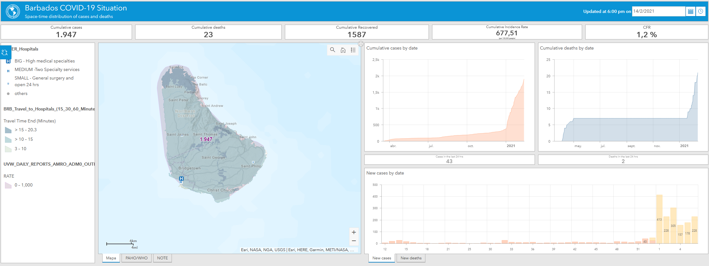
Overview of Barbados COVID-19 situation

Slide 11
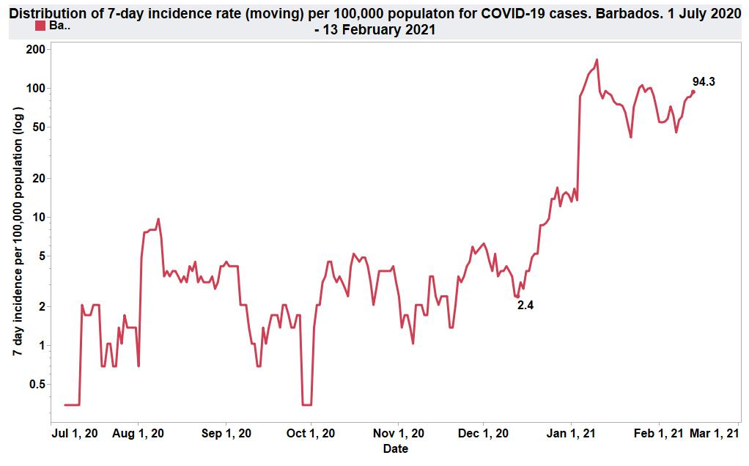
94.3
2.4

Slide 12
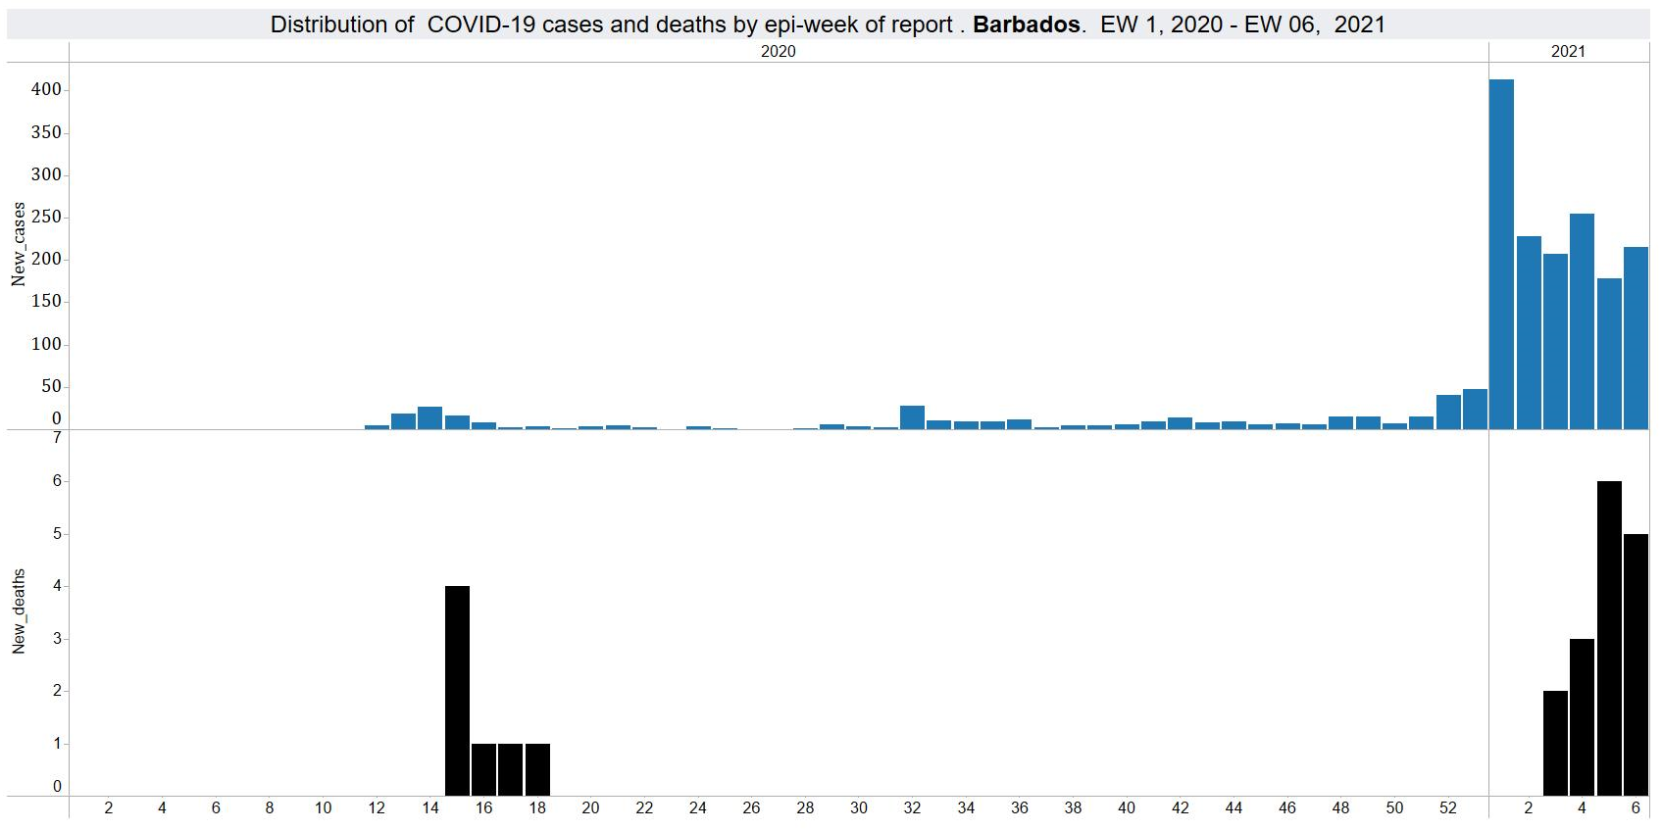

Slide 13
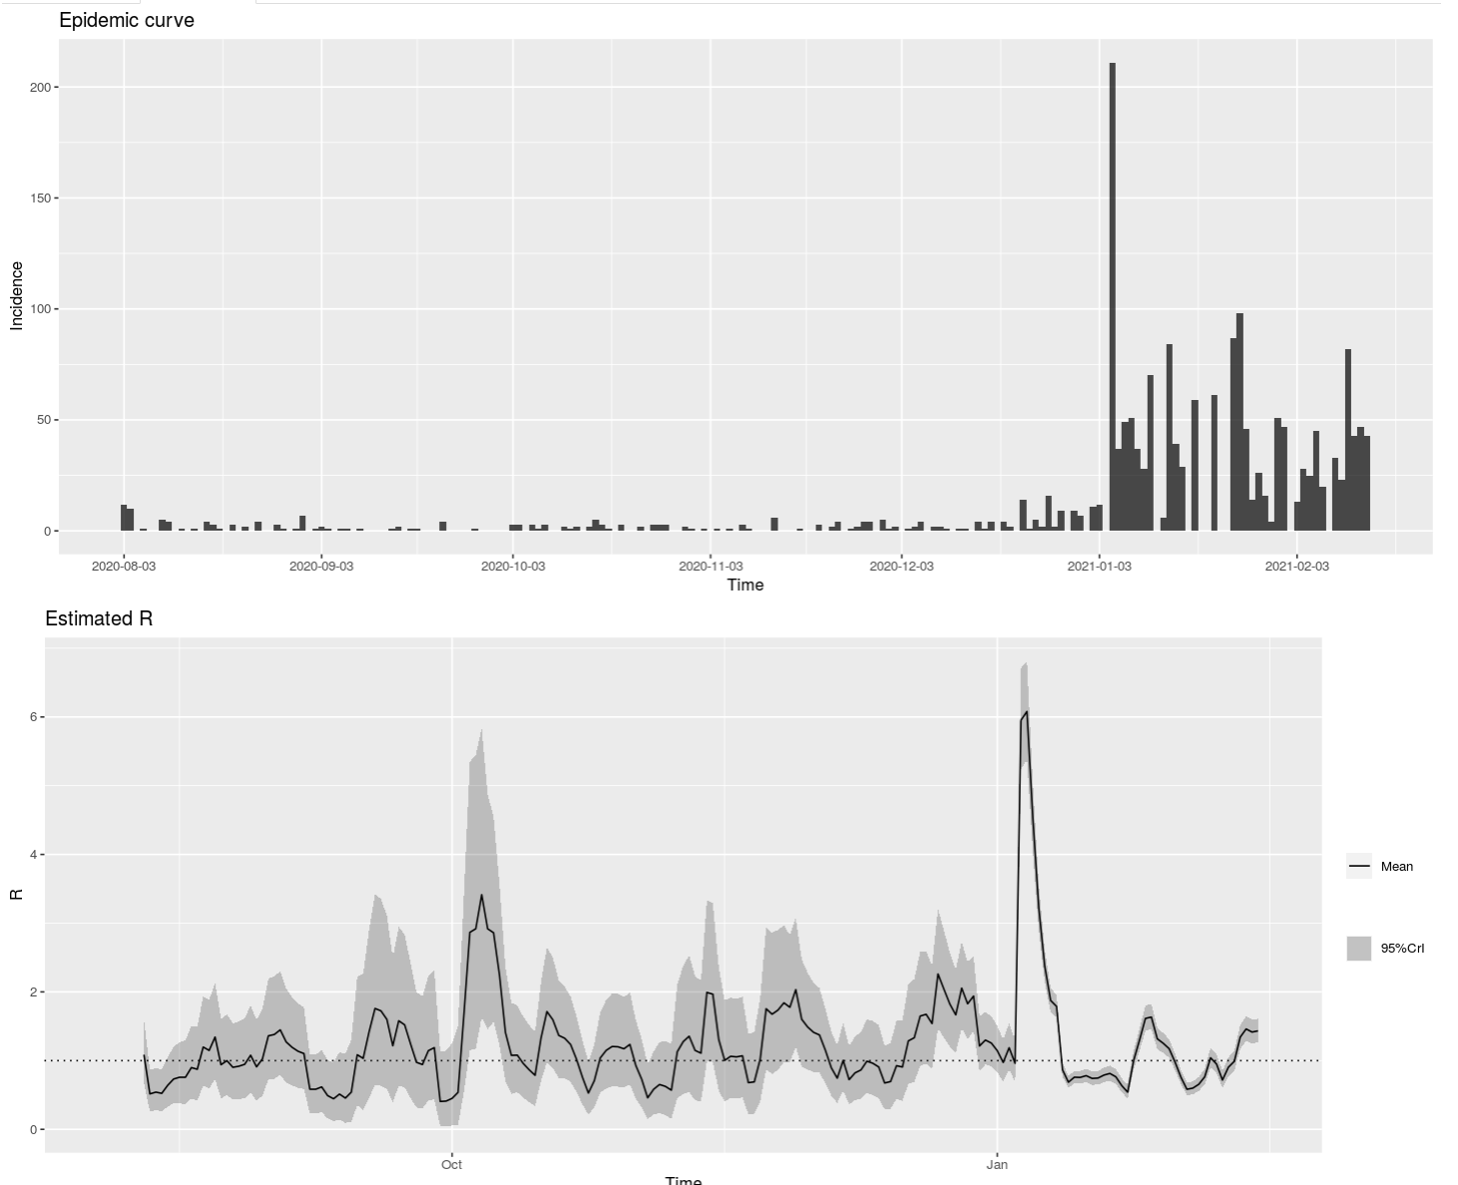
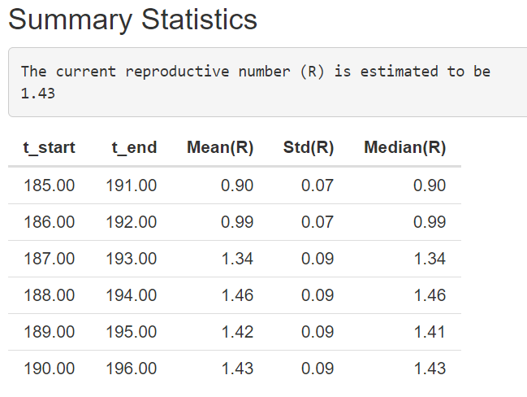
Rt
1.43

Slide 14
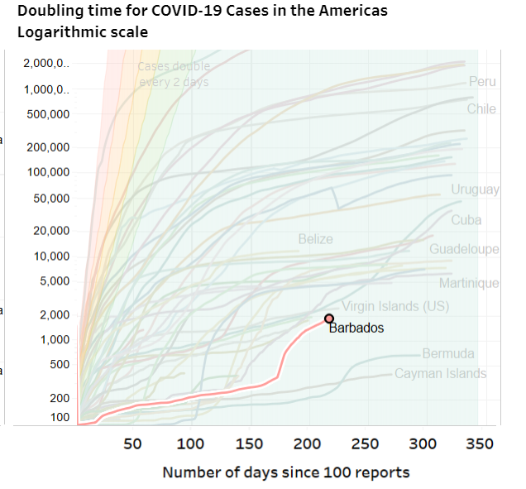

Slide 15
Saint Lucia
February 15, 2021

Slide 16
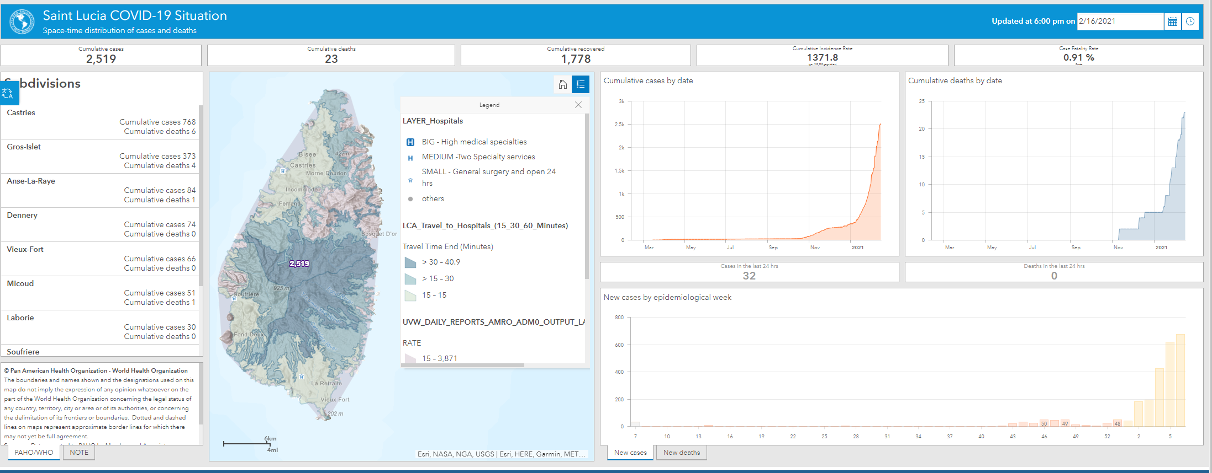
Overview of Saint Lucia COVID-19 situation
https://paho-covid19-response-who.hub.arcgis.com/pages/paho-saint-lucia-covid-19-response

Slide 17
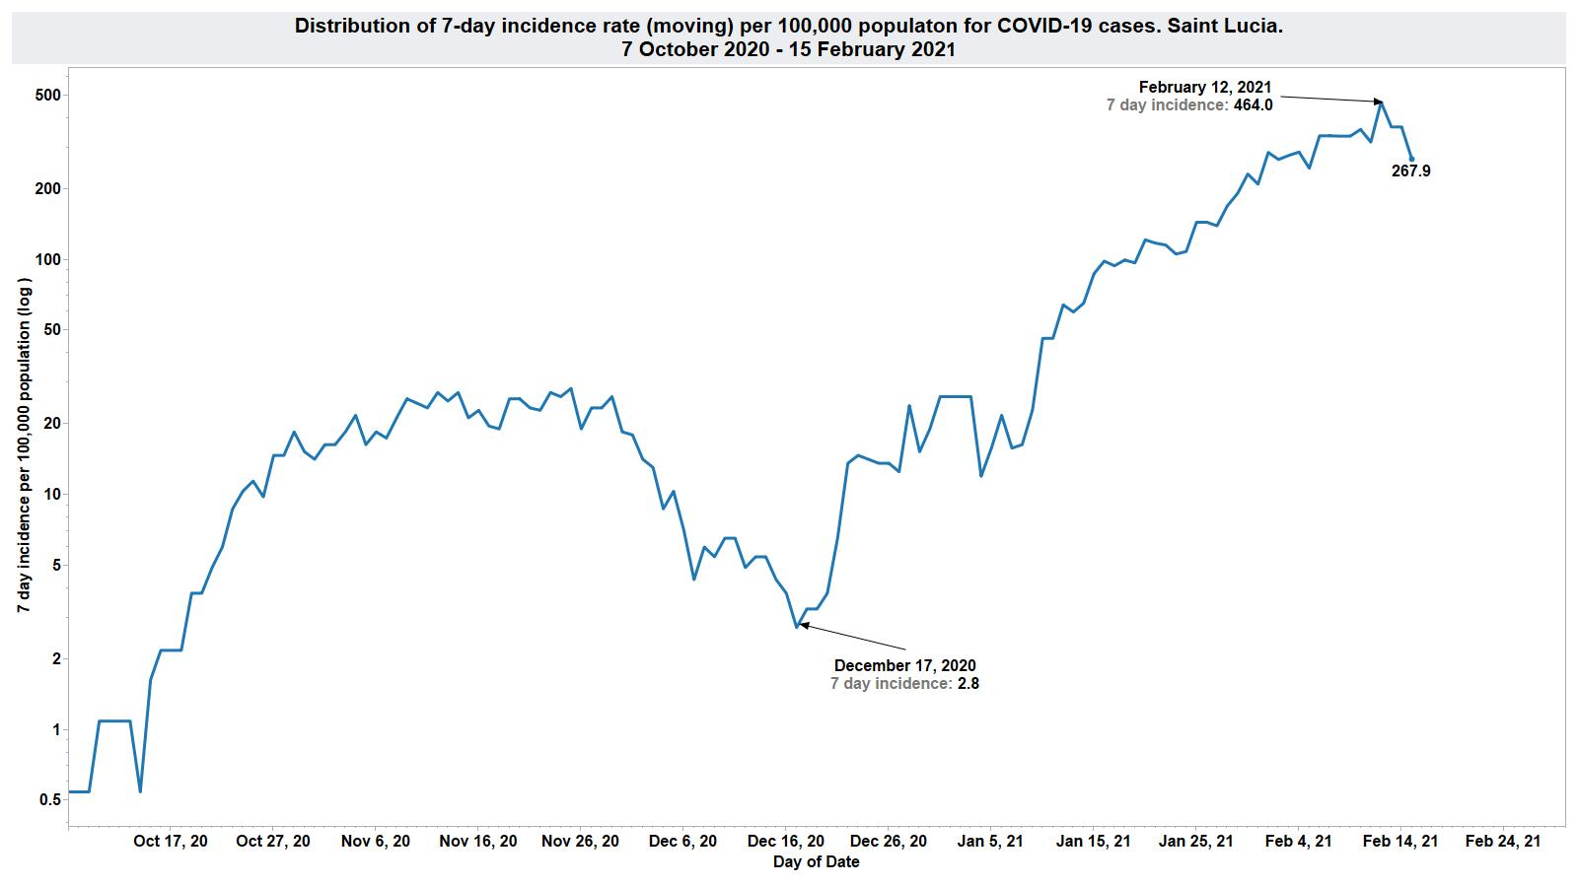
267.9
2.8

Slide 18
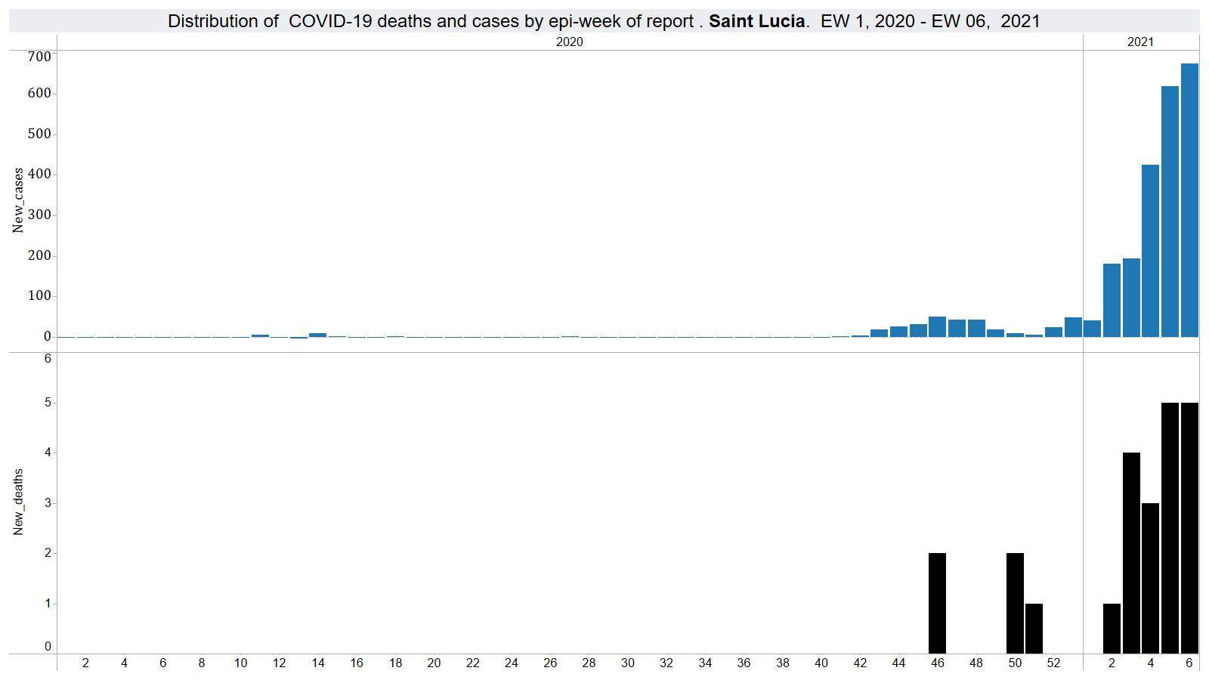

Slide 19
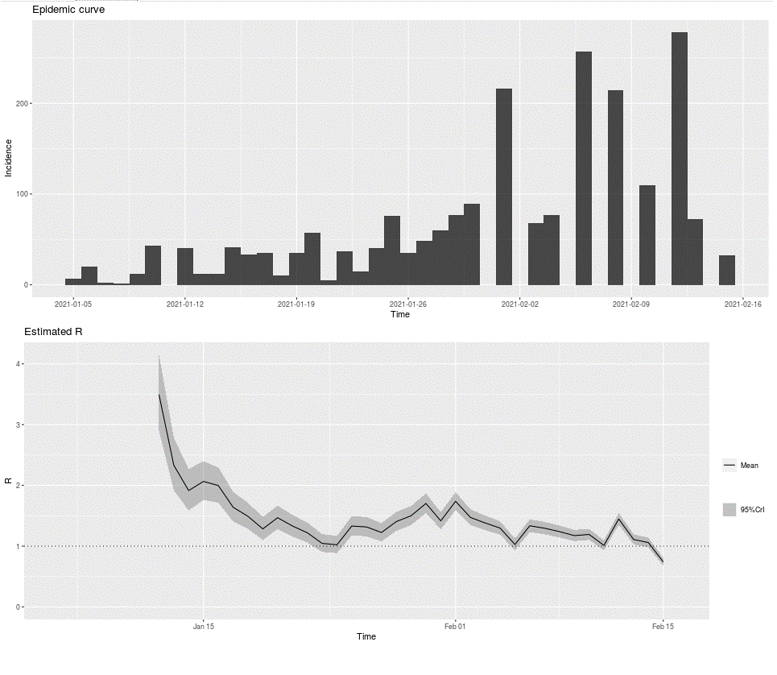
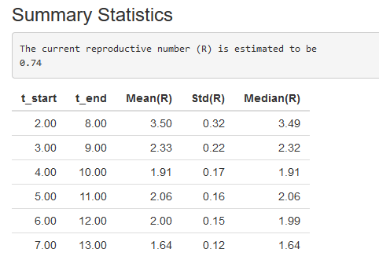
Rt
1.64

Slide 20
Saint Vincent and the Grenadines
February 15, 2021

Slide 21
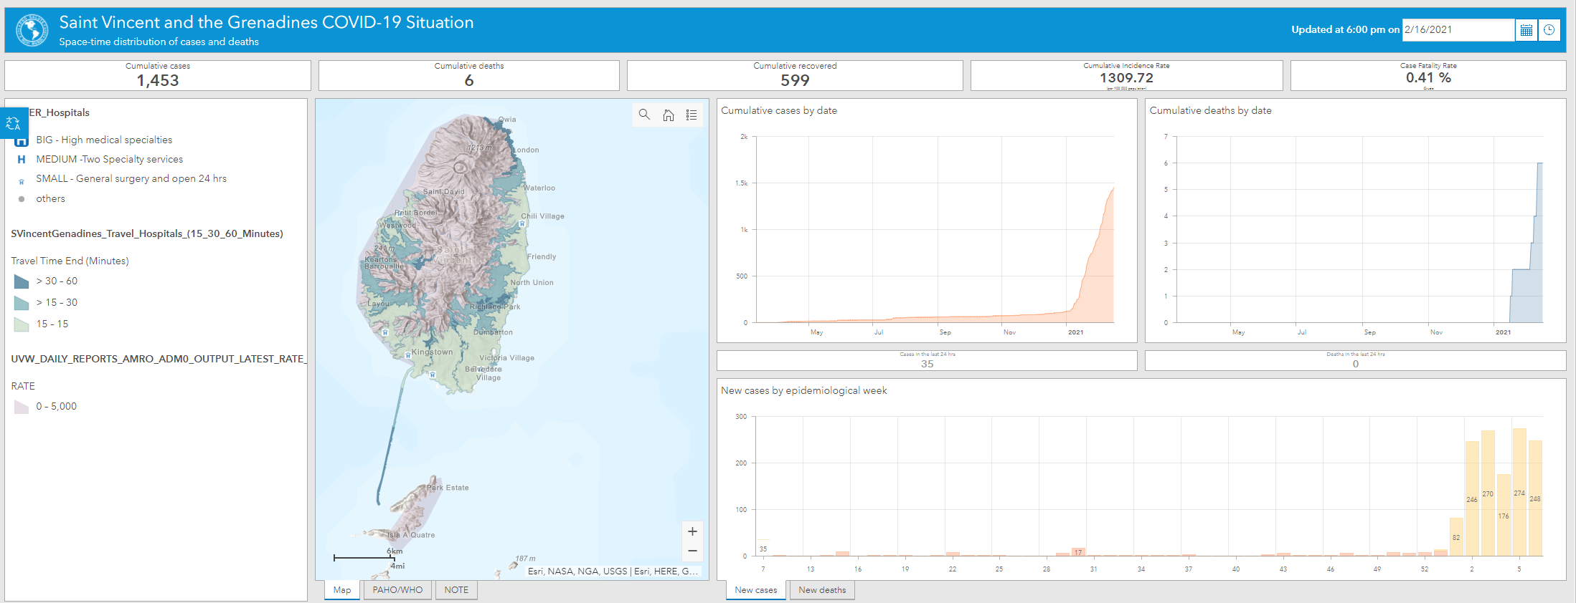
Overview of Saint Vincent and the Grenadines COVID-19 situation
https://paho-covid19-response-who.hub.arcgis.com/pages/paho-saint-vincent-and-the-grenadines-covid-19-response

Slide 22
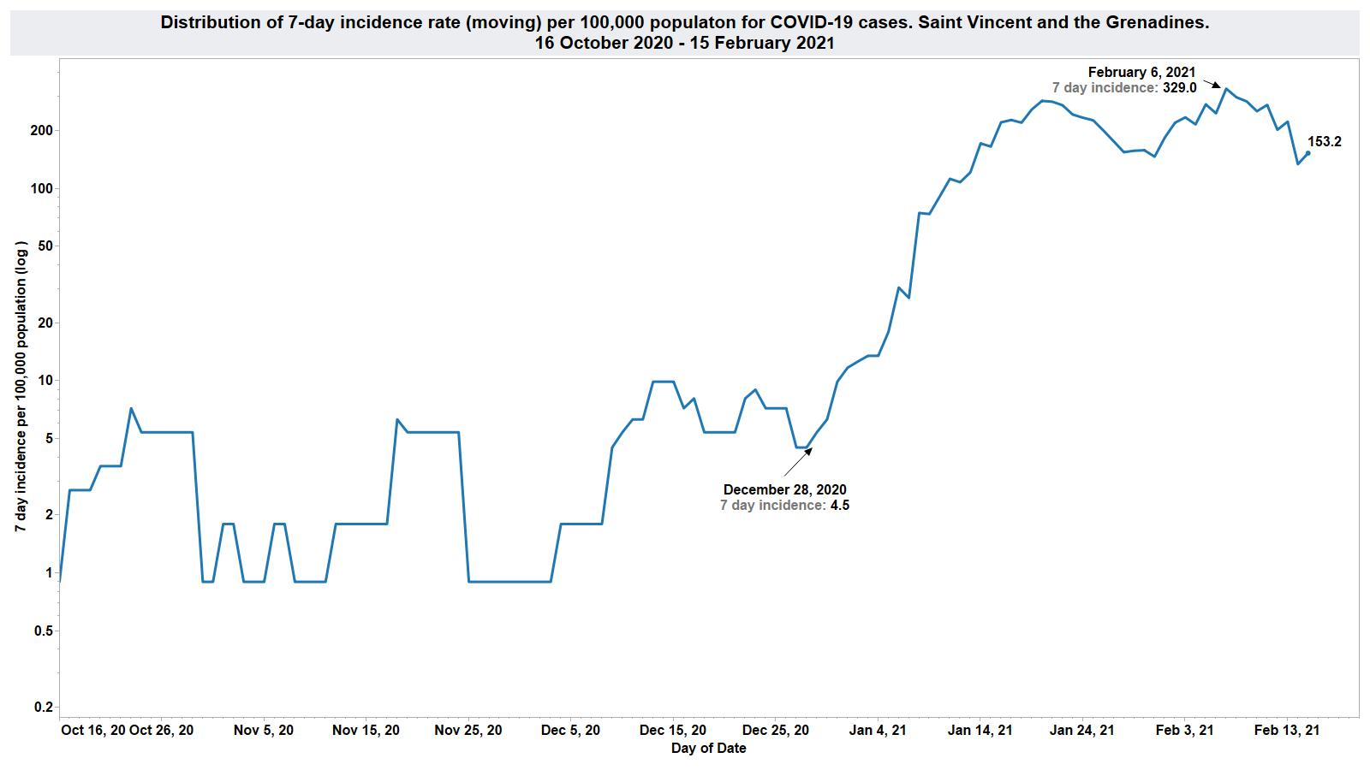
153.2
4.6

Slide 23
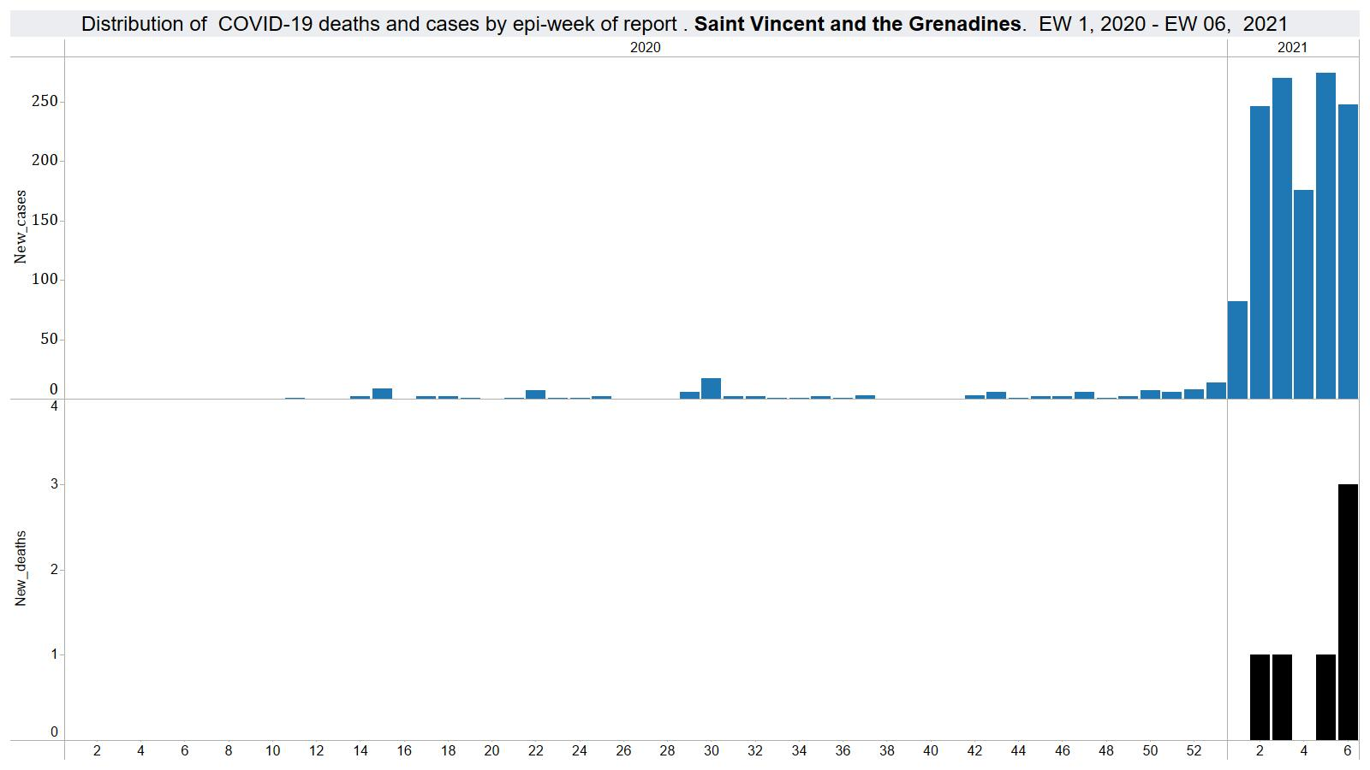

Slide 24
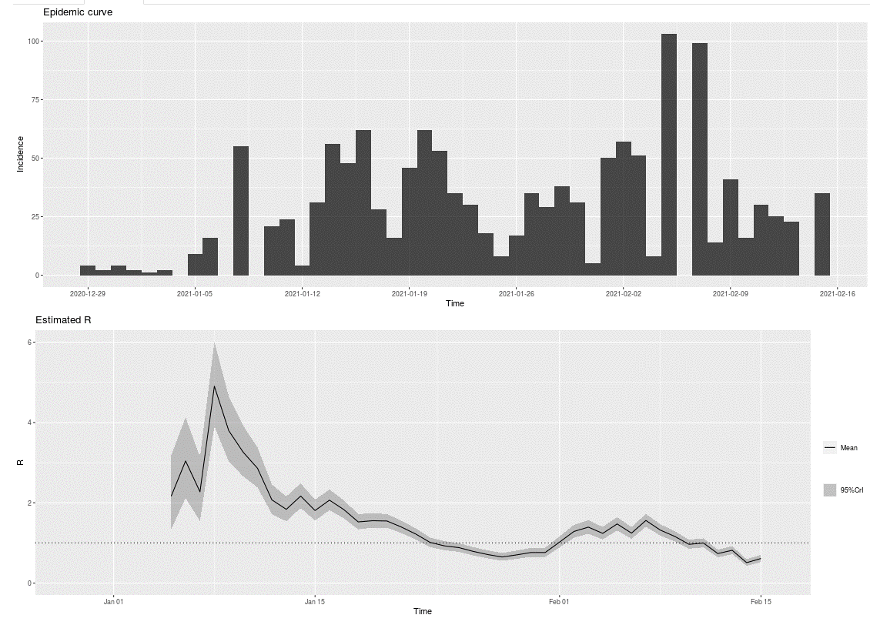
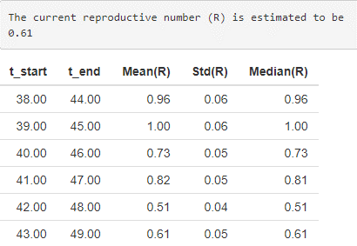
Rt
0.61

Slide 25
Antigua and Barbuda
February 15, 2021

Slide 26
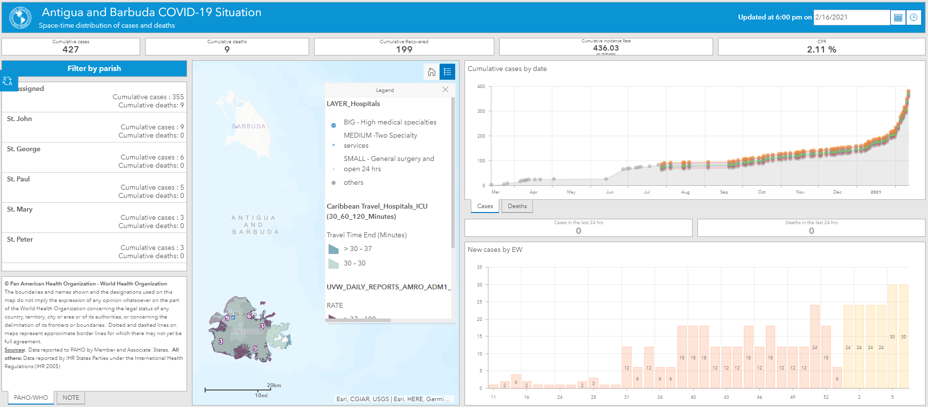
Overview of Antigua and Barbuda COVID-19 situation
https://paho-covid19-response-who.hub.arcgis.com/pages/paho-antigua-and-barbuda-covid-19-response

Slide 27
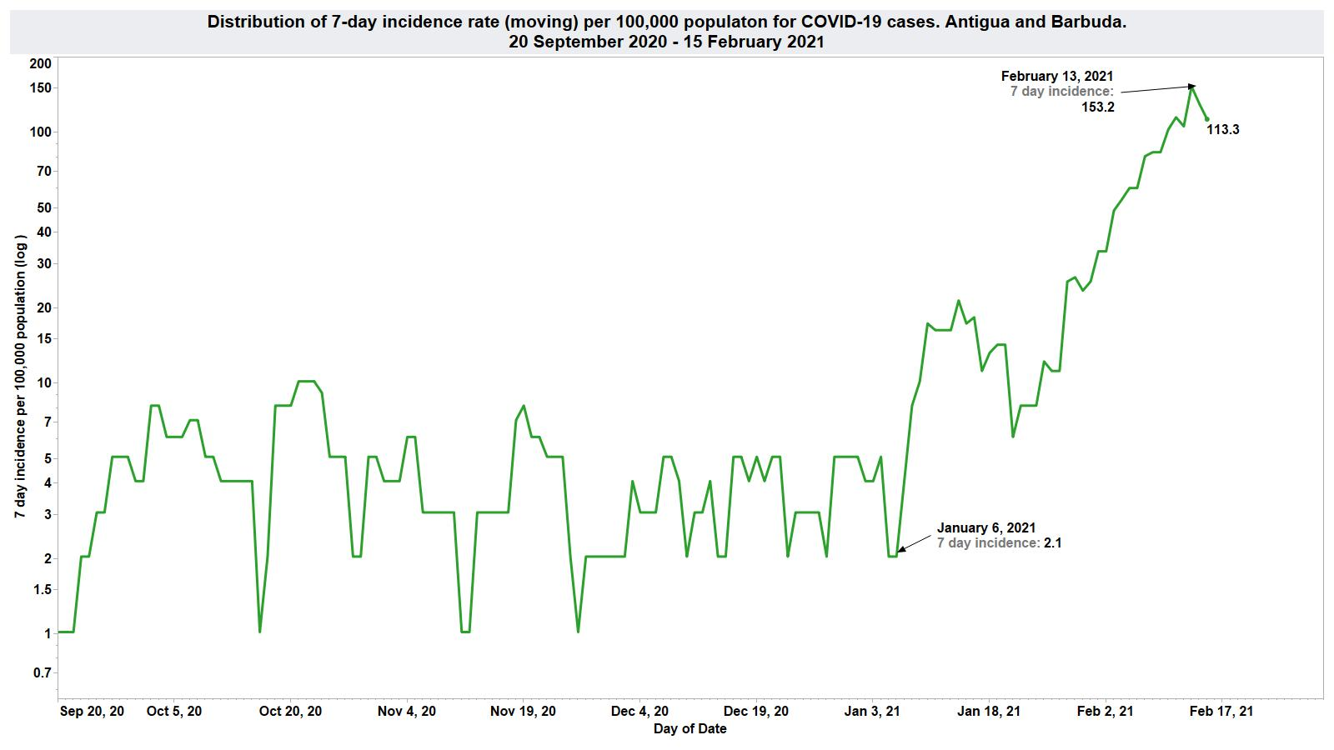
113.3
2.1

Slide 28
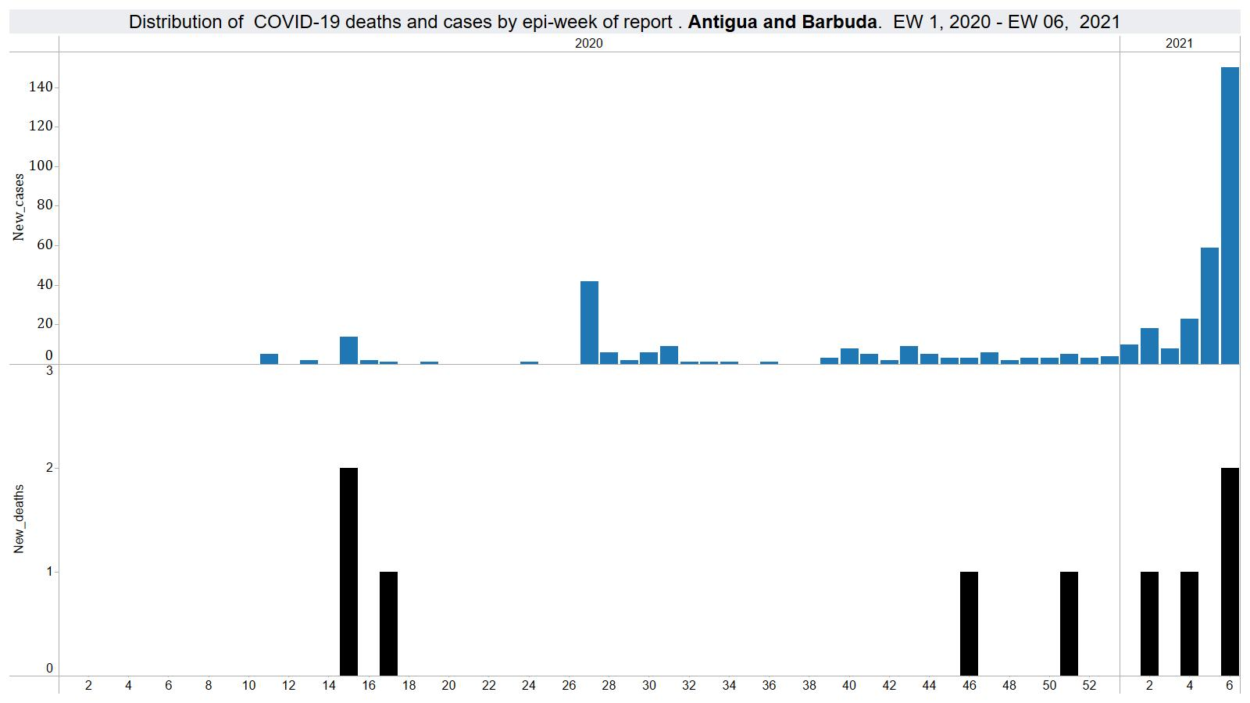

Slide 29
Grenada
February 15, 2021

Slide 30
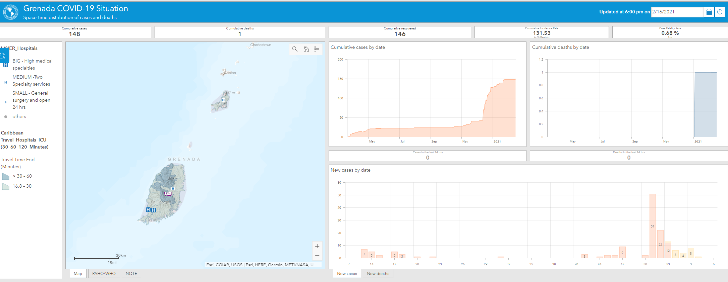
Overview of Grenada COVID-19 situation
https://paho-covid19-response-who.hub.arcgis.com/pages/paho-grenada-covid-19-response

Slide 31
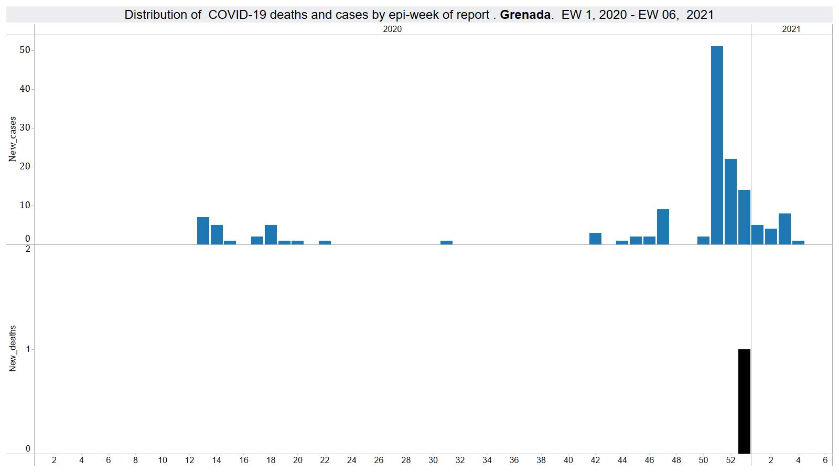
Total cases – 148
Total deaths – 1
Last case reported 24 January 2021

Slide 32
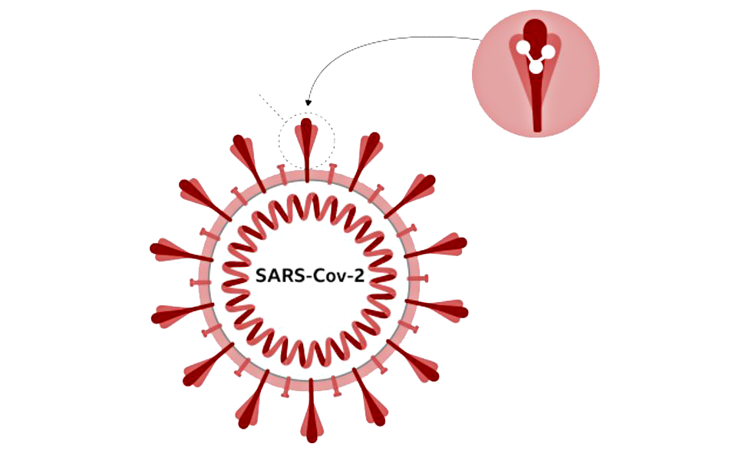
All viruses change over time
It is normal for viruses to evolve over time through mutations, as a consequence the emergence of new variants is to be expected
  Mutation refers to the actual change in the virus genetic sequence
  A changed virus is called a variant of the original virus. Variants can differ by one mutation or many
  Mutations may result in the virus being more transmissible, increase disease severity or influence efficacy of diagnostics, therapeutics or vaccines
  When these variants increase the risk to human health they are considered to be variants of concern
When there are many infections in a population the likelihood of the virus mutating increases
Spikes, used by the virus to attach to human cells
Changes to the spike protein can result in changes in virus transmissibility or disease severity

Slide 35
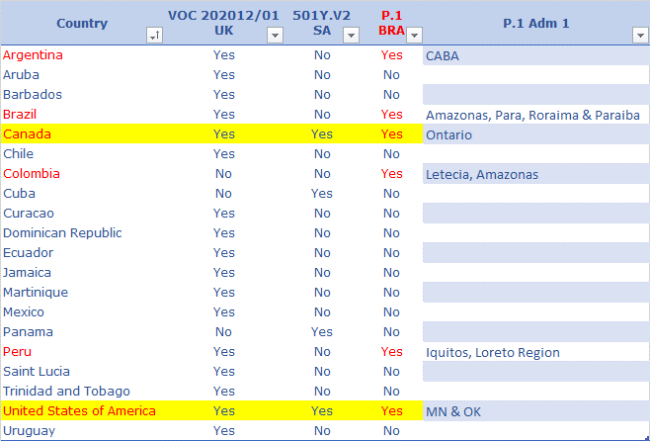
Distribution of the SARS-COV-2 variants of concern in the Region of the Americas
Notes:
As of 11 February, 20 countries and territories in the region of the Americas have reported at least one of the three SARS-CoV-2 variants of concern (VOC) currently circulating globally – VOC 20212/01; 501Y.V2 and P1. The VOC 202012/01 (UK variant) is the most identified variant in our region with 17 having detected the variant. Besides United States and Canada which identified all three variants, Panama and Cuba are the only other countries in our region to have detected the South African variant – and that is the only variant detected in either of the two countries.
Of the three VOCs, P.1 was initially identified in a group of travelers from Brazil to Japan, and in Amazonas State, Brazil, where recent data shows that the proportion of cases with P.1 among tested samples in Manaus City increased from 52% in December 2020 to 85% in January 2021. Since then, the variant has been detected in 5 other countries in the region of the Americas and at least 7 other countries – mostly in Europe.

Slide 36
SARS-CoV-2 variants & re-infection
Changes in the virus genomic sequence, called mutations, can make prior immunity less effective (e.g. as with the influenza virus)
Recently, several SARS-CoV-2 variants have emerged that involve genetic mutations of the spike protein
Studies are ongoing to investigate if some of these variants can evade the immune response to a previous SARS-CoV-2 infection and make people more vulnerable to re-infection
In lab experiments, one of the mutations present in the variants identified in South Africa and Brazil has helped the virus evade antibodies generated after an initial infection
In Brazil, studies are ongoing to determine if a new variant called P.1 may lead to more cases of re-infection
https://www.who.int/docs/default-source/coronaviruse/risk-comms-updates/update47-sars-cov-2-variants.pdf?sfvrsn=f2180835_4
https://elifesciences.org/articles/61312#content
https://www.thelancet.com/journals/lancet/article/PIIS0140-6736(21)00183-5/fulltext?s=08

Slide 37

Re-infection of SARS-CoV-2
Generally, a person who recovered from a viral infection is protected against a new infection
It is not yet known how long protection will last after a SARS-CoV-2 infection
To date, re-infection with SARS-CoV-2 seems rare but several cases of repeat SARS-CoV-2 infection have been reported
Preliminary results from the SARS-CoV-2 Immunity and Reinfection Evaluation (SIREN) study conclude that past SARS-CoV-2 infection reduces the risk of re-infection by 83% for at least 5 months and that fewer than 1% of 6,600 study participants who had COVID-19 were re-infected
https://www.thelancet.com/journals/laninf/article/PIIS1473-3099(20)30783-0/fulltext
https://www.thelancet.com/journals/laninf/article/PIIS1473-3099(20)30764-7/fulltext
https://www.medrxiv.org/content/10.1101/2021.01.13.21249642v1

Slide 38
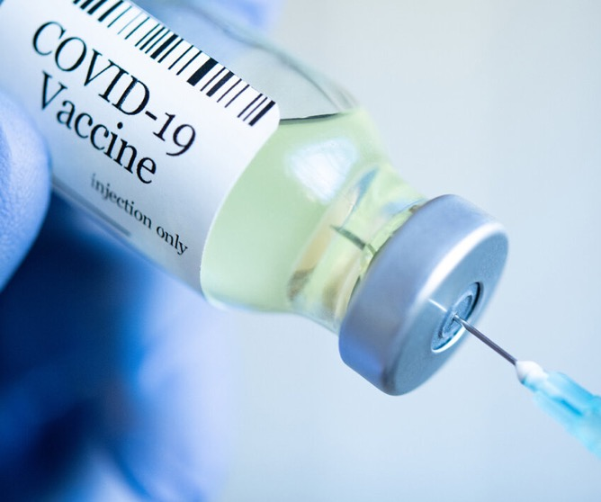
SARS-CoV-2 variants & COVID-19 vaccines
Current variants involve mutations to the gene for the spike protein that is targeted by COVID-19 vaccines
Several COVID-19 vaccines have reported reduced efficacy to protect against mild to moderate disease in people infected with SARS-CoV-2 variants, however the vaccines are still expected to protect against severe disease and death
Studies are ongoing to examine if some vaccines may be more susceptible to effects of the variants than others
  those using smaller epitopes (the receptor binding domain on the spike protein) may be more susceptible than those using a larger part of the virus such as the spike protein or the whole inactivated virus
https://www.who.int/publications/m/item/draft-landscape-of-covid-19-candidate-vaccines

Slide 39

COVID-19 Vaccine and SARS-CoV2 variants
Data are limited, early, and incomplete
Availability of Evidence (10 Feb 2021)
 | B 1.1.7 (original report SSA) |  | B 1.351 (original report AZ) |  | P 1 (original report Brazil)
 | Clinical | Lab | Clinical | Lab | Clinical | Lab
AstraZeneca |  | pending | limited |  | pending | pending
J & J |  |  | prelim | pending
Moderna
Novavax | prelim |  | prelim | pending
Pfizer
Sinopharm |  |  |  | pending
Evidence on protection against severe disease, hospitalization and deaths are especially limited

Slide 40








Performance against B.1.351 (variant first identified in South Africa)
Pre-Read Only
PRELIMINARY
Reduction of neutralizing activity in laboratory assays | Clinical efficacy in South Africa | Clinical efficacy in global studies | Clinical efficacy criteria
3x | - | 95% | -
6x | - | 94.1% | -
2.5-31x / eliminated³ | 22% (NS)² | 62-90% | Mild & moderate
- | - | 91.6% | -
pending | 57% | 72% | Moderate to severe
pending | 49%¹ 60%² | 89% | Mild, moderate & severe
1.6x | - | 79 - 86% | -
- | - | 50.4% | -
Sinopharm
Including HIV positive subjects (6% of the study population); 2. Excluding HIV positive subjects; 3. previously infected placebo participants showed similar results
Sources South Africa:: J&J; Novavax; Moderna; Pfizer 1 & Pfizer 2; AstraZeneca/Oxford; Sinopharm Sources global: 1. The Lancet on AZ/Oxford, The Lancet on Sputnik V, Bloomberg on Sinovac, Bloomberg on Sinopharm, Novavax website, J&J website

Slide 41
Variants are concerning and demonstrate the importance of collective action
Suppressing the virus through existing public health measures, as well as scaling up vaccine manufacturing and rolling out the vaccine as quickly as possible will be critical.
Coordinated action on strain surveillance, collaboration among vaccine development, research and vaccine manufactures along with access to vaccines by all countries are essential for getting ahead of the virus.

Slide 42





COVID-19 protective measures
Protect yourself & others
Keep your distance
Wash your hands frequently
Cough & sneeze into your elbow
Ventilate or open windows
Wear a mask

Slide 43
Progress on execution of COVID-19 SPRP

Slide 44
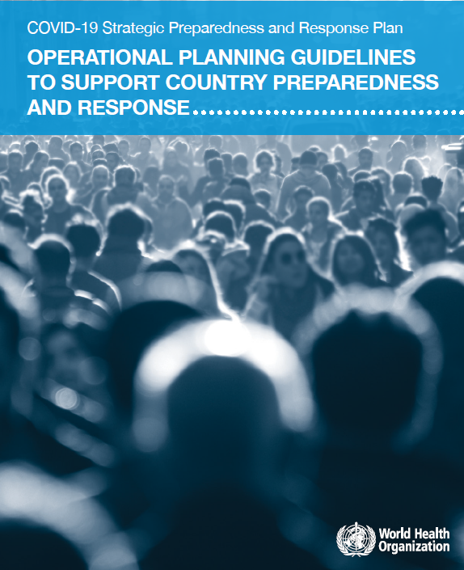
Progress on the execution of SPRP for COVID-19

Slide 45
Pillars
1 Country‑level coordination, planning and monitoring;
2 Risk communication and community engagement;
3 Surveillance, rapid-response teams, and case investigation;
4 Points of entry, international travel and transport;
5 National laboratories;
6 Infection prevention and control;
7 Case management;
8 Operational support and logistics;
9 Maintaining essential health services and systems.

Slide 46
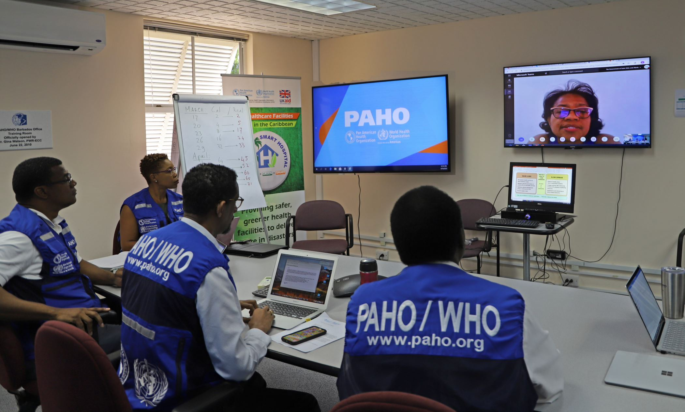
Pillar 1
IMST daily meetings and virtual meetings with countries
Development of proposals for resource mobilization to assist countries in preparedness and response
WHO Partners Platform
UN Multisectoral Response Plan (MRP) and funding appeal
Consultations for development of country SPRPs (July – Dec 2020)

Slide 47
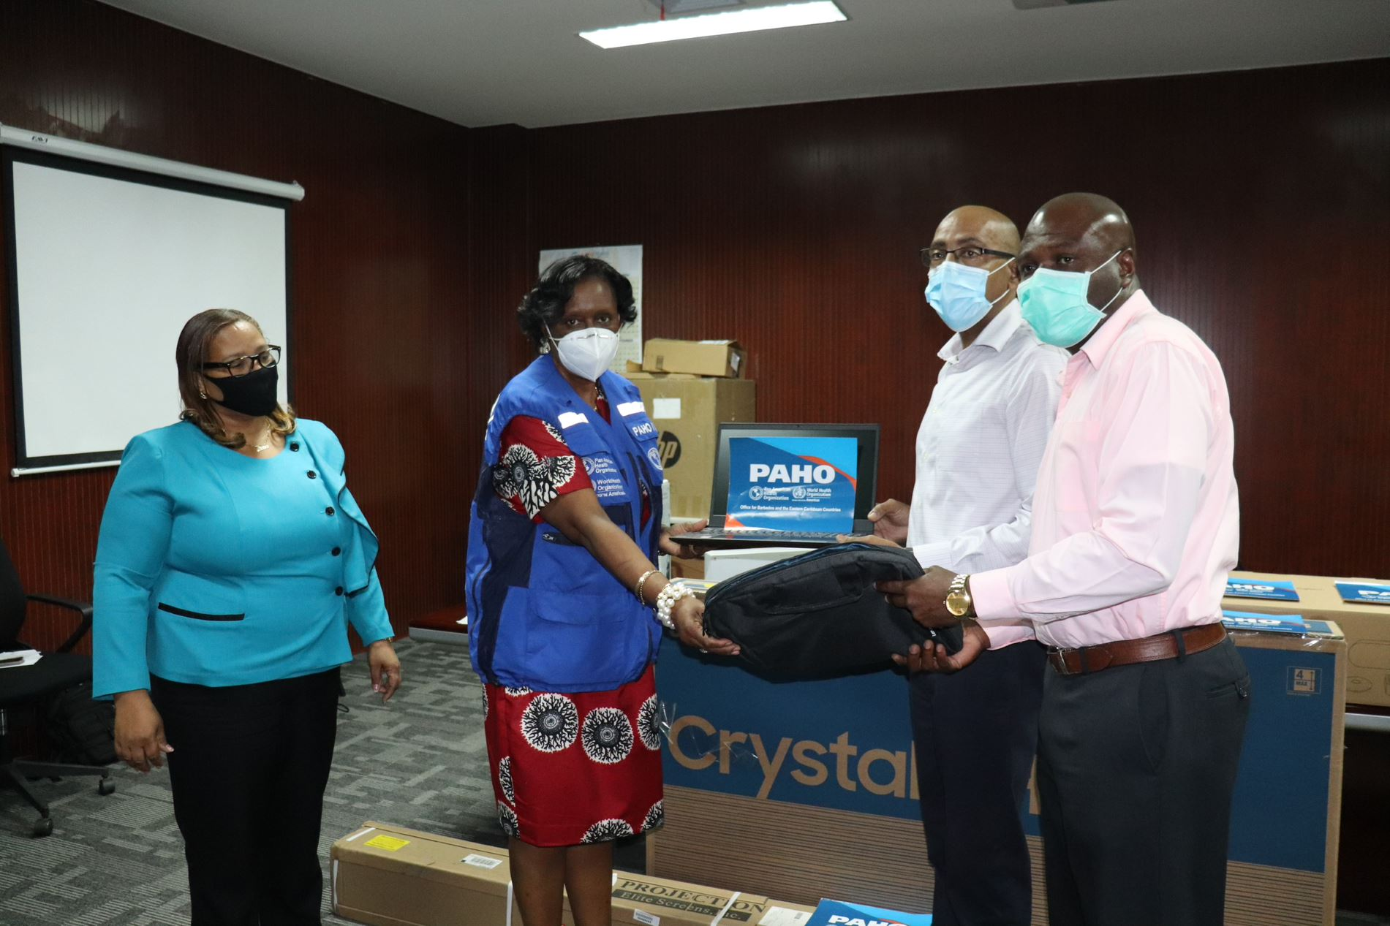
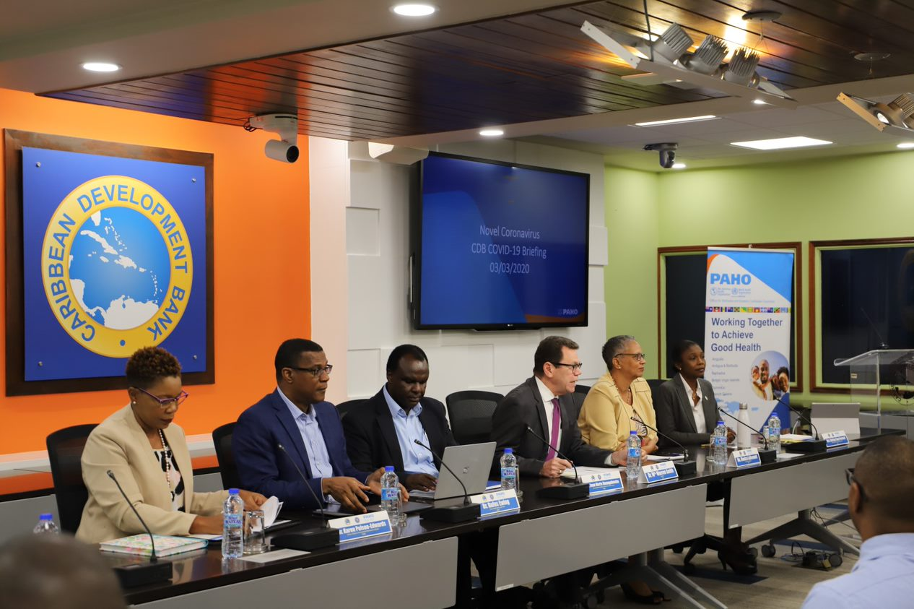
Pillar 2
Pillar 2
Produced and disseminated videos, posters, social media cards
Procured equipment for strengthening Health Promotion Units (ATG, DMA, GRD, LCA)
Engaged partners from various communities
Conducted several thematic webinars:
  Scaling up COVID-19 Testing in the Eastern Caribbean and UKOTs​
  Reopening of Borders​
  NCDs, Maternal and Child Health, Gender Based Violence and Men’s Health
  Dengue in midst of COVID-19 response

Slide 48
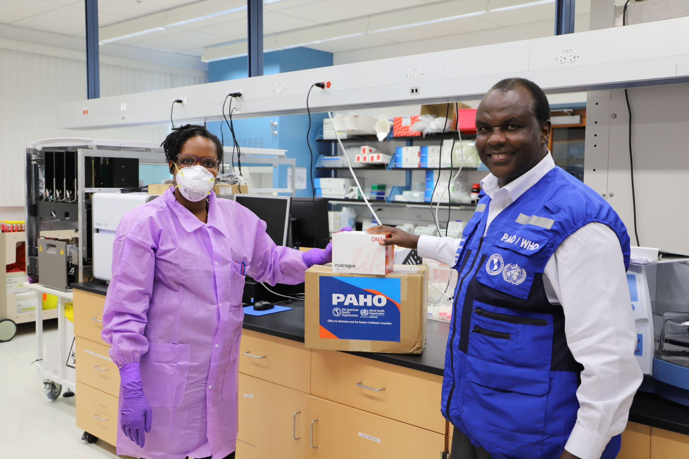
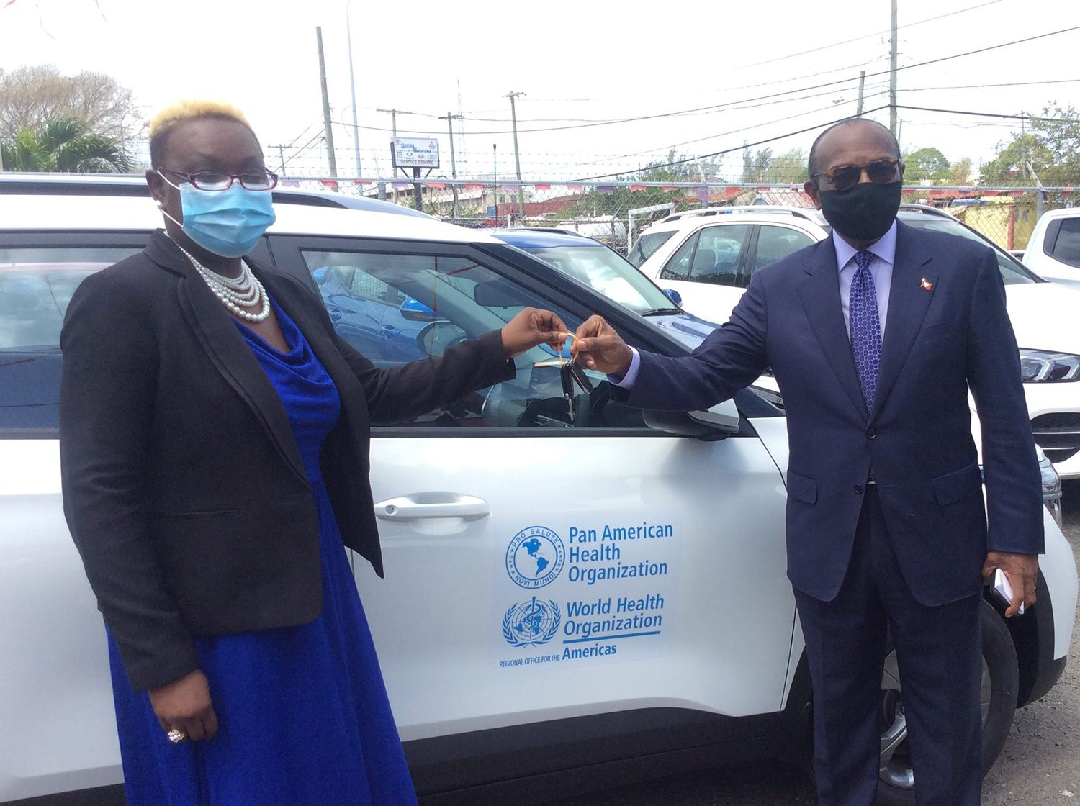
COVID-19 Support to Countries​
Pillars 3 & 4
Support to strengthen surveillance and in communities and at POEs:
Hiring of Surveillance Officers (DMA, GRD, KNA), IT personnel (KNA)
Purchase of thermal imagers (DMA)
Vehicles (ATG, BRB, DMA, KNA)
IT equipment - Computers​, tablets, printers
Pillar 5
  Strengthened laboratory capacity
  Laboratory Equipment and Supplies: PCR Machines, extraction kits, GenXpert cartridges (1,320); swabs​ (265,150)

Slide 49
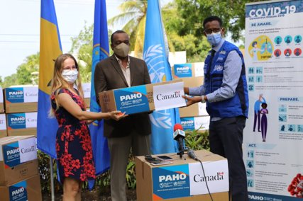
COVID-19 Support to Countries
(Pillars 6&7)
PPEs |  | Medical Equipment & Supplies
Items | Quantities | Items | Quantities
Surgical masks | 869,325 | Ventilators | 41
N95 masks | 284,108 | Oxygen Concentrators | 28
Gloves | 26,226 | Infusion Pumps | 20
Gowns | 203,642 | Vital Signs Monitors | 30
Face shields | 73,056 | Defibrillators | 4
Goggles | 26,226
Thermometers | 1,266

Slide 50
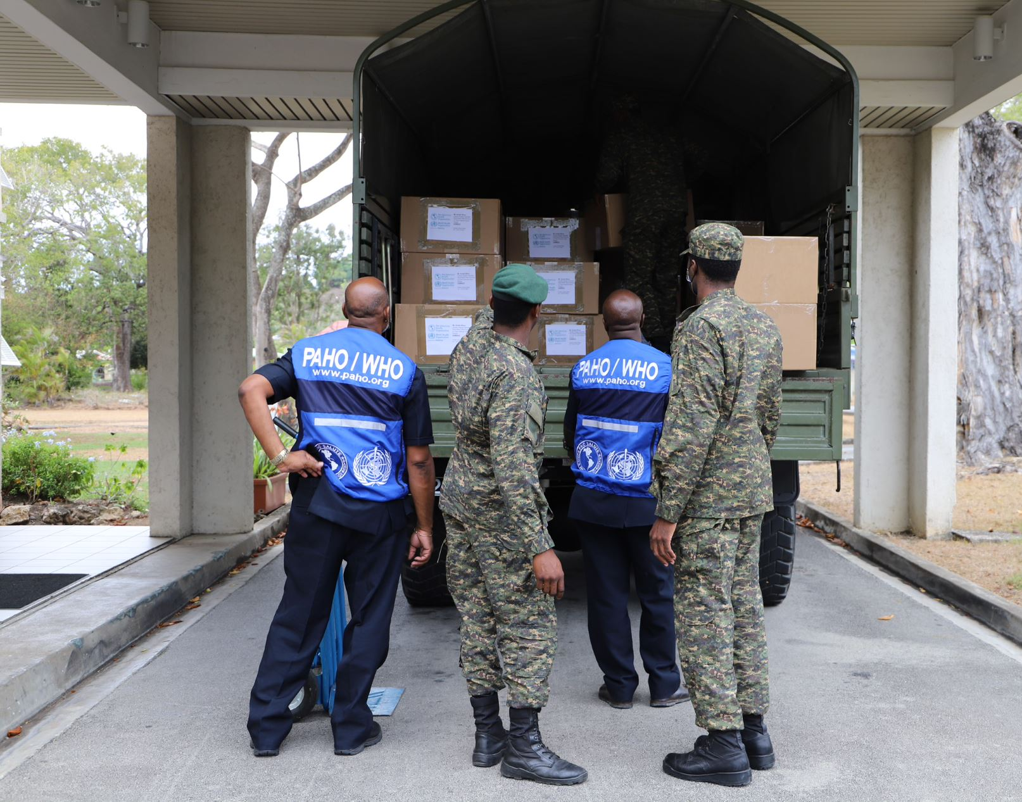
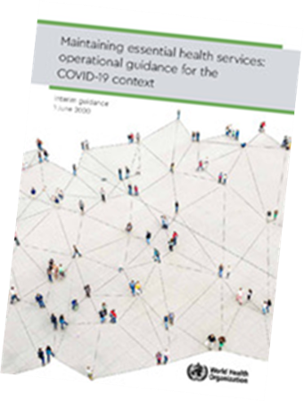
COVID-19 Support to Countries
Pillar 8
Operations and Logistics Support: Partnership with RSS
Pillar 9
Mental Health and Psychosocial Support
Supported countries in Dengue response:
  (ATG, BRB, GRD, KNA, LCA, VCT, VGB)
Preparing Health Systems for introduction of ​
COVID-19 vaccine​
​

Slide 51
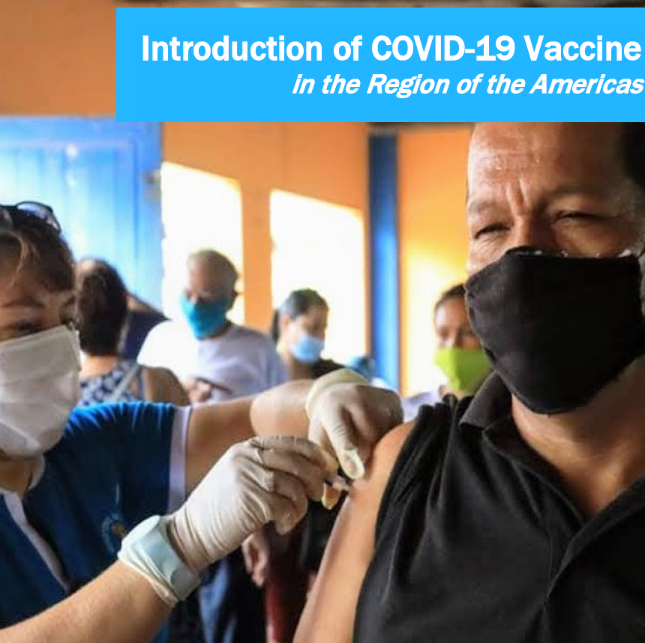
Beyond 2020....
Continued support in the response through the SPRP
Expansion to include 2 additional pillars:
  Pillar 10 – Strategy for the Introduction of Vaccines
  Pillar 11 – Research

Slide 52
Financial Implementation

Slide 53
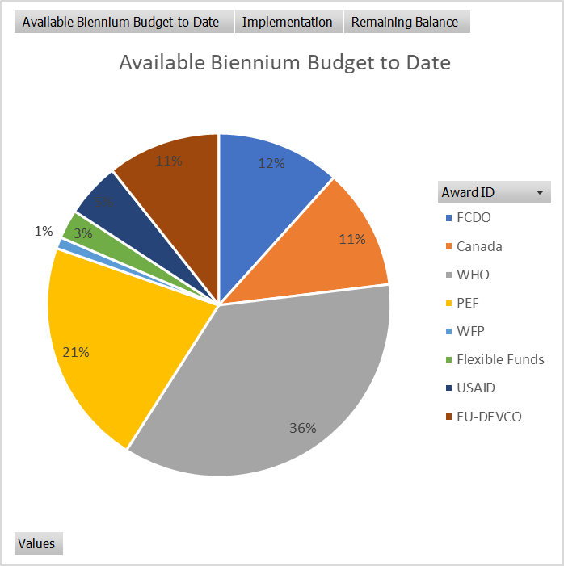
COVID-19 Resources mobilized to date – Barbados and the Eastern Caribbean Countries
By Donor
Donor | Funds Mobilized (US$)
FCDO | 1,040,973
Canada | 1,016,478
WHO* | 3,207,153
PEF | 1,904,762
WFP | 95,923
PAHO | 245,390
USAID | 460,000
EU-DEVCO | 949,301
Grand Total | 8,919,982
Fund Source | Pipeline
European Union: (AIA, MSR, VGB) | 750,000
Flexible Funds issued in 2021* | 370,000
Grand Total | 1,120,000

Slide 54
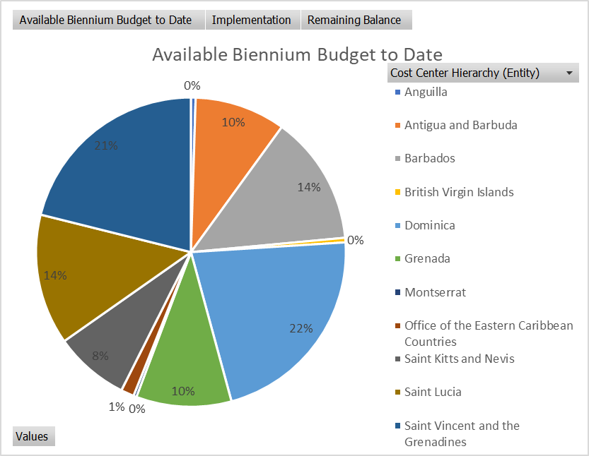
COVID-19 Resources mobilized to date – Barbados and the Eastern Caribbean Countries.
By Country
Country | Funds Mobilized
Anguilla | 43,873
Antigua and Barbuda | 846,817
Barbados | 1,206,458
British Virgin Islands | 42,754
Dominica | 1,943,600
Grenada | 887,445
Montserrat | 28,307
Office of the Eastern Caribbean Countries | 121,842
Saint Kitts and Nevis | 698,468
Saint Lucia | 1,218,535
Saint Vincent and the Grenadines | 1,881,880
Grand Total | 8,919,982.21

Slide 55
COVID-19 Resources mobilized to date – By Fund and Country/Territory

Slide 56
COVID-19 Resource Implementation by Donor
Countries with balances reflect funding which will expire during mid to late 2021

Slide 57
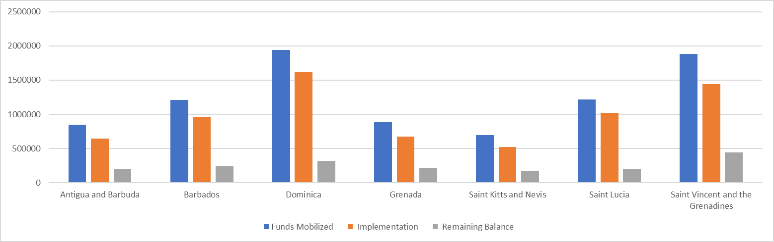
COVID-19 Resource Implementation
by Country
Funds Available in DMA and VCT include funding from PEF to the country
Overall Implementation rate 80%
Country implementation rate: 75-85%
Countries with balances reflect funding which will expire during mid to late 2021

Slide 58
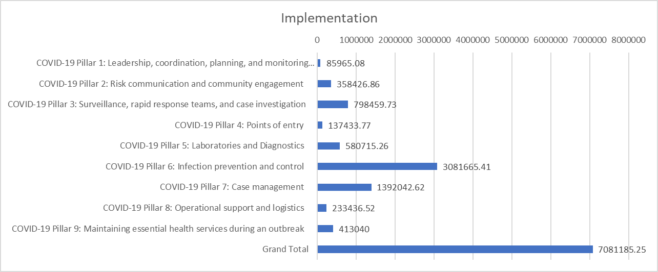
COVID-19 Resource Implementation
by SPRP Pillar

Slide 59
Funds Available for non-COVID related TC
2021
Country/Territory | Funds Available 2021
Anguilla | 68,759.79
Antigua and Barbuda | 367,257.33
Barbados | 568,842.75
British Virgin Islands | 103,545.00
Dominica | 439,327.61
French Departments in the Americas | 165,978.42
Grenada | 529,054.97
Montserrat | 42,693.00
Saint Kitts and Nevis | 382,270.03
Saint Lucia | 355,723.94
Saint Vincent and the Grenadines | 399,292.24
Grand Total | 3,422,745.08
Donor | Funds Available
EU Spotlight Initiative | 7,394.44
EU-ACP | 749,113.12
EU-DEVCO | 945,036.70
PAHO | 1,575,593.82
UN-India Partnership | 90,735.00
PHAC | 54,872.00
Grand Total | 3,422,745.08
Programmatic Area | Funds Available
Environmental Health/Infection Prevention and Control | 90,735.00
Gender Based Violence | 7,394.44
Health Emergencies preparedness and risk reduction, Stewardship and Health Governance | 945,036.70
Health Systems and NCDs | 749,113.12
NCDs and Risk Factors | 54,872.00
Flexible | 1,575,593.82
Grand Total | 3,422,745.08

Slide 60
Video
Response to COVID-19 in Barbados and the Eastern Caribbean Countries
August – December 2020

Slide 61
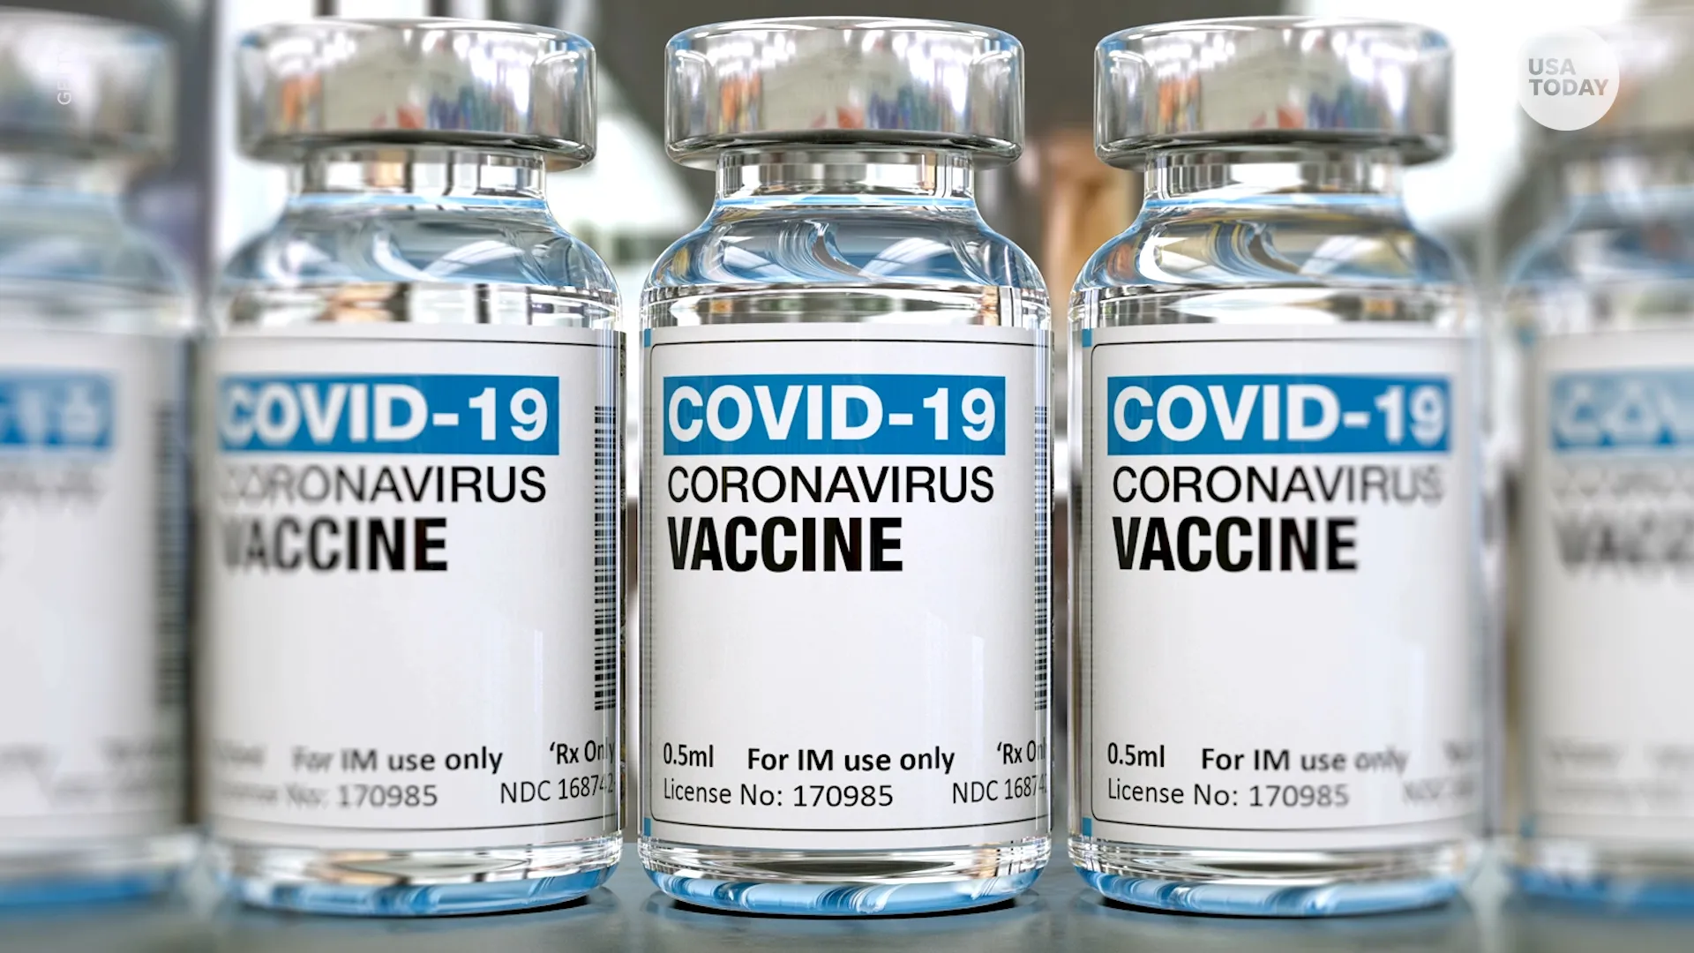
COVID-19 Vaccine Roll-out

Slide 62
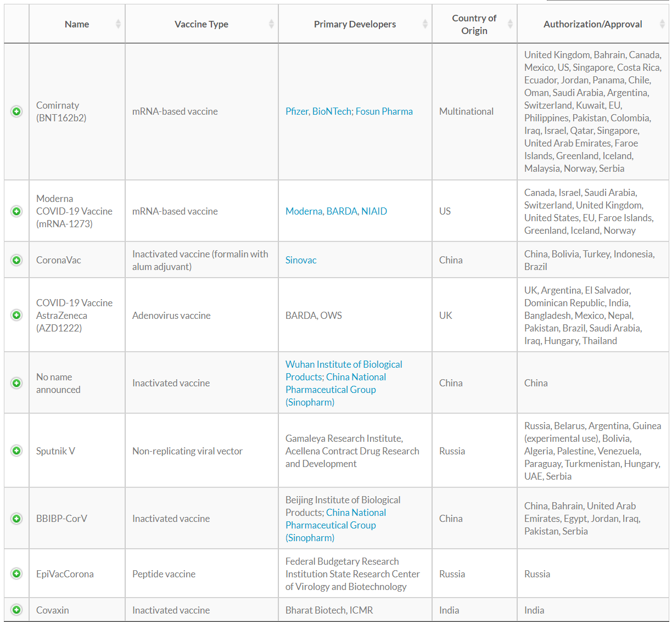
More that 10 vaccines are being used in 70 countries.
Geneva/Oslo, 18 December 2020

Slide 63
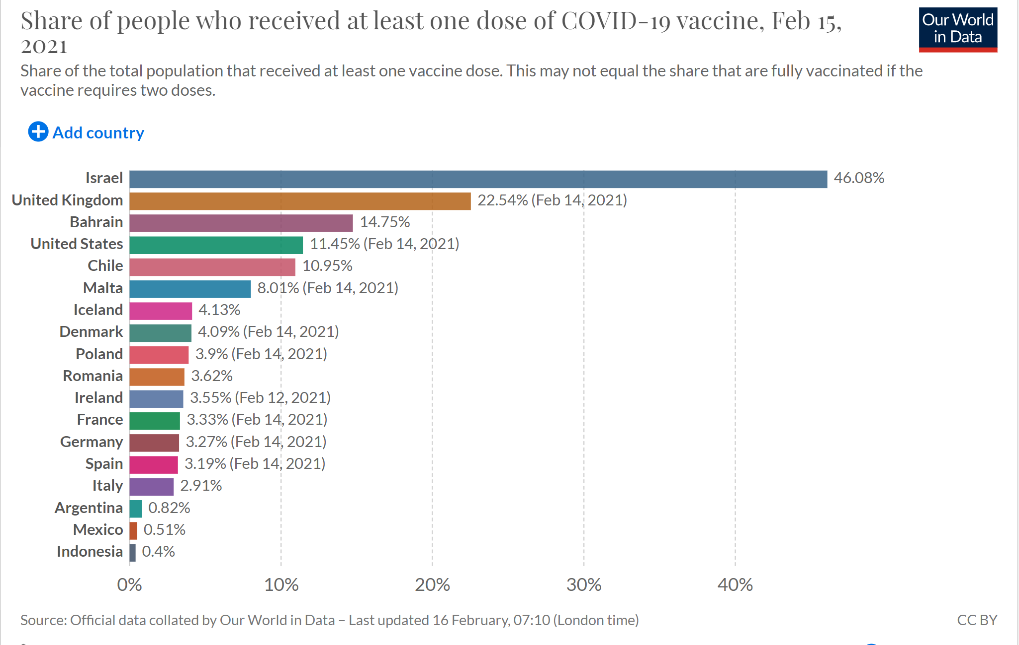

Slide 64
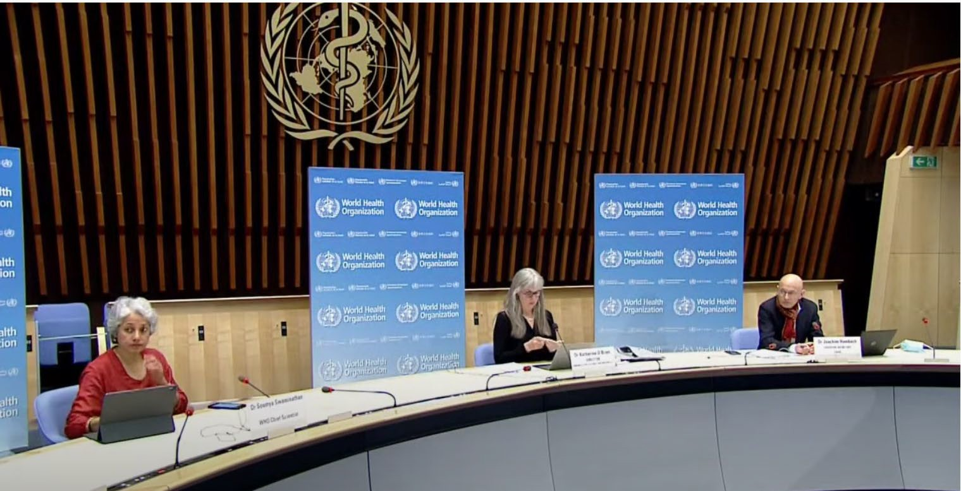


Slide 65



Slide 66

Implications for Participants of the COVAX Facility

Slide 67

COVAX in Barbados and the Eastern Caribbean Countries

Slide 68

Vaccine Roll out in Barbados and the ECC

Slide 69
PAHO Support
Updates and technical briefings (Webinars
Training on the use of the various tools (VIRAT, CCE)
Meetings with authorities (coordination and engagement of authorities)
Support in completing COVAX and other requirements
Readiness support and Monitoring
Development of NATIONAL DEPLOYMENT AND VACCINATION PLAN FOR COVID-19 VACCINE

Slide 70

Cold chain: 2 – 8⁰C
Two doses → 63% effectiveness
  0.5mls
  IM
  Deltoid muscle
2nd dose - 8-12 weeks after 1st dose
  Increased effectiveness with longer
dosing interval ≈ 71%
Two doses given intramuscularly into the deltoid muscle
Studies showed no severe disease or hospitalizations 22 days after the 1st dose
Recommended for persons 18yrs and above
OXFORD/AstraZeneca Vaccine

Slide 71

Accessing COVID-19 vaccines
Countries have a NVDP
NVDP defines priority groups by stages
NVDP defines strategies

Slide 72
Questions and Discussion

