Slide 1










Confirm your zoom account is the latest version available (5.17.7)/
Confirme que su cuenta de zoom tiene la última versión disponible (5.17.7)
CONTROL GUIDE FOR PARTICIPANTS |  | GUÍA DE CONTROL PARA PARTICIPANTES
Hover the cursor over your name, then click more>rename to edit to rename yourself including Country acronym and participant's name (PER-Jose Rodriguez). |  | ponga el cursor sobre su nombre, luego haga clic en más para renombrarse e identificarse incluyendo el acronimo del Pais y nombre del participante (PER-Jose Rodriguez)
Click the PARTICIPANTS, CHAT and Q&A buttons to activate and use them during the meeting. |  | Haga clic en los botones de PARTICIPANTES, CHAT y Q&A para activarlos y usarlos durante la reunion si es necesario.
Click the INTERPRETATION button and choose the same language to listen AND speak. Use the off selection to ask the question to every one in the meeting Click Mute Original Audio if necessary. |  | Haga clic en el botón de INTERPRETACIÓN y escoja el mismo idioma para escuchar y hablar. Ponga off si desea hacer la pregunta y que lo escuchen todos los participantes Desactive el audio original si es necesario.
Make sure to click the microphone icon in the bottom bar to unmute before you speak. Please remain muted when speaker is presenting. |  | Asegúrese de hacer clic en el botón de microfóno de la barra inferior antes de hablar. Por favor mantenerse en modo silencio cuando el ponente esté hablando.
To ask for the floor, click REACTIONS, then RAISE HAND button at the lower right side of the screen. |  | Para solicitar la palabra haga clic en el botón de RAISE HAND en la parte inferior derecha de la pantalla.
Choose the layout view between GALLERY or SPEAKER view in the upper right corner. |  | Escoja la visualización preferida en la parte superior derecha de la pantalla.

Slide 2
PAHO Strategic Plan 2026-2031
1st Member State Consultation
4 September 2024
Virtual (Zoom link)

Slide 3
Agenda
Update on the Strategic Plan development process
Proposed content for the situation analysis
Components of the Proposed results framework
Next Steps

Slide 4
Updates on the Strategic Plan Development Process

Slide 5
Timeline for the development of the SP26-31
Phase 1: preparation of the SP development process (completed)
Phase 2:
analysis and drafting
Phase 3:
refinement and approval
Virtual consultations with Member States and relevant stakeholders
Results-based management framework revision
Program Budget 26–27 development
Country strategic input and prioritization
June
CE174
September
CD61
March
SPBA19
June
CE176
September
CD62
2024
2025
Milestone 1
Roadmap for the development of the SP 26–31 presented to the 174th Session of the Executive Committee (completed)
Milestone 2
Progress update on the development of the SP 26–31 to the 61st Directing Council
Milestone 3
Full draft SP 26–31 and outline PB 26–27 presented to 19th Session of the Subcommittee on Program, Budget, and Administration
Milestone 4
Updated SP 26–31 and draft PB 26–27 presented to 176th Session of the Executive Committee
Milestone 5
Final drafts of the SP 26–31 and PB 26–27 presented to the 62nd Directing Council
See document (CD61/INF/1 – ENG, ESP, FRA, POR) for more details.
www.paho.org

Slide 6
SP 26-31 Consultations
Development of key components (situation analysis, RBM framework including revised results chain) and inputs (theory of change and country strategic input)
Process launched
In PASB
Results Framework including OCM scopes and indicators
Full draft of the SP, including indicators and compendiums
PB 26-27 outline
Development of outputs and their indicators
June
2024
2025
September
March
September
March
Jun
Jul
Aug
Sep
Oct
Nov
Dec
Jan
Feb
Mar
Apr
May
Jun
Sep
20 Jun:
Information Session with Member States
4 Sep:
1st Member States Consultation
30 Oct:
2nd Member States Consultation
16 Jan:
3rd Member States Consultation
13 Mar:
Information Session
with Member States
23 Apr:
Information Session with Member States
22 Jul:
Information Session with Member States
5 Sep:
1st Stakeholders
Consultation
5 Nov:
2nd Stakeholders
Consultation
Note: Additional details are available in the document on the consultation methodology.

Slide 7
Proposed content for the situation analysis

Slide 8
Overview
Improving health and wellbeing in the Americas Region: great achievements and significant strides over the last two decades
Despite improvements, persistent threats and stagnating progress have jeopardized efforts to improve health and wellbeing and close equity gaps.
Challenges and barriers to achieving universal health, with a widening equity gap.
Outlook for the future: PAHO's unique position as a regional leader for ensuring that all people and communities in the Americas enjoy optimal health and wellbeing.

Slide 9
1. Improving health and wellbeing in the Americas Region: great achievements and significant strides have been made over the last two decades.
Regional landscape (political, environmental, social, demographic; profound inequalities within the region; and status of SDG3 targets, including impact of non-health SDGs, such as poverty, hunger, education, gender equality, water and sanitation, economic growth, etc.)
Regional health status
Advances in communicable disease prevention, control, and elimination
Epidemiological shift to noncommunicable diseases as a high burden of morbidity and mortality
See notes page below for details.
Notes:
The primary organizational mandate is to improve health and wellbeing for all people throughout the Americas Region. The PASB and Member States have had great achievements since the creation of PAHO, and significant strides during the last two decades. The current landscape represents the context where the Organization needs to focus its efforts.
Description of regional landscape (political, environmental, social, demographic; profound inequalities within the region; and status of SDG3s, including impact of non-health SDGs, such as poverty, hunger, education, gender equality, water and sanitation, economic growth, etc.)
Regional health status
life expectancy and health-adjusted life expectancy
immunization (coverages and impacts, vaccine development and procurement)
advances and challenges in reproductive and maternal health
antenatal, delivery, postpartum, and postnatal care: components, quality, and timing of care
prevalence rate of modern contraceptive methods and unmet demand
improvements in identifying maternal deaths and their causes, with setbacks in the maternal mortality ratio
advances and challenges in child and adolescent health
immunization coverage rates and reduction in burden of vaccine preventable diseases.
access to health coverage among children
nutrition – obesity, diabetes mellitus (rising trend among 15-24 yrs)
reduction in neonatal and child mortality
respiratory illness
security and violence: homicide and other factors
lack of adequate and appropriate mental and neurological health services: trends in increasing suicide and substance abuse rates, particularly among youth
advances in communicable disease prevention, control, and elimination
epidemiological shift to noncommunicable diseases as a high burden of morbidity and mortality:
aging population
disability (especially multiple disabilities and impact of compounded inequities)

Slide 10
2. Despite improvements, persistent threats and stagnating progress have jeopardized efforts to improve health and wellbeing and close equity gaps
The COVID-19 pandemic highlighted weaknesses in health systems that have a direct impact on a person’s access to timely, appropriate, and good quality health services.
There are persistent health inequities in the Region, demonstrating the intersectionality of social determinants’ impact on health that present comprehensive challenges to health systems resilience.
Over the last two decades, one in four global disasters occurred in the Americas, mostly due to natural and human-induced disasters. The impact of climate change on health can no longer be ignored.
See notes page below for details.
Notes:
2. Although great strides have been made in improving health in the Region, persistent threats and stagnating progress have jeopardized efforts to improve health and wellbeing and close equity gaps.
The COVID-19 pandemic highlighted weaknesses in health systems that have a direct impact on a person’s access to timely, appropriate, and quality health services.
Disruption of health services jeopardizing essential health services delivery
Health and social impact of COVID-19 on the Americas​
Detailed analysis of the pandemic’s social toll on health, mortality, and economies
Disproportional impact of COVID-19 on the Americas
Mental health and suicide
Long-term implications for public health and healthcare systems
There are persistent health inequities in the Region, demonstrating the intersectionality of social determinants’ impact on health that present comprehensive challenges to health systems resilience.
Social, health inequities, and demographic shifts
Environmental degradation and climate change
Stagnated economic growth and extreme income/wealth inequality
Institutional challenges to democracy and geopolitical threats
Human migration, displacement, and regional stability
Over the last two decades, one in four global disasters occurred in the Americas, mostly due to natural and human-induced disasters. The impact of climate change on health can no longer be ignored.
Brief statistics on the situation
Advances and challenges in emergency preparedness

Slide 11
3. There are challenges and barriers to achieving universal health, with a widening equity gap.
Health expenditure and financial sustainability (public investment).
Limited progress on establishing primary healthcare-based systems and access to essential medicines.
Need for better integrated health systems and person-centered approaches.
Shortage and inadequate distribution of human resources for health.
Need to strengthen the evidence ecosystem at country level to inform decision. making, improve health outcomes, and bolster confidence in science.
See notes page below for details.
Notes:
3. Challenges and barriers to achieving universal health, with a widening equity gap​: What are the efforts needed to improve health systems and their resilience that address the multiplicities of care?
Health expenditure and financial sustainability (public investment)
Limited progress on establishing primary healthcare-based systems and access to essential medicines.
Need for better integrated health systems and person-centered approaches.
Shortage and inadequate distribution of human resources for health.
Shortage of health personnel, which by 2030 could reach two million in Latin America and the Caribbean alone.
Enhanced and continued competency training for the health workforce
Need to strengthen the evidence ecosystem at country level to inform decision. making, improve health outcomes, and bolster confidence in science.
Improve availability of data and capacity to effectively utilize information in applications to health care and public health
Bridge the digital gap through digital transformation of the health sector

Slide 12
4. Outlook for the future: PAHO has a unique position as a regional leader for ensuring that all people and communities in the Americas enjoy optimal health and wellbeing.
Accelerate action to achieve the SDG3/SHAA2030 targets.
Promote health equity.
Construct resilient health systems.
Promote innovation in medicines and health technologies.
Escalate disease prevention and control (achieving the goals of the Director’s Interprogrammatic Initiatives on Disease Elimination and Better Care for NCDs).
Revamp health emergency preparedness and response.
Create strong, effective, and accountable institutions.
See notes page below for details.
Notes:
4. Outlook for the future: What is the Organization’s position as a regional leader for ensuring that all people and communities in the Americas enjoy optimal health and wellbeing?
Accelerate action to achieve the SDG3/SHAA2030 targets​
Promote health equity
address the social protection and health more comprehensively – policies, programs, socio-economic inequalities, access to essential services, and mitigating adverse impacts of SDH on health
address conditions of vulnerability and vulnerable groups (women, children, migrants, ethnic groups, LGBTQ+)
meet the needs of an aging population
Address risk factors, climate and environmental impacts on health
Construct resilient health systems
Promote Innovation in medicines and health technologies
Escalate disease prevention and control (achieving the goals of the Elimination Initiative and Better Care for NCDs)
Revamp health emergency preparedness
Create strong, effective, and accountable institutions

Slide 13
Components of the proposed Results Framework

Slide 14
Context and Considerations for the
Results Framework
Results must be…
Guided by collective priorities
Responsive to commitments
Informed by lessons learned and recommendations
areas where PAHO adds value
driving impact in countries
addressing inequities in health
Country Cooperation Strategies
Regional and global mandates: SHAA2030 and GPW 14, among others
  Guided by lessons learned from external evaluation of Results-based management, external audits, and others
  Pragmatic and streamlined approach, with a simple programmatic structure and informed by SMART/CREAM criteria

Slide 15
Updated Results Chain
Main changes
Better alignment through theory of chain
sustainable changes in the health of populations
sustainable changes in the health of populations
Impact
Emphasis on MS accountability at impact/outcome level
collective or individual changes in the factors that affect the health of populations
collective or individual changes in the factors that affect the health of populations
Outcome
Outputs (OPTs) redefined to focus on PASB contribution, for which PASB is solely accountable, in line with standard UN/WHO def
changes in national systems, services, and tools
PASB deliverables that influence, enable, and catalyze the joint action of member states and partners towards delivery of targeted outcomes
Output
Entity-specific deliverables against an agreed budget that influence, enable, and catalyze the joint action toward delivery of targeted outcomes
deliverables against an agreed budget for which PASB is directly accountable during the biennium
Products and services
Current
Updated
Joint accountability
See notes page below for details.
PASB accountability
Notes:
Full revised definitions:
Impact
Definition : sustainable changes in the health of populations. Such changes will be assessed through impact indicators that reflect a reduction in morbidity or mortality or improvements in well-being of the population (e.g., increases in people’s healthy life expectancy).
Accountability: Member States are responsible for achieving impacts in collaboration with PASB and other PAHO partners, through the achievement of outcomes. They can be delivered during one or more biennium across the three biennia in the strategic plan period.
Outcome
Definition: collective or individual changes in the factors that affect the health of populations. These include, but are not limited to, increased national capacity, increased service coverage or access to services, stronger health systems, and/or reduction of health-related risks.
Accountability: Member States are responsible for achieving outcomes in collaboration with PASB and other PAHO partners, through changes in national policies, strategies, plans, laws, programs, services, norms, standards, and/or guidelines, amongst others. They can be delivered during one or more biennium across the three biennia in the strategic plan period.
Output
Definition: PASB deliverables that influence, enable, and catalyze the joint action of member states and partners towards delivery of targeted outcomes.
Accountability: PASB is directly accountable for delivering outputs. They are delivered within the biennium for each Program Budget.
Product and service
Definition: Entity-specific deliverables against an agreed budget that influence, enable, and catalyze the joint action of member states and partners towards delivery of targeted outcomes.
Accountability: PASB entities are directly accountable for delivering products and services. They must be delivered within a two-year Program Budget period.

Slide 16
Proposed Results Framework for the SP26-31
Cross-cutting approaches to achieve equity in all its dimensions
Impact goal
Improved health and wellbeing, for everyone, throughout the Region
Strategic objectives
Health equity, determinants, root causes of ill health, risk factors, and climate change
Resilient health systems based on primary care
Disease prevention, control, and elimination
Prevent, prepare, detect, and respond better to health emergencies
Strong, effective, and accountable organization
Outcomes
Inequities, determi-nants, risk factors, and health promo-tion
Adapt and mitigate climate-related threats to health
Steward-ship and governance for resilient HS based on PHC, incl health workforce
Person-centered, resilient care and services throughout the life course
Access to health technologies, innovation, and production
Digital trans-formation, informationsystems for health, evidence, and science
Non-commu-nicable diseases and mental health
Commu-nicable diseases, antimi-crobial resis-tance and immuni-zation
Prevent, mitigate, prepare, be ready to respond
Rapid detection and response
PAHO’s leader-ship and govern-ance
PASB’s institu-tional capacity
Outputs
Outputs

Slide 17

Strategic objective 1: Accelerate efforts to address health equity, health determinants and root causes of ill health, risk factors, and the threats posed by climate change on health.
Objetivo estratégico 1: Acelerar los esfuerzos para abordar la equidad en salud, los determinantes de la salud y las causas raíz de la mala salud, los factores de riesgo y las amenazas que plantea el cambio climático para la salud.
Outcome: Country capacities enhanced to reduce health inequities, promote health, and address risk factors and social and environmental determinants.
Outcome: Country capacities strengthened to adapt to and mitigate climate-related threats to health.
Resultado intermedio: Capacidades de los países fortalecidas para reducir las inequidades en materia de salud, promover la salud y abordar los factores de riesgo y los determinantes sociales y ambientales.
Resultado intermedio: Capacidades de los países fortalecidas para adaptarse a las amenazas a la salud relacionadas con el clima y mitigarlas.
See notes page below for details.
Notes:
Outcome: Country capacities enhanced to reduce health inequities, promote health, and address risk factors and social and environmental determinants.
Scope:
Reduce health inequities through action on social determinants of health in all its dimensions (commercial, political, economic, etc.) as well as environmental determinants.
Better respond to the needs of populations in situation of vulnerability, recognizing cultural and gender diversity, and protecting human rights.
Strengthen intersectoral action and Health in All policies including collaboration with social protection, labor, environment, education and other sectors.
Overcome barriers to access to health and health care, with a focus on Primary Health Care, considering special needs related to gender, ethnicity, social class, migrant status and informal workers, among others.​
Enhance the health sector capacity to monitor social determinants of health and health inequalities and assess the health equity impact of policies within and outside the health sector to strengthen health governance.
Strengthen social participation and community engagement to improve health, health equity and wellbeing and to enhance effectiveness and sustainability of policies and programs.
Strengthen local governance for health and wellbeing and tackle urban health challenges, to achieve health equity and the goals of the 2030 Agenda.
Promote health and wellbeing by implementing effective population-based health promotion strategies including healthy settings (schools, workplaces, universities, markets, and housing) and a health in all policies approach.
Strengthen legal frameworks to promote health and to prevent diseases and injuries.
Intensify efforts to prevent diseases and premature death by action on risk factors and by promoting healthy environments. This includes:
Reduce modifiable risk factors for noncommunicable diseases including through action on its determinants (with special emphasis on the commercial and economic dimensions of the SHD), intersectoral action, and community participation.
Intensify efforts to prevent communicable diseases and related conditions through action on risk factors and its underlying causes such as environmental determinants, and through strengthened community engagement and intersectoral coordination, and the One Health approach, where applicable. ​
Address occupational and environmental risk factors health by improving working and environmental conditions.
Outcome: Country capacities strengthened to adapt to and mitigate climate-related threats to health.
Scope:
Position climate change and health centrally in the health sector and other sector’s agendas and ensure investment for climate change and health by strengthening and creating intra and intersectoral governance mechanisms and galvanizing political and social support including through community and civil society participation. ​
Improve anticipation, prevention, preparation for, response, and recovery from the health impacts of climate change, while protecting populations in situations of vulnerability and small island states by strengthening the health sector’s capacity for adaptation, including reviewing and adjusting existing programs, as well as intersectoral coordination.​
Improve low-carbon health systems and create resilient and green health infrastructure such as SMART hospitals and foster sustainable and climate friendly societies, aimed at achieving health co-benefits and reducing health inequities by strengthening health sector’s capacity for mitigation.​
Improve the development and implementation of adaptation and mitigation strategies that protect health and reduce health inequities by strengthening surveillance of climate change and health, and the generation, communication and use of evidence that considers the differential risks by different population groups.​

Slide 18
Strategic objective 2: Build resilient health systems for universal access to health and universal health coverage, based on the primary health care
Objetivo estratégico 2: Construir sistemas de salud resilientes para el acceso universal a la salud y la cobertura universal de salud, basados ​​en la atención primaria de salud
Outcome: Stewardship and governance strengthened for resilient health systems based on primary health care.
Outcome: Person-centered, resilient healthcare and services strengthened for communities and people throughout the life course.
Resultado intermedio: Rectoría y gobernanza fortalecidas para lograr sistemas de salud resilientes basados ​​en la atención primaria de salud.
Resultado intermedio: Servicios y atención de salud resilientes y centrados en la persona fortalecidos para las comunidades y las personas a lo largo del curso de vida.
See notes page below for details.
Notes:
Outcome: Stewardship and governance strengthened for resilient health systems based on primary health care.
Scope:
Achievement of this outcome requires improved national and subnational health policies and planning, strengthening of the essential public health functions, sustained and improved public financing for health, addressing financial and non-financial barriers to access to health, and a fit for purpose health workforce;
Strengthen the capacities of health authorities to lead inclusive national and subnational processes, and formulate, monitor, and evaluate policies, plans, and programs to improve health throughout the life course, and reorient health systems towards primary health care, including the regulation of resources (financial, technological, health workforce) impacting the achievement of universal health, equity, and resilience of health systems.
Improve and prioritize the evaluation and implementation of essential public health functions at all institutional levels, in collaboration with civil society, to strengthen the development of health systems based on primary health care.
Generate evidence and information in health financing and the economy, increase and improve public expenditure in health, prioritizing investments in health development and promotion, disease prevention, and the expansion of health systems based on primary health care. Protect against financial risks that cause impoverishing or catastrophic expenditure.
Promote and execute the continued analysis of the health workforce and labor market, and lead intersectoral planning processes to attract, recruit and retain health workers, and address substantive workforce gaps, accelerating the production availability of a well-qualified and well distributed workforce, particularly for remote and underserved areas and populations.
Promote the transformation of health professional education based on primary health care, supporting interprofessional capacity development and the organization of interprofessional teams within health services.
Outcome: Person-centered, resilient healthcare and services strengthened for communities and people throughout the life course.
Scope:
Strengthen the capacity of health systems and services to deliver integrated people-centered care throughout the life course, and ensure access to and coverage of high-quality, equitable, and people-centered health services, addressing the differentiated needs of people where they live, in the context of a rapid demographic and epidemiological transition.
Strengthen integrated and person-centered care through the primary health care approach, to boost and maintain health capacities and to address communicable and noncommunicable diseases; vaccine preventable diseases; risk factors across the life course; sexual, reproductive, maternal, newborn, child, adolescent, and older persons’ health; and the social determinants of health.
Strengthen integrated health service delivery networks and enhance the organization, management, and governance of health services at both individual and population-based levels, increasing the resolutive capacity of the first level of care. This involves developing innovative models of care that are intersectoral, people-, family-, and community-centered; that promote coordination, communication, and continuity of care; and the integration of priority health programs, health technology and telemedicine services within health services networks.
Promote, strengthen, and improve health care for women, mothers, and newborns, accelerating the reduction of maternal, neonatal, and child mortality, and strengthening capacities in reproductive health policies, care, and services.
Improve the capacity to respond to the diverse needs of all groups and populations, through the reduction of availability, geographic, organizational, acceptability, and financial barriers to access healthcare and services, particularly for older persons and other people in conditions of vulnerability.

Slide 19
Strategic objective 2: Build resilient health systems for universal access to health and universal health coverage, based on the primary health care
Objetivo estratégico 2: Construir sistemas de salud resilientes para el acceso universal a la salud y la cobertura universal de salud, basados ​​en la atención primaria de salud
Outcome: Increased equitable access to and rational use of quality, affordable and effective medicines, vaccines, diagnostics and other health technologies and services, strengthening innovation and production, generating ecosystems, and addressing barriers to access across the full life cycle of health technologies.
Outcome: Digital transformation of the health sector accelerated by advancing the development and integration of information systems for health, fostering robust regional health intelligence and evidence, and strengthening capacities of the scientific ecosystem.
Resultado intermedio: Mayor acceso equitativo a, y uso racional de, medicamentos, vacunas, diagnósticos y otras tecnologías y servicios de salud de calidad, asequibles y eficaces, fortaleciendo la innovación y la producción, generando ecosistemas y abordando las barreras de acceso a lo largo de todo el ciclo de vida de las tecnologías de salud.
Resultado intermedio: Transformación digital del sector de la salud acelerada, impulsando el desarrollo y la integración de sistemas de información para la salud, fomentando una inteligencia y evidencia sanitarias regionales sólidas y fortaleciendo las capacidades del ecosistema científico.
See notes page below for details.
Notes:
Outcome: Increased equitable access to and rational use of quality, affordable and effective medicines, vaccines, diagnostics and other health technologies and services, strengthening innovation and production, generating ecosystems, and addressing barriers to access across the full life cycle of health technologies.
Scope:
Update and support implementation of policies and strategies that improve timely access to and rational use of quality, affordable and effective health technologies, including medicines, vaccines and diagnostics and radiological, pharmaceutical, transplant, and blood services to prevent, diagnose, treat, eliminate, and palliate diseases and other medical conditions with a comprehensive, coherent, and integrated approach.
Foster innovation and regional development and production of health technologies, supporting enabling environments and ecosystems for sustainable and public health driven impact.
Promote adequate financing and financial protection mechanisms to foster innovation and access of health technologies and services, including the progressive elimination of out-of-pocket expenditures, according to national public health priorities and the context of each health system. Support comprehensive strategies to address the high prices and costs of some health technologies including promotion of competition and evidence-based decision making.
Promote the development and strengthening of national, regional and subregional regulatory systems that can ensure the quality, safety, and effectiveness of health technologies and services, including medicines, vaccines and medical devices.
Promote sustainable, efficient, and transparent public procurement mechanisms, as well as the PAHO revolving funds, which limit fragmentation, improve availability, and take advantage of economies of scale to improve equitable access to essential and strategic health technologies.
Outcome: Digital transformation of the health sector accelerated by advancing the development and integration of information systems for health, fostering robust regional health intelligence and evidence, and strengthening capacities of the scientific ecosystem.
Scope:
This digital transformation will enhance health outcomes by ensuring equitable access to quality health services, improving health surveillance, managing noncommunicable diseases, and addressing other public health priorities. It envisions a robust global evidence ecosystem that empowers governments, professionals, and civil society members to make well-informed decisions for a better future. PAHO will work to improve capacities of the scientific ecosystem by enabling greater integration of the research, ethics, evidence and knowledge systems, fostering quality, translation and impact, safeguarding integrity, and building trust in science.
Promote the digital transformation of the health sector to enhance the efficiency, accessibility, and quality of health services, improve health outcomes, and ensure that health systems are resilient and capable of responding to public health challenges and emergencies.
Foster the adoption and innovation of digital health technologies among health workers by enhancing digital literacy, supporting targeted training, and strengthening governance frameworks.
Promote partnerships across sectors to improve connectivity and bandwidth, drive the development of artificial intelligence, big data, and digital public goods solutions, while ensuring equitable access and continuous evaluation to improve health outcomes and address public health challenges.
Strengthen information systems for health to support data-driven decision-making, improve health surveillance, and monitor progress towards health goals. This includes developing interoperable systems that facilitate the secure exchange of health datasets and platforms across various levels of care and sectors.
Facilitate the adoption of electronic health records and other digital tools to improve the coordination of care, reduce medical errors, and enhance patient safety and outcomes. This includes ensuring that these systems are patient-centered, secure, and aligned with global standards for privacy, data protection, and cybersecurity.
Strengthen health analysis and surveillance to support routine monitoring at the regional, national, and subnational levels to inform health policy and programmatic decisions.
Leverage advanced health analysis, business intelligence, and geographic information systems to enable real-time data analysis, predictive modeling, and spatial health data mapping. These tools, combined with cross-sector collaborations, will empower data-driven decision-making, optimize resource allocation, and enhance public health planning, disease monitoring, and targeted interventions.
Enhance health monitoring frameworks by increasing capacity to apply and utilize standardized data management and analytical approaches to generate data-driven evidence for impact on population health.
Enhance capacity to measure and monitor health inequalities within routine health information systems according to standardized approaches that promote high coverage and quality of health and vital statistics within health systems and strategies.
Strengthen capacity to utilize health intelligence and communicate effective messages, drive decisions and policy action to improve health and wellbeing.
Drive empowerment and institutional change for science. This includes advancing scientific research by strengthening research ethics, investing in diverse talent development, and leveraging emerging technologies like genomics and AI to produce impactful, regionally relevant knowledge.
Ensure excellence and integrity of science. This includes promoting evidence-based norms and standards, ensuring health decisions are guided by science and ethics, fostering trust in science, and implementing effective knowledge management and multilingual publishing to improve health outcomes.
Maximize the impact of health interventions. This includes accelerating health equity by increasing access to scientific knowledge, delivering impactful science-based solutions, and leveraging knowledge-sharing mechanisms to reduce health information disparities across diverse populations.

Slide 20
Strategic objective 3: Accelerate the elimination, reduction, management and control of communicable and non-communicable diseases, disabilities and mental health-related conditions, and strengthen the health system response for violence, road safety, suicides and unintentional injuries
Objetivo estratégico 3: Acelerar la eliminación, reducción, gestión y control de las enfermedades transmisibles y no transmisibles, las discapacidades y las condiciones relacionadas con la salud mental, y fortalecer la respuesta del sistema de salud a la violencia, la seguridad vial, los suicidios, y las lesiones no intencionales.
Outcome: Screening, early detection, management, rehabilitation, and palliative care for the main NCDs and mental and neurological health conditions strengthened, based on the primary health care approach, and disabilities, violence, road safety, suicide prevention, and unintentional injuries addressed through health service strengthening.
Outcome: Prevention, control, and elimination of communicable diseases and related conditions accelerated and sustained.
Resultado intermedio: El tamizaje, la detección temprana, el manejo, la rehabilitación y los cuidados paliativos de las principales ENT y condiciones de salud mental y neurológica fortalecidos, con base en el enfoque de atención primaria de salud, y las discapacidades, la violencia, la seguridad vial, prevención del suicidio y las lesiones no intencionales abordadas mediante el fortalecimiento de los servicios de salud.
Resultado intermedio: Prevención, control y eliminación de enfermedades transmisibles y condiciones relacionadas acelerados y sostenidos.
See notes page below for details.
Notes:
Outcome: Screening, early detection, management, rehabilitation, and palliative care for the main NCDs and mental and neurological health conditions strengthened, based on the primary health care approach, and disabilities, violence, road safety, suicide prevention, and unintentional injuries addressed through health service strengthening.
Scope:
Strengthen national capacity, leadership, governance, and partnerships to accelerate the response for screening, early detection, management, rehabilitation and palliative care for the main NCDs, and mental and neurological health conditions.
Strengthen and orient health systems to provide screening, early detection, management, rehabilitation and palliative care for the main NCDs and mental and neurological health conditions through people-centered primary health care and universal health.
Strengthen the health system response for disabilities, all forms of violence, road safety, suicides, and unintentional injuries.
Strengthen information and surveillance system capacity to monitor progress on the early detection, management and control of NCDs, mental and neurological health conditions, disabilities, all forms of violence, road safety and unintentional injuries allowing the prioritization of resources and ensuring an effective response.
Facilitate and promote community engagement to reduce risks, build resilience and establish supportive environments for NCD and mental and neurological health management and treatment.
Outcome: Prevention, control, and elimination of communicable diseases and related conditions accelerated and sustained.
Scope:
Strengthen country capacities to ensure equitable access to comprehensive, people-centered health services by leveraging evidence-based strategies, primary health care, life-course approaches, and robust governance and financing to effectively prevent, control, and eliminate communicable diseases and sustain elimination gains.
Advance coordinated efforts to ensure equitable access to essential health technologies— such as diagnostics, vaccines, vector control measures, and treatments— and accelerate the adoption and use of innovative solutions to effectively and sustainably prevent, control, and eliminate communicable diseases and related conditions, and protect elimination achievements.
Enhance information, surveillance, and laboratory systems and capacities to integrate human, animal, and environmental efforts to anticipate risks, prioritize resources, and ensure effective responses for preventing, controlling, and eliminating diseases, outbreaks, and antimicrobial resistance.
Advance multisectoral coordination to address social and environmental determinants, climate change, and incorporate the One Health approach, where applicable, to intensify efforts to control, and eliminate communicable diseases and related conditions, and safeguard elimination achievements.
Facilitate inclusive participation processes that empower civil society and communities to actively and meaningfully engage in planning, implementing, monitoring, and evaluating integrated strategies and health services to prevent, control, and eliminate communicable diseases and related conditions, while protecting the gains of elimination.

Slide 21
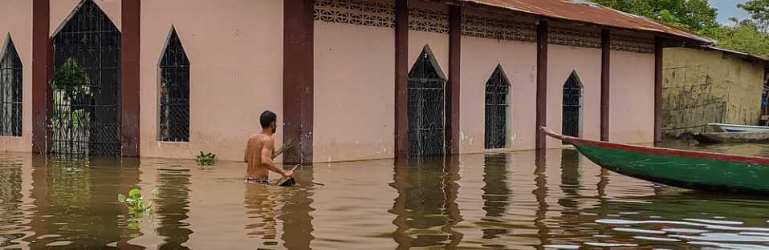
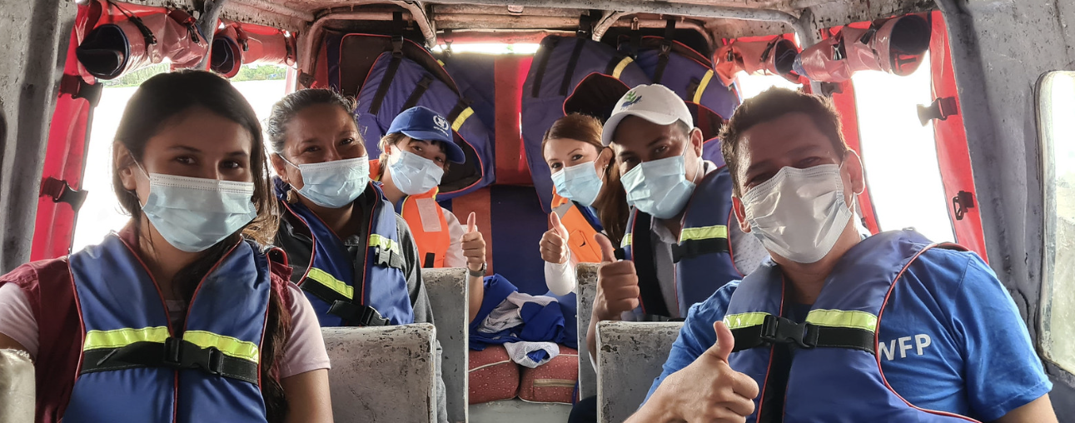
Strategic objective 4: Prevent, prepare, detect, and respond better to health emergencies.
Objetivo estratégico 4: Prevenir, preparar, detectar y responder mejor ante las emergencias de salud.
Outcome: Country capacities strengthened to prevent, mitigate, prepare for, and be ready to respond to health emergencies and disasters caused by any hazard.
Outcome: Regional and national capacities enhanced to rapidly detect and respond to health emergencies and disasters caused by any hazard.
Resultado intermedio: Capacidades de los países fortalecidas para prevenir, mitigar, preparar y estar listos para responder a emergencias y desastres de salud causadas de cualquier tipo de amenaza.
Resultado intermedio: Capacidades regionales y nacionales fortalecidas para mejorar la detección y respuesta rápida a emergencias de salud y desastres causadas de cualquier tipo de amenaza.
See notes page below for details.
Notes:
Outcome: Country capacities strengthened to prevent, mitigate, prepare for, and be ready to respond to health emergencies and disasters caused by any hazard.
Scope:
Increase national capacities in emergency planning, management, and testing at all levels and across all health emergency phases through the full implementation of the International Health Regulations (IHR), pandemic agreements, and the Sendai Framework for Disaster Risk Reduction (SFDRR).
Incorporate risk reduction actions into national and territorial policies and strategies to reduce disaster risks (such as those linked to hydro-meteorological hazards, climate change, geological hazards, among others) and prevent epidemics/pandemics, strengthen the resiliency of healthcare facilities, clinical management, infection control and prevention, whole-of-society resilience, and reduce emergency impacts, while ensuring the continuity of essential health services across all levels.
Strengthen disease and event surveillance by enhancing diagnostic laboratory networks for epidemic-prone and emerging pathogens (including those zoonotic) under biosafety and quality assurance policies, expanding genomic surveillance, leveraging technological innovation, and ensuring early warning and detection through interconnected information and analyses across the human-animal-environmental health interface.
Engage and empower communities, with a special attention to people and population in situation of vulnerability (such as women, children, indigenous people, people with disabilities, people living non-communicable disease, migrants), in evidence-based and resilient preparedness, readiness and response to health emergencies and disasters.
Coordinate across sectors and stakeholders to enhance regional and global health security and equitable access to countermeasures and supplies during epidemics, pandemics, and other health emergencies.
Outcome: Regional and national capacities enhanced to rapidly detect and respond to health emergencies and disasters caused by any hazard.
Scope:
Strengthen surveillance for early warning to detect, verify, assess the risk, report, and alert on acute public health events and health emergencies of any origins
Enhance the use of Artificial intelligence-driven systems and scaling up the non-traditional surveillance approach to enable earlier detection, rapid investigation, efficient risk assessment and timely early warning on health emergencies and disasters
Strengthen national and subnational capacities in data collection, management, and analysis for health emergencies, including the use of Geographic Information Systems (GIS) for spatial analysis, and advanced analytics for forecasting, nowcasting, and scenario modeling for improved data, enhanced analysis and actionable insights to guide public health decision making during response activities by expanding existing capacity-building activities and developing a network of modelers for health emergencies in the region to promote international, multi-disciplinary and multi-sectoral collaborations and also to create a pool of technical experts who can act as surge capacity and promotes international, multi-disciplinary and multi-sectoral collaborations.
Enhance countries’ response capacity by strengthening coordination mechanisms and improving information management during emergencies and disasters.
Expand and deploy multisectoral rapid-response teams with diverse expertise in technical areas to effectively contain health threats and mitigate the impact of outbreaks and emergencies.
Strengthen PAHO’s institutional capacity for emergency response through the implementation of improved policies and procedures.

Slide 22
Strategic objective 5: Bolster leadership, governance, and performance of PAHO to advance the regional health agenda and deliver technical cooperation that drives public health impact in countries
Objetivo estratégico 5: Reforzar el liderazgo, la gobernanza y el desempeño de la OPS para avanzar en la agenda de salud regional y brindar una cooperación técnica que impulse el impacto de la salud pública en los países
Outcome: PAHO’s leadership capacity and governance mechanisms strengthened, bolstering its resilience and strategic collaboration to drive results and impact for advancing health development with equity.
Outcome: PASB’s institutional capacity enhanced to deliver PAHO's mission in an efficient, transparent, and accountable manner through modern and innovative management practices that foster an engaging, inclusive, and respectful culture.
Resultado intermedio: Capacidad de liderazgo y mecanismos de gobernanza de la OPS fortalecidos, reforzando su resiliencia y la colaboración estratégica para impulsar resultados e impacto para avanzar en el desarrollo de la salud con equidad.
Resultado intermedio: Capacidad institucional de la OSP potenciada para cumplir la misión de la OPS de manera eficiente y transparente y con la rendicion de cuentas, mediante las prácticas de gestión modernas e innovadoras, mientras que se fomenta una cultura participativa, inclusiva y respetuosa.
See notes page below for details.
Notes:
Outcome: PAHO’s leadership capacity and governance mechanisms strengthened, bolstering its resilience and strategic collaboration to drive results and impact for advancing health development with equity.
Scope:
Enhance effective health leadership through convening, agenda-setting, and partnerships.
Strengthen country focus presence, including strengthening and streamlining the Country Cooperation Strategies.
Enhance the results-based management (RBM) approach, covering all components of the RBM cycle, with clearer PASB contribution to health outcomes and accountability for results and resources.
Conduct realistic budgeting and improve quality of funding, with more predictable and flexible funding.
Harmonize accountability mechanisms and further promote organizational accountability.
Improve external and internal communications.
Strengthen the ethical culture of the Organization, including Preventing and Responding to Sexual Exploitation, Abuse and Harassment, fostering a respectful PASB corporate culture and engagement.
Aim for simplification of internal processes and controls related to internal audits.
Conduct investigations into allegations of misconduct involving PAHO personnel.
Ensure coordination and coherence with WHO.
Increase the participation of Member States from the Region in WHO Governing Bodies meetings, including reaching a regional position, when possible.
Outcome: PASB’s institutional capacity enhanced to deliver PAHO's mission in an efficient, transparent, and accountable manner through modern and innovative management practices that foster an engaging, inclusive, and respectful culture.
Scope:
Modernize, innovate, and streamline policies, processes, and systems to strengthen internal management, controls, and decision-making.
Integrate efficiency, transparency, and accountability (ETA measures) into internal processes and management systems (PAHO Forward).
Implement the people strategy 2025-2030, including promotion of individual accountability through a culture of feedback.
Strengthen procurement through market intelligence, strategic negotiation tactics, innovative contracting, and partner/supplier relationship management.
Implement sustainable environmental practices and policies through PAHO Green.
Implement the IT strategy to work smarter using new tools and with governance mechanisms in place, as well as the use of artificial intelligence in PAHO processes.
Strengthen compliance, with particular emphasis in areas where non-compliance could result in significant financial or reputational damage to the Organization.
Invest in modernization and preventive maintenance through planning and use of the Master Capital Investment Fund.

Slide 23
Next Steps

Slide 24

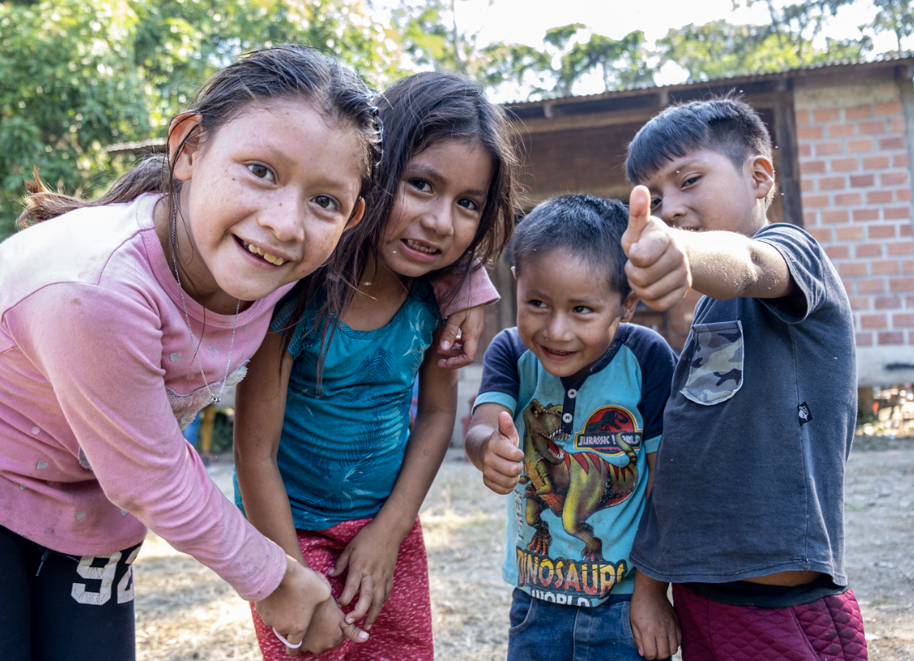
Next steps
Member States are invited to provide feedback during the session and in writing to strategicplan26-31@paho.org by 13 September 2024.
61st Directing Council will consider the updates on the implementation of the roadmap (CD61/INF/1 – ENG, ESP, FRA, POR) on 30 September – 4 October 2024.
PASB teams will review feedback and build the first full draft SP, that will serve for the 2nd MS consultation, which will be held on 30 October 2024.
Notes:
Photo: https://www.flickr.com/photos/pahowho/53881539100/

Slide 25
Closure

Slide 26
Thank you
Gracias
Merci
Obrigado

