Slide 1
PAHO's performance monitoring tool for national EPI teams
Template
Annex 12. Opening ceremony

Slide 2
Agenda
Current status of immunization
Aim and objective of the tool
Different parts of the tool
Rating questions on a maturity scale
Key points to consider
Expected outputs

Slide 3
Current status of Immunization in Guatemala
DTP3 coverage rates, Guatemala
96%
-17%
Multiple factors have changed since the last EPI evaluation
COVID-19 pandemic
Introduction of the _ vaccine
Government structure
The health system’s legal framework
79%
2012
2022
Source:https://immunizationdata.who.int/compare.html?COMPARISON=type1__WIISE/MT_AD_COV_LONG+type2__WIISE/MT_AD_COV_LONG+option1__DTP_coverage+option2__DTP_PLUS_coverage&CODE=GTM+PER&YEAR=

Slide 4
General situation in the country
Note: Please include the relevant slides from “Annex 4b: situation analysis presentation”

Slide 5
The tool’s objective is to…
Self-assess performance of the national immunization program in the country across 13 EPI components using a comprehensive performance management tool to identify successes and gaps and set priorities for the program

Slide 6
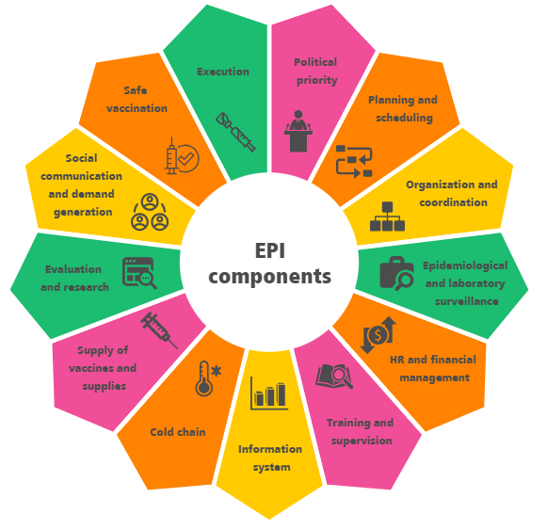
And it aims to…
í
To self-assess the performance of each component of EPI (as shown in the diagram)
Develop a national action plan for the improvement of EPI and to:
Prioritize the recommendations that require immediate intervention
Define the timeline for activities and budget required.
Determine if further assessment or support is required to address gaps in a specific component.

Slide 7
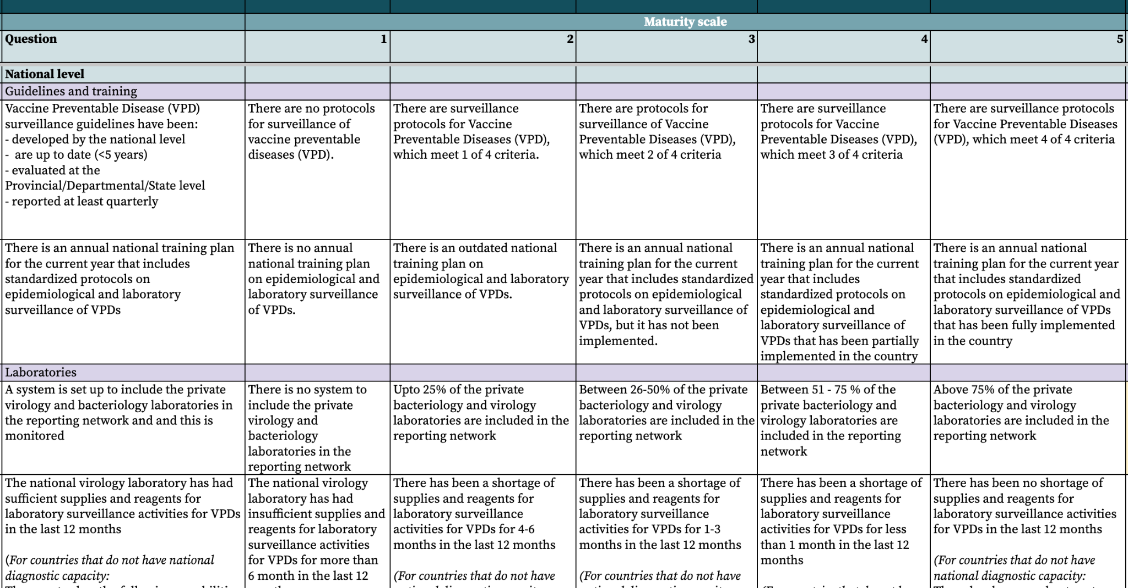
The tool has different four main parts to it
2. Five-point maturity scale
1. Questions
3. National/sub national level
4. Sub sections

Slide 8
And a total of…
196 questions across all components:
109 at the national level
67 at the subnational level
20 at the local level

Slide 9
The five-point scale helps to assess maturity across each question
LEVEL 1: INITIAL
LEVEL 3: DEFINED
LEVEL 5: OPTIMIZED
The available elements are implemented with the functionality of a routine system. Biases or problems are not recognized.
All elements are available, reliable, complete, up-to-date and implemented in a standardized and efficient way.
Insufficient or unavailable elements.
1
2
3
4
5
LEVEL 2: MANAGED
LEVEL 4: QUANTITATIVELY MANAGED
The available elements present problems of completeness, updating, their use is not appropriate.
All items are available, reliable, complete, up-to-date. And some biases/problems are known that can be improved.

Slide 10
There are three key points to consider when scoring questions
PAHO CIM advisors only provide support and technical clarifications. They do not provide recommendations to select a final rating
The tool is designed for self-assessment EPI and promoting improvement in the program. It is not intended to evaluate or pass judgment on the country's performance.
The maturity scale rating is not the primary focus; identifying the underlying causes of bottlenecks and achievements is what will aid the country's improvement.

Slide 11
This self assessment will yield five main outputs
1
Desk review:
To gather data on the performance of each component of the EPI over the last 5 years.
Situation analysis:
To provide a situation overview of EPI before the self-assessment is conducted
Performance Monitoring Tool:
Self-administered at the national and sub-national level and through field visits at the local level
Final report and presentation:
Description of the current status of each EPI components and recommendations.
Action plan
A plan to close the most urgent gaps of the national EPI.
2
3
4
5

